Slide 1
APNIC Update
Notes:
Check the actual name of the RIR meeting. Coming meetings
- LACNIC XVI
- ARIN XXVIII
RIPE 63
AFRINIC 15

Slide 4
IPv4 Exhaustion
Reached “Final /8” on 15 April 2011
103.0.0.0/8
New allocation policy activated
Up to /22 per member
From 15 April to 27 August 2011, made 583 delegations to 30 economies

Slide 6
Root servers

Slide 7
Policies Implemented 2011
prop-088: Distribution of IPv4 Addresses Once the Final /8 Period Starts
prop-093: Reducing the Minimum Delegation Size for the Final /8 Policy
prop-094: Removing Renumbering Requirement from Final /8 Policy

Slide 8
Policies at APNIC 32
Consensus…
prop-096: Maintaining Demonstrated Needs Requirement in Transfer Policy after the Final /8 Phase
Endorsed by APNIC EC, 3 Nov 2011
No consensus – returned to mailing list
prop-100: National IP Address Plan – Allocation of Country-wide IP Address Blocks
prop-099: IPv6 Reservation for Large Networks
prop-098: Optimizing IPv6 Allocation Strategies (simplified)

Slide 9
Learning and Development
New Area under Philip Smith
Training Lab
infrastructure upgraded
Workshops on IPv6, four-byte ASNs
More hands-on sessions
Collaborations
6Deploy, intERlab, NIRs (ID, TW, CN)
APNIC Conference Hubs
Jakarta and Port Moresby (Feb 2011)
Phnom Penh (Aug 2011)

Slide 10
IPv6 Program
Major IPv6 events in the region
IPv6 Transition Day at APRICOT 2011 and APNIC 32
IPv6 Deployment workshop at ICANN 41
Supporting regional IPv6 activities
Inaugual SGNOG
China Global IPv6 Summit 2011
Pacific IGF (New Caledonia)
Asia Pacific IGF (Singapore)
Secretariat for APIPv6TF

Slide 11
IPv6 Program
Activities with inter-governmental organizations
Asia Pacific Economic Cooperation (APEC TEL)
Continuous engagement with IPv6 information
Asia Pacific Telecommunity (APT)
APT Policy and Regulatory Forum (PRF) and Pacific PRF
Secretariat of Pacific Community (SPC)
MoU on IPv6 deployment in the Pacific
Pacific ICT Ministers Meeting
APNIC’s recommendations in the ministerial communiqué
ITU Asia Pacific collaboration
IPv6 capacity-building workshop

Slide 12
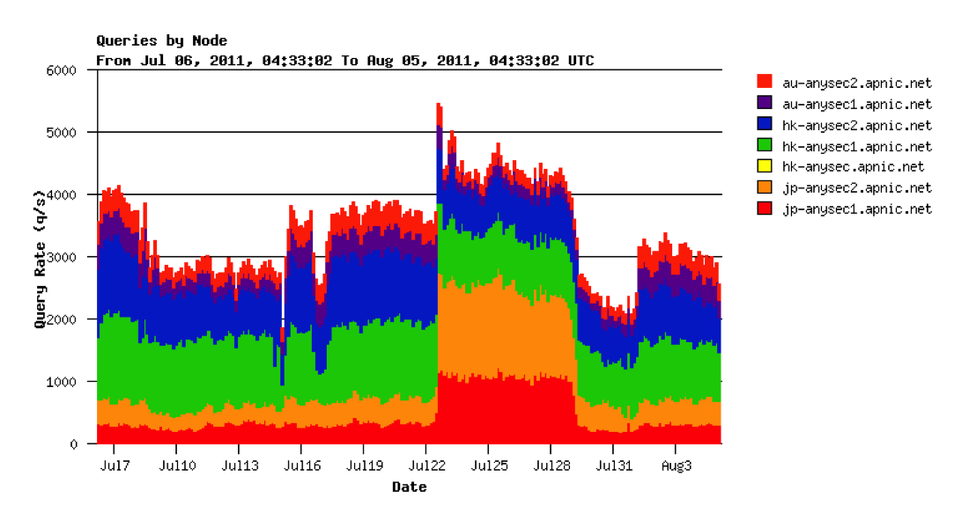
Technical Area
APNIC now serving e.in-addr-servers.arpa and e.ip6-servers.arpa. labels
Notes:
Transitioned and successfully taken on full load from 8 March 2011
Servers handling about 3,000 queries per second

Slide 13
Agile
Notes:
Tracking software development with aim to achieve a 95% target implementation by the end of 2011

Slide 14
APNIC Labs
Supporting R&D with remote measurement techniques
Software expertise provided for client-side IPv6 capability measurements
Google analytics measurements for IPv6 client capability targeted at website owners
http://labs.apnic.net
Notes:
Measuring whether or not you can or can’t use IPv6

Slide 15
DNSSEC
3 May 2011, DS records submitted to IANA
Allows validation to occur from root down to APNIC’s reverse zones
Users can update reverse DNS DS record through MyAPNIC
Single zone via whois domain objects
Multiple zones via zone file upload

Slide 16
Public Affairs
IGF related events
Second APrIGF in Singapore
First PacIGF in New Caledonia
APIL in China
NRO
Public affairs coordination
Renewal of IANA contract (comments FNOI)
OECD
High-level meeting on Internet Economy

Slide 17
New APNIC Identity
New image for a new era
:: representing our new IPv6 world
() representing our collaborative community
Changing icon represents our dynamic and diverse community

Slide 18
Coming up…
APNIC 34
Phnom Penh, Cambodia, August 2012
APNIC 35:
Singapore, Singapore, February 2013
Notes:
Change in the original dates, now starting a day before.

Slide 19
Thanks

