Slide 1
IGF Remote Hub

Slide 2
History of the IGF
Created as an outcome of the World Summit on the Information Society (WSIS)
Phase I – Geneva, 2003
Phase II – Tunis, 2005
http://www.itu.int/wsis

Slide 3
Geneva Declaration of Principles
The Internet has evolved into a global facility available to the public and its governance should constitute a core issue of the Information Society agenda. The international management of the Internet should be multilateral, transparent and democratic, with the full involvement of governments, the private sector, civil society and international organizations. It should ensure an equitable distribution of resources, facilitate access for all and ensure a stable and secure functioning of the Internet, taking into account multilingualism.
http://www.itu.int/wsis/docs/geneva/official/dop.html

Slide 4
Tunis Agenda for the Information Society
We recognize that Internet governance includes more than Internet naming and addressing. It also includes other significant public policy issues such as, inter alia, critical Internet resources, the security and safety of the Internet, and developmental aspects and issues pertaining to the use of the Internet.
We agree, inter alia, to invite the UN Secretary-General to convene a new forum for multi-stakeholder policy dialogue.
http://www.itu.int/wsis/docs2/tunis/off/6rev1.html

Slide 5
Tunis Agenda, paragraph 72
The mandate of the Forum is to:
Discuss public policy issues… to foster the sustainability, robustness, security, stability and development of the Internet.
Facilitate discourse between bodies … and discuss issues that do not fall within the scope of any existing body.
Interface with appropriate intergovernmental organizations and other institutions on matters under their purview.
Facilitate the exchange of information and best practices, and… make full use of the expertise of the academic, scientific and technical communities.
Advise all stakeholders in proposing ways and means to accelerate the availability and affordability of the Internet in the developing world.
Identify emerging issues
Contribute to capacity building
Discuss issues relating to critical Internet resources

Slide 6
History of the IGF
2006 – First IGF, Athens, Greece
2007 – Rio, Brazil
2008 – First IGF in Asia Pacific, Hyderabad, India
2009 – Sharm el Sheikh, Egypt
2010 – Vilnius, Lithuania
Last IGF in current five-year mandate

Slide 7
Future of the IGF
Under-Secretary General of ECOSOC has issued statement recommending continuation of IGF:
http://www.intgovforum.org/cms/2010/Briefing.for.MS.on.the.question.of.the.IGF_FINAL.pdf
United Nations Assembly to consider future of IGF in December 2010
Likely outcome: IGF to continue
In 2009 Kenya volunteered to hold IGF 2011

Slide 8
IGF in Asia Pacific
Asia Pacific Regional IGF (APrIGF) 2010
http://rigf.asia
Bangladesh Consultation on Fourth Annual Meeting of the Internet Governance Forum (2009)
Hong Kong IGF (2010)
Held straight after APrIGF

Slide 9
APrIGF
14-16 June 2010, Hong Kong
Cyber-Security and Network Confidence
Challenges and Criticalness of an Open Internet Culture
The Digital Divide in Asia
Managing Critical Internet Resources
Challenges and Opportunities for Internationalized Domain Names
Civil Society in Internet Governance
Notes:
Sessions based on themes of IGF 2010, with an AP flavour

Slide 10
IGF remote hubs
Webcast and ask questions via chat
IGF ADDRESS
Four Asia Pacific hubs to be connected via chat:
Bangladesh (Dhaka)
Hong Kong
Indonesia (Jakarta)
Philippines (Manila)
APNIC WEBSITE ADDRESS

Slide 11
IGF 2010 - developing the future together
Key themes
Managing critical Internet resources
Security, openness and privacy
Access and diversity
Internet governance for development (IG4D)
Taking stock of Internet governance and the way forward
Emerging issues: cloud computing

Slide 12
Critical Internet Resources
Status of IPv6 availability around the world; examples and cases
The internationalization of critical Internet resources management and enhanced cooperation
The importance of new TLDs and IDNs for development
Maintaining Internet services in situations of disaster and crisis

Slide 13
IPv6 availability around the world
RIRs have allocated over two trillion IPv6 addresses to network operators
More than 500 times the size of the entire IPv4 address pool
Only 0.003% of the entire IPv6 address pool

Slide 14
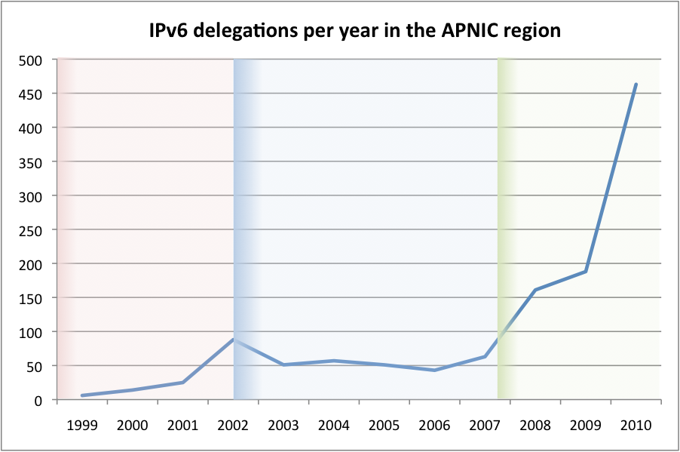
IPv6 in Asia Pacific
Almost a quarter of all APNIC account holders now have IPv6 addresses
An increase of over 150% in just over a year
http://icons.apnic.net/display/IPv6/Three+phases+of+IPv6+allocations
Notes:
Three phases: experimental (1999-2002), early adopters (2002-2007) and deployment (2007 to now)
(Also reflected globally. The link shows another graph that demonstrates this)

Slide 15
IPv6 at APNIC
Request addresses via “one click” IPv6 kickstart
http://www.apnic.net/kickstartIPv6
Information about IPv6 deployment
http://icons.apnic.net/IPv6
APNIC IPv6 Program
http://www.apnic.net/ipv6

Slide 16
Access and diversity
Access to infrastructure
Enabling environments
Legal frameworks
Access to content
Linkages between access to knowledge and security solutions
Side effects of the tools and methods used to block content
Notes:
Multilingual Internet
Access by minority groups, including indigenous people, people with disabilities, women, the elderly, migrants
Accessibility issues include:
Web accessibility: readers for the vision impaired
Accessibility for persons with disabilities was a significant obligation of the U.N. Convention on the rights of people with disabilities and was supported by the WSIS Tunis commitment
From summary of Access main session at IGF 2009:
“It was noted that global debates on access had moved from just infrastructure-based arguments to issues of policy, regulation, and rights. But infrastructure was critical, and focus was drawn to issues such as bandwidth and regulatory issues.”

Slide 17
Security, openness and privacy
Interconnection between the three
Content of session to be developed out of the workshops on the same themes held before the main session
Notes:
Security, openness and privacy are interlinked. While it may seem that security automatically results in lack of privacy, or that openness can result in lack of security, there doesn’t have to be a trade-off between these different things.
Openness includes:
Freedom of expression
The responsibility of “internet intermediaries” for content placed on their websites/bulletin boards, etc, by other people (for example, is YouTube responsible for illegal content uploaded to their site by Internet users?)
Security includes:
Protection of online commerce users
- Coordination between law enforcement and private industry on cyber-security

Slide 18
Internet Governance for Development (IG4D)
What exactly is it?
Global governance issues that may have particular relevance to development
Managing engagement with global Internet governance while also meeting national ICT strategies
Taking the IG4D agenda further
Notes:
Three of the IGF mandate points listed in the Tunis Agenda have a strong development focus:
Advise all stakeholders in proposing ways and means to accelerate the availability and affordability of the Internet in the developing world.
Strengthen and enhance the engagement of stakeholders in existing and/or future Internet governance mechanisms, particularly those from developing countries.
Contribute to capacity building for Internet governance in developing countries, drawing fully on local sources of knowledge and expertise.
From the web page for this session…
This session will explore the possible effects of global Internet governance arrangements on the development of the Internet and people-centred information societies in developing countries. The discussion will consider the institutional processes and substantive policy outputs of governance arrangements and whether these may raise developmental concerns that have not received sufficient attention to date. The session will be divided into four parts: 1. What do we really mean by Internet governance for development (IG4D); 2. Examples of specific global governance issues that may have particular relevance to development. Possible sub-themes include, among others, the governance of names and numbers, technical standardization, security, international interconnection, intellectual property, and transnational consumer protection, as well as the procedural or institutional aspects of key governance arrangements; 3. How developing and other countries organize and manage their national-level engagement with global Internet governance in the context of their wider national ICT strategies; and 4. How to take an IG4D agenda forward in the IGF and other international settings.

Slide 19
Emerging Issues: Cloud Computing
What is ‘cloud’?
How can it be used
Why should users use the cloud?
Infrastructure, hardware, and environment
Privacy, integrity, confidence in the cloud, public policy, regulation

