Slide 1
Critical Issues in IP Addressing
PITA 14th AGM and Conference
Critical issues
27 April 2010
Paul Wilson
Director General, APNIC

Slide 2
Overview
Introduction
The main game…
IPv4 Consumption
Transition to IPv6
Security and IP addresses
Resource Certification: RPKI
Abuse contact registration: IRT

Slide 3
Why IPv6?

Slide 4
Internet Fundamentals
Open network, open standards
Developed within IETF system (RFC series)
TCP/IP, DNS, DHCP, HTTP, IPSEC, etc etc
“Dumb network” – global p2p datagram service
“IP over Everything”
Layered networking model (a la OSI)
Relying on ITU and IEEE standards
Serial line, Modem, Ethernet, ISDN, xDSL, cable/fibre, MPLS, 802.11x, Mobile 2G/3G…
Platform for competition and innovation
Great benefits to consumers

Slide 5
The “Protocol Hourglass”
Applications
Phone/Fax/SMS
TV/VOD/conf
“The Internet”
Voice
Video
Data
Network
Infrastructure
Fixed, Dialup/ISDN
Mobile/2G
Cable/ADSL

Slide 6
The Hourglass – Tomorrow
Voice, email, IM
Video, TV, conf
WWW+++
Applications
Network
IP
802.11*/WiMax
Mobile/3G
Cable/*DSL
FTTH, ETTH
Infrastructure

Slide 7
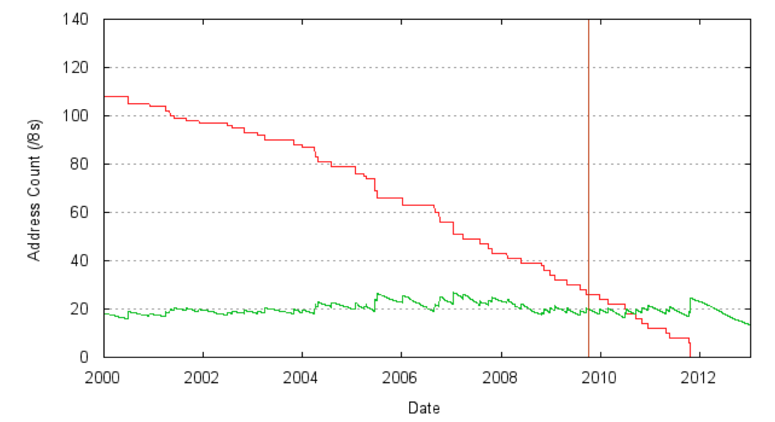
Projected IPv4 Lifetime
Projected IANA exhaustion: 22/09/2011
Projected RIR exhaustion: 07/07/2012
http://www.potaroo.net/tools/ipv4/index.html 10 Apr 2010

Slide 8
IPv4 Address Global Distribution
As of April 2010

Slide 9
IPv4 Consumption
Many mitigation approaches have been discussed in RIR policy meetings
Policy and procedural measures have been agreed in most RIRs
Some policies regional, some global
Hard landing: The “do nothing” approach
Too much risk for serious consideration
Soft landing: measures to extend IPv4 lifetime
Rationing
Stricter justification requirements
Reclaiming unused IPv4 addresses
Transfer policies

Slide 10
IPv4 Scarcity Issues
Significant increase in policy violations
Fraudulent claims for IPv4 addresses
Unofficial transfer/loan/trading of addresses
Increasing security concerns
Decreasing accuracy of whois records
Inability to tell harmless from harmful uses
Policy measures taken
Fair distribution of final /8s from the IANA
Reservation of space in the last /8, for new entrants
APNIC transfer policy allowing transfers to be recognized
Practical measures
Improved security and verification mechanisms
Throttle on address space requests from IANA

Slide 11
IPv4 “Quality Assurance”
Historical misuse of unallocated address space
Informal usage (e.g. 1/8 for various purposes)
Superseded usage (e.g. 14/8 for X.25 networks)
Previously known, or suspected, usages
Affected address space was not allocated
Today, address space must be put to use
Allocated by IANA to RIRs according to agreed random procedure, ensuring fair distribution
Each new APNIC /8 is now tested before delegating to APNIC members

Slide 12
Case Study: 1.0.0.0/8
Well known as a “problem block”
Allocated to APNIC in early 2010
APNIC research activity
With RIPE NCC, Merit Networks and YouTube
Servers able to cope with huge traffic load
Over 10Tb of data collected in 6 days
Findings…
Small parts of 1.0.0.0/8 extremely polluted
Popular use of 1.1.1.1 and 1.2.3.4
Evidence of widescale POS terminal usage
The rest (vast majority) appears OK

Slide 13
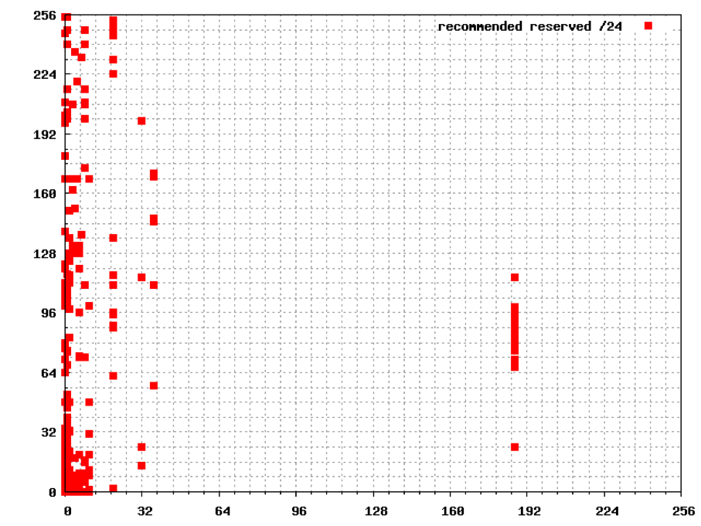
Analysis of 1.0.0.0/8
http://www.potaroo.net/studies/1slash8

Slide 14
IPv6 Transition: Issues
Transition mechanisms
Dual stack
Tunneling IPv6 over IPv4
Translation
Tunneling IPv4 over IPv6
Security implications
Firewalls
VPNs
Software and hardware
Human resources

Slide 15
IPv6 Transition Mechanisms
“Dual stack”
IPv4 and IPv6 coexist in one device
Support connection to/from IPv4 and IPv6
Does not provide interconnectivity
IPv6 packet
IPv6
IPv6 packet
DS
Client
DS
Host
IPv4 packet
IPv4
IPv4 packet

Slide 16
IPv6 Transition Mechanisms
Tunneling (1)
Transport of IPv6 traffic over an IPv4 network
The main mechanism currently being used to achieve IPv6 connectivity (e.g. Teredo)
IPv6
Host
IPv6
IPv6 packet
DS Client
IPv4 ISP
IPv4
IPv4 packet
IPv6 packet

Slide 17
IPv6 Transition Mechanisms
Translation
Addresses are translated between IPv4 network and IPv6 network (CGN, IVI)
Necessary to internetwork between IPv4 and IPv6
IPv6
Host
IPv6
IPv6 packet
IPv4
Client
IPv4
IPv4 packet

Slide 18
IPv6 Transition Mechanisms
Tunneling (2)
Transport of IPv4 traffic over an IPv6 network
Will be required in later stages of transition
DS Client
IPv6 ISP
IPv6
IPv4
Host
IPv4
IPv6 packet
IPv4 packet
IPv4 packet

Slide 19
IPv6 Transition: Security
Firewalls
Must be dual-stack/dual-protocol, or separate dedicated firewalls for IPv4 and IPv6
IPv4 firewall may miss tunneled IPv6 traffic
VPNs
Must tunnel both IPv4 and IPv6 traffic
Some VPNs may not encrypt IPv6 traffic at all, leaving it to flow in the clear
Network monitoring
Likewise must be IPv4 and IPv6 aware
Many other application and technology-specific security issues

Slide 20
IPv6 Transition: Software
Client software
Email, www, tools and utilities
Do your off the shelf software packages support IPv6?
Business applications
Billing, payroll, specialist applications
Can legacy applications be converted?
Any in-house applications?
In general
All Internet-aware software should be IPv6 aware, otherwise will need dual stack connectivity
Notes:
More information:
http://www.cert.org/blogs/vuls/2009/04/bypassing_firewalls_with_ipv6.html

Slide 21
IPv6 Transition: Hardware
Routers, wireless switches, modems, computers, etc
All must be considered eventually
Most new hardware now supports IPv6
Or should have an upgrade path
CPE equipment will need upgrade
Eg DOCSIS 3.0 for cable modems
Aim to build IPv6 into your checklist for your hardware upgrade cycle
If not, another upgrade may be needed

Slide 22
IPv6 Transition: Human Resources
ISPs and businesses
Are you hiring IPv6-ready staff?
Are you seeking IPv6 training for current staff?
Educational institutions
Are you producing IPv6-ready graduates?

Slide 23
IP Address Security: RPKI
Resource Public Key Infrastructure
Certificates carrying IP address block details, signed by APNIC
Certification hierarchy starts with single root authority, and extends through RIRs and ISPs to end users
Used to secure routing system by verifying authority for route origination
Progress to date
Production RPKI available at APNIC now
APNIC as pioneer working with RIRs to produce global production RPKI system
NRO deadline of 1 Jan 2011 for first phase
Applications are yet to be standardized

Slide 24
IP Address Security: IRT
IRT (Incident Response Team) records
Details of where to send abuse reports related to specific resources
Policy proposal 79: IRT records will be mandatory
Policy now in final call (ends 3 May 2010)
Upon implementation of this policy, IRT must be included in:
All new IP and AS number objects
All existing IP and AS number objects the next time you update them

Slide 25
IP Address Security: IRT
How IRT object will affect you
Do you have IP address or AS number registrations in the APNIC Whois Database?
Do you have a contact point for abuse reports?
If so, create an IRT record for your organisation
If not, you can:
Establish contact point (IRT)
Use another party (e.g. a CERT)
To comment on this proposal, email policy@apnic.net before 3 May 2010

Slide 26
What Next?

Slide 27
More Users, More Devices
In 2010s…
Commodity Internet service provision
Broadband, mobile, always-on
Large reduction in consumer electronics costs
A network-ready society
Ubiquitous pervasive networking
Bringing online the “Next 5 Billion”
Plus a device population some 2–3 orders of magnitude larger than today’s Internet
“Internet for Everything”

Slide 28
IPv6 is Here!
IPv6 is no longer experimental
IPv6 is in commercial use
Signification acceleration in deployment over past year
Start planning now
Don’t wait until IPv4 runs out
What will you do the first time a customer complains they can’t reach a site because you don’t support IPv6?
The main questions have answers…

Slide 29
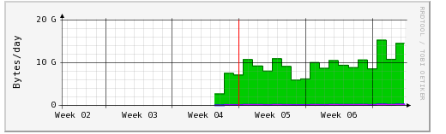
Chicken or Egg?
“Google has quietly turned on IPv6 support for its YouTube video streaming Web site, sending a spike of IPv6 traffic across the Internet…” – 1 Feb 2010 Networld
Monash University, Melbourne, Australia:

Slide 30
“What’s the Killer App for IPv6?”
The Internet !

Slide 31
Sometime in 2012…
ISPs will need addresses for new network infrastructure
and will receive only IPv6
End users will start receiving IPv6 Internet services
With or without private IPv4 addresses
Enterprises and businesses will get IPv6 for their new networks
“Customer NAT” will apply to IPv4
All Internet users will be affected
What will you need to do?

Slide 32
Questions?

Slide 33
Thank You
pwilson@apnic.net

