Slide 1
IPv6 and the Role of RIRs
RIGF.Asia
Hong Kong, June 2010

Slide 2
Internet fundamentals
Open network, open standards
Developed within IETF system (RFC series)
TCP/IP, DNS, DHCP, HTTP, IPSEC, etc etc
“Dumb network” – global p2p datagram service
“IP over Everything”
Layered networking model (a la OSI)
Relying on ITU and IEEE standards
Serial line, Modem, Ethernet, ISDN, xDSL, cable/fibre, MPLS, 802.11x, Mobile 2G/3G…
Platform for competition and innovation
Great benefits to consumers

Slide 3
The “Protocol Hourglass”
Applications
Phone/Fax/SMS
TV/VOD/conf
“The Internet”
Voice
Video
Data
Network
Infrastructure
Fixed, Dialup/ISDN
Mobile/2G
Cable/ADSL

Slide 4
The Hourglass – Tomorrow
Voice, email, IM
Video, TV, conf
WWW+++
Applications
Network
IP
802.11*/WiMax
Mobile/3G
Cable/*DSL
FTTH, ETTH
Infrastructure

Slide 5
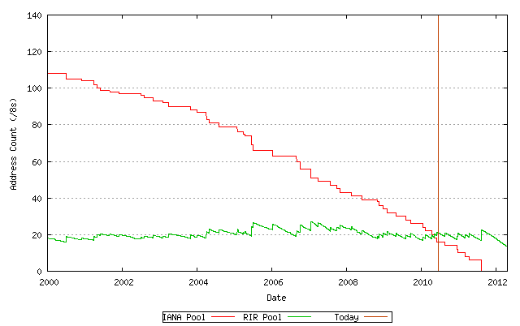
Projected IPv4 Lifetime
Projected IANA exhaustion: 11/08/2011
Projected RIR exhaustion: 17/04/2012
http://www.potaroo.net/tools/ipv4 16 June 2010

Slide 6
IPv4 Address Global Distribution
✗ 18
May 2010

Slide 7
IPv4 Consumption – Mitigation
Many approaches discussed in regional meetings
Policy and procedural measures adopted
Some policies regional, some global
Hard landing: The “do nothing” approach
Too much risk for serious consideration
Soft landing: measures to extend lifetime
Rationing (eg /8 last block)
Stricter justification requirements
Reclaiming unused IPv4 addresses
Transfer policies

Slide 8
Transition to IPv6
IPv4 address exhaustion is inevitable
August 2011: IANA allocates the last /8
August 2012: APNIC is the first RIR to exhaust its IPv4 address pool
IPv6 should be inevitable
The only solution to IPv4 exhaustion
Protocol is 10 years old
Under a news spotlight for at least 18 months
The transition…
Requires all stakeholders to act, but differently
Will take 10+ years to complete

Slide 9
IPv6 Address Management
RIRs continue providing equitable services to the Internet community
A stable and proven structure for 20 years
Address management is not the issue in IPv6 deployment
Policies are stable and unrelated to deployment
All efforts should go to IPv6 deployment
In the core (ISPs, vendors)
At the edges (users, software developers)
Governments: Policies and procurement
Notes:
Talk of alternative mechanisms for IPv6 address space distribution is a distraction

Slide 10
IPv6 is Here!
IPv6 is no longer experimental
IPv6 is now in commercial use
Signification acceleration in deployment over past year
The main questions have answers…

Slide 11
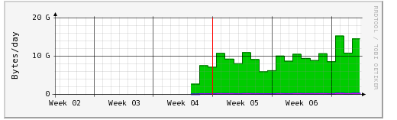
Chicken or Egg?
“Google has quietly turned on IPv6 support for its YouTube video streaming Web site, sending a spike of IPv6 traffic across the Internet…” – 1 Feb 2010 Networld
Monash University, Melbourne, Australia:

Slide 12
What’s the Killer App for IPv6?
The Internet !

Slide 13
Sometime in 2012…
ISPs will need addresses for new network infrastructure
and will receive only IPv6
End users will start receiving IPv6 Internet services
With or without private IPv4 addresses
Enterprises and businesses will get IPv6 for their new networks
“Customer NAT” will apply to IPv4
All Internet users will be affected
What will you need to do?

Slide 14
RIRs and Internet Governance
Open, bottom up, neutral, non-profit, multistakeholder organisations
Predating ICANN by many years
Supporting the ICANN model, and ICANN itself
Satisfied with IANA arrangements at present
Participating in IG forums and discussions
RIRs individually and collectively (as NRO)
WSIS, WGIG (some ECOSOC accredited)
ITU-T and ITU-D (some sector members)
Many regional activities and forums
IGF and MAG: long record of participation and financial support – we support continuation.

Slide 15
Historical Note
What is a “Critical Internet Resource?”
Informal survey, November 2007
http://archive.apnic.net/news/docs/cir-pwilson-20071112.pdf

Slide 16
Thank you
Paul Wilson
Director General, APNIC
pwilson@apnic.net

