Slide 1
IP(v4) Address Transfers

Slide 2
Background
IPv4 shortage is looming
IPv4 demand will outlast unallocated pool (2012)
IPv6 deployment by this time is not guaranteed
Where will addresses be found for new networks?
Options
Sorry, “No more IPv4”
RIR recovery of un(der)used addresses
Register transfers under approved policies
Unregistered “blackmarket” transfer

Slide 3
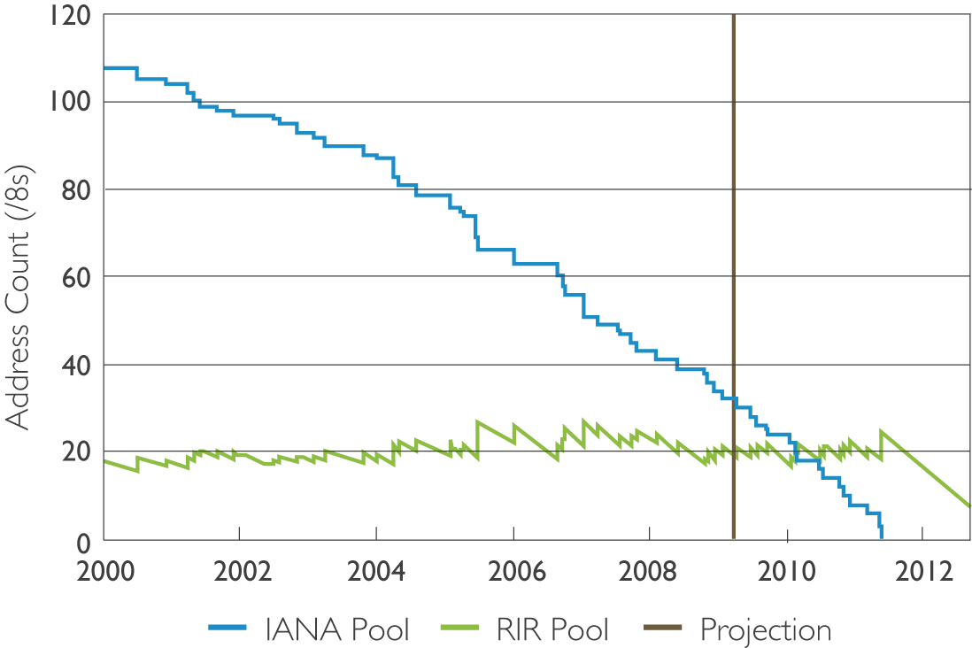
IPv4 lifetime

Slide 4
IPv4 Address Transfer
Currently:
RIRs allocate address to requestors on request
According to demonstrated need
According to agreed policies
While resources are available
Possibly in future:
Addresses can be transferred between parties
From one with addresses to spare
To another who needs addresses

Slide 5
Transfers - Cons/Risks
Stockpiling
Limited by IPv6 deployment
Routing fragmentation
Self-limiting due to ISP filtering
Price escalation
Self-limiting, encouraging IPv6 deployment
Choice of “Expensive” vs “unavailable”?

Slide 6
Transfers - Pros
Markets optimise use of resources
Resource priced according to its value
and the cost of alternatives (NAT, IPv6…)
Well understood mechanisms
By regulators, service providers, community
Rebalance global IPv4 address distribution
Assist in transition to IPv6
Maintain accuracy of registration
Assuming that transfers will take place anyway

Slide 7
Transfer policies: Variables
Limit size of transfer
To avoid excessive fragmentation
Limit access to RIR allocations after transfer
For seller and/or buyer, specified period of time
Timing of policy
Before or after exhaustion of IPv4 supplies
Require justification by recipient
According to normal allocation policies
To enforce “need-based” approach
Notes:
Limiting access:
Attempt to limit stockpiling.
Justification:
Generally supported, only objection is that if addresses are available for transfer, any additional requirements may encourage blackmarket.
Timing:
Ideally after, but “soft landing” would be encouraged by allowing transfers earlier
(allowing market to develop, prices to be established etc)

Slide 8
Thanks
pwilson@apnic.net

