Slide 1
APNIC Update
The state of IP address distribution and its impact to business operations
Elly Tawhai
Senior Internet Resource Analyst/Liaison Officer, Pacific, APNIC

Slide 2
About APNIC
What we do
“Regional Internet Registry”
Why we do it
Needed technical/administrative service
Support development of the Internet as a single, seamless, routable, global network
How we do it
Non-profit mutual organization
Bottom-up policy process
Notes:
To start with, it probably helps to start with a summary of APNIC from the top.
There are a few basic questions…
What are we are what do we do?
Well, we are an RIR, and this should be quite clear by now. I hope so!
But let’s ask, why do we do it?
Well, we fulfill a needed technical service, that is to allocate and register unique IP addresses.
But also, we do our job in a particular way, to support “the Internet” as we know it.
In particular we support the Internet as a single, seamless, routable, global network.
And because we think this is important, it does guide many things about our work.
Finally, how do we do out work, as an organisation and as a community?
Well, as we often say, we work in the collective public interest of this community and of the Internet itself.
And this is not just a set of words, it actually leads to the bottom-up policy development process which we also know very well by now. ☺

Slide 3
Overview
IP address distribution in the AP region
Status of IPv4 exhaustion
IP address availability impact in business
Strategic considerations

Slide 4
Key Points
APNIC’s IPv4 address pool is running out
Look at your IPv4 life extension and IPv6 deployment options
Commit resources, deadlines, and report on this issue to senior management

Slide 5
No More IPv4 at IANA
Montevideo, 3 February 2011 – The Number Resource Organization (NRO) announced today that the free pool of available IPv4 addresses is now fully depleted. On Monday, January 31, the Internet Assigned Numbers Authority (IANA) allocated two blocks of IPv4 address space to APNIC, the Regional Internet Registry (RIR) for the Asia Pacific region, which triggered a global policy to allocate the remaining IANA pool equally between the five RIRs. Today IANA allocated those blocks. This means that there are no longer any IPv4 addresses available for allocation from the IANA to the five RIRs.
IANA
AfriNIC
APNIC
ARIN
LACNIC
RIPE

Slide 6
APNIC IP Address Distribution 2008 - 2010

Slide 7
APNIC IP Address Distribution 2008 - 2010
Notes:
IPv6 delegations more than tripled in 2010 - 9 – 10% are in production IPv6 deployment of some kind
In 2010, we had 121 million IPv4 addresses delivered to our customers. But we have 212 million /48 iPv6 networks deployed. Now it’s a matter of seeing how people start routing them.

Slide 8
What Services Do These IP Addresses Go To?

Slide 9
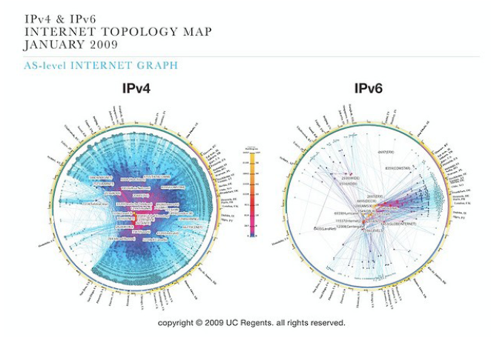
Global IPv4 vs IPv6 Deployment State
Notes:
The Cooperative Association for Internet Data Analysis
This visualization represents macroscopic snapshots of IPv4 and IPv6 Internet topology samples captured in January 2009. The plotting method illustrates both the extensive geographical scope as well as rich interconnectivity of nodes participating in the global Internet routing sytem.
For the IPv4 map, CAIDA collected data from 33 monitors located in 30 countries on 5 continents. Coordinated by our active measurement infrastructure, Archipelago (Ark), the monitors probed paths toward 7.4 million /24 networks that cover 95% of the routable prefixes seen in the Route Views Border Gateway Protocol (BGP) routing tables on 1 January 2009.
For the IPv6 map, CAIDA collected data from 6 Ark monitors located in 4 countries on 2 continents. This subset of monitors probed paths toward 1,491 prefixes which represent 88.9% of the globally routed IPv6 prefixes seen in Route Views BGP tables on 1 January 2009.
We aggregate this IP-level data to construct IPv4 and IPv6 Internet connectivity graphs at the Autonomous System (AS) level. Each AS approximately corresponds to an Internet Service Provider (ISP). We map each observed IP address to the AS responsible for routing traffic to it, i.e., to the origin (end-of-path) AS for the IP prefix representing the best match of this address in the BGP routing tables. For the IPv4 graph, we used the BGP IPv4 routing table provided by Route Views. For the IPv6 graph, we used the IPv6 routing table collected by RIPE NCC.
The outdegree of an AS node is the number of next-hop ASes that we observed accepting our probe traffic as it left this AS. The link color reflects outdegree value, from lowest (blue) to highest (yellow). Toward the center of the graph we have manually labeled some of the highest outdegree ASes with their associated ISPs.
To determine the longitude of an AS, we used the IPv4 BGP table from Route Views to find a set of announced IPv4 prefixes for each AS. We subdivided prefixes into the smallest prefixes that Digital Envoy's NetAcuity mapped to a single geographic location in January 2009. We then calculated the AS angle coordinate from the weighted average (by number of IP addresses in each mapped prefix) of the longitude coordinates of all such subdivided prefixes. NetAcuity currently only supports IPv4 mapping, so we use the IPv4-derived locations for ASes in both graphs.
Calculating AS coordinates as described above results in a large number of overlapping nodes (hundreds in the case of the IPv4 graph) which distort the graph's edge. To better visualize so many ASes at the edge, we refined our node placement algorithm to spread out overlapping nodes. This modification creates bulges in the outermost ring of the AS-core, corresponding to longitudes with substantial Internet infrastructure deployment, which also correlates with populous regions of the globe.
The IPv6 graph grew from 486 AS nodes in January 2008 to 515 nodes in January 2009. Over the same period we saw an increase in the number of IPv4 ASes from 18K to almost 23K. Whether these changes represent actual new AS allocations or result from modifications in our measurement methodology is not clear. Compared with the AS-core graph of January 2008, we observed a westward shift in the position of ISP TelstraClear due to its increased presence (per NetAcuity's mapping) in Australia.

Slide 10
What Do the Stats Say?
The Internet in the Asia Pacific region is still growing at an accelerated rate, particularly in access networks
APNIC IPv4 requests will continue because networks are still growing to meet the population demand while IPv6 is being deployed
IPv6 is being deployed globally!

Slide 11
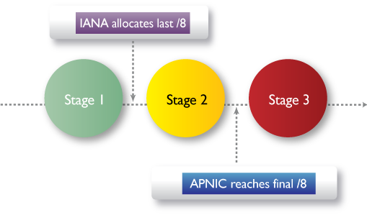
IPv4 Exhaustion
IPv4 exhaustion management
http://www.apnic.net/ipv4-exhaustion
3 stages – currently in stage 2
Probably May 2011 if not sooner
Notes:
The Number Resource Organization (NRO) announced in February 2011 that the
final five IPv4 address blocks (5 x /8) were shared equally among the world’s
five regions.
Prior to exhaustion, APNIC developed a staged approach to manage the
remaining pool of IPv4 addresses within the Asia Pacific.
The staged approach ensures the delegation of remaining IPv4 address blocks
is orderly, fair, and transparent.
The staged approach ensures a small delegation of IPv4 addresses for future
applicants and for those deploying IPv6.
APNIC distributes address blocks in accordance with the approved policy
developed by the Asia Pacific Internet community through an open, transparent, and
bottom-up policy development process.
The region agreed on a change in APNIC IPv4 delegation policy, in terms of
the number of IPv4 address Members can receive.
- - -

Slide 12
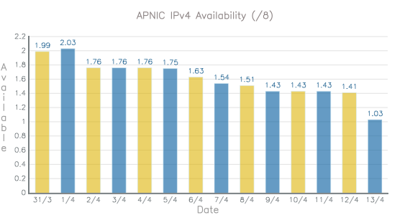
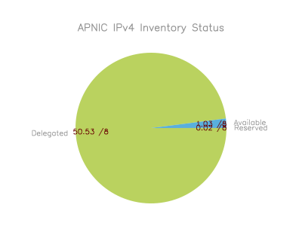
APNIC IPv4 Consumption
Notes:
As of stats from Wednesday 6 only 0.08 /8 to go (An, an)
From website https://www.apnic.net/community/ipv4-exhaustion/graphical-information?view=text-only
The above bar graph shows APNIC pool of Available IPv4 addresses. It shows the daily total of IPv4 addresses, expressed in terms of /8s. The total will decrease and increase according to APNIC allocations to networks, delegations of /8s received from IANA, and resource returns. When APNIC only has a total of one /8 left, the final /8 policy will be triggered.
As of 13/4 there is 1.03 remaining

Slide 13
Policy Changes
IPv4 policy during Stages 1 and 2
Address policy remains the same until APNIC reaches the final /8
IPv4 policy during Stage 3
To extend the life of APNIC’s last /8, each organization can only receive a limited size from it
Current policy: limited to a single /22
Policy refinements pending APNIC EC endorsement

Slide 14
Resource Services
2010 IPv6 delegations more than tripled
650 delegations in 2010
Strong response to “Kickstart IPv6” with over 402 new applications
Members with existing IPv4 allocations or assignments may instantly qualify for an IPv6 block
Notes:
Kickstart IPv6:
- A result of prop-073
Using MyAPNIC, users click the appropriate link to receive delegation
Members with an IPv4 allocation, eligible for a /32 of IPV6
Members with an IPv4 assignment, eligible for a /48 of IPv6

Slide 15
IPv6 within the Pacific

Slide 16
IP Address Availability Impact
Strategic
How to maintain growth post IPv4 depletion
IPv6 business pressures
Operational
Extending IPv4 life
IPv6 deployment stages

Slide 17
Strategic Considerations
How to maintain growth post IPv4 depletion
Will IPv4 be available from other sources?
Deploy public IPv4 selectively
How much to invest on migration technologies
IPv6 business considerations
Transit provisioning
You will need to handle IPv6 traffic
Content providers
You will be asked to provide IPv6 connectivity
Consumer access
You will need to use IPv6 to expand your network

Slide 18
IPv6 Capacity Building
APNIC remains committed to providing Training, focusing on IPv6 topics
Face-to-face
eLearning
Streamlined IPv6 request processing
1-click IPv6 request in MyAPNIC
1-click IPv6 membership sign-up
Much lower cost per IP address compared to IPv4

Slide 19
Conclusions
APNIC’s IPv4 is running out; stage 3 will be in May 2011 or earlier. Sticking with an IPv4 only network is no longer an option
Start considering your IPv4 life extension and IPv6 deployment options
There is no single answer; find the one that fits your business strategy
Commit resources (staff and budget) to address this issue. Establish deadlines and regular reporting to senior management
Notes:
For those whom is deploying equipment without any urgency then cost factor is low. So you replace equipment at the time it needs upgrading.

Slide 20
Next Meeting – APNIC 32
Where: Busan, South Korea
When: Sunday, 28 August - Thursday, 1
September 2011

Slide 21
Thank You
elly@apnic.net

