Slide 1
Handling Network Abuse Reports at APNIC
17 November 2010
APT Cybersecurity Forum, Sydney
George Kuo
Member Services Manager, APNIC

Slide 2
APT Bali Plan of Action
Nov 2009
Widen broadband connectivity
Provide a secure, safe, and sustainable environment through ICT initiatives
Facilitate effective convergence of services
  Timely implementation of IPv6
Encourage development of content and applications
Develop human resource capacity
http://www.unescap.org/idd/events/2009_IWG_on_ICT/APT-%20IWG13.ppt

Slide 3
Overview
Introduction to APNIC
Internet registry structure
  Internet resources distribution & management
  Internet resources Policy development
Common network abuse questions APNIC receives
Using APNIC Whois Database

Slide 4
APNIC’s Mission
Assist the Asia Pacific community in effective resource management
  Equitable allocation and registration services
  Membership total: 2,397
Provide educational opportunities
  Fully equipped Training lab (IPv6 supported)
Coordinate IP addressing policy development and public positions
Seek public consideration of issues that benefit members and the community

Slide 5
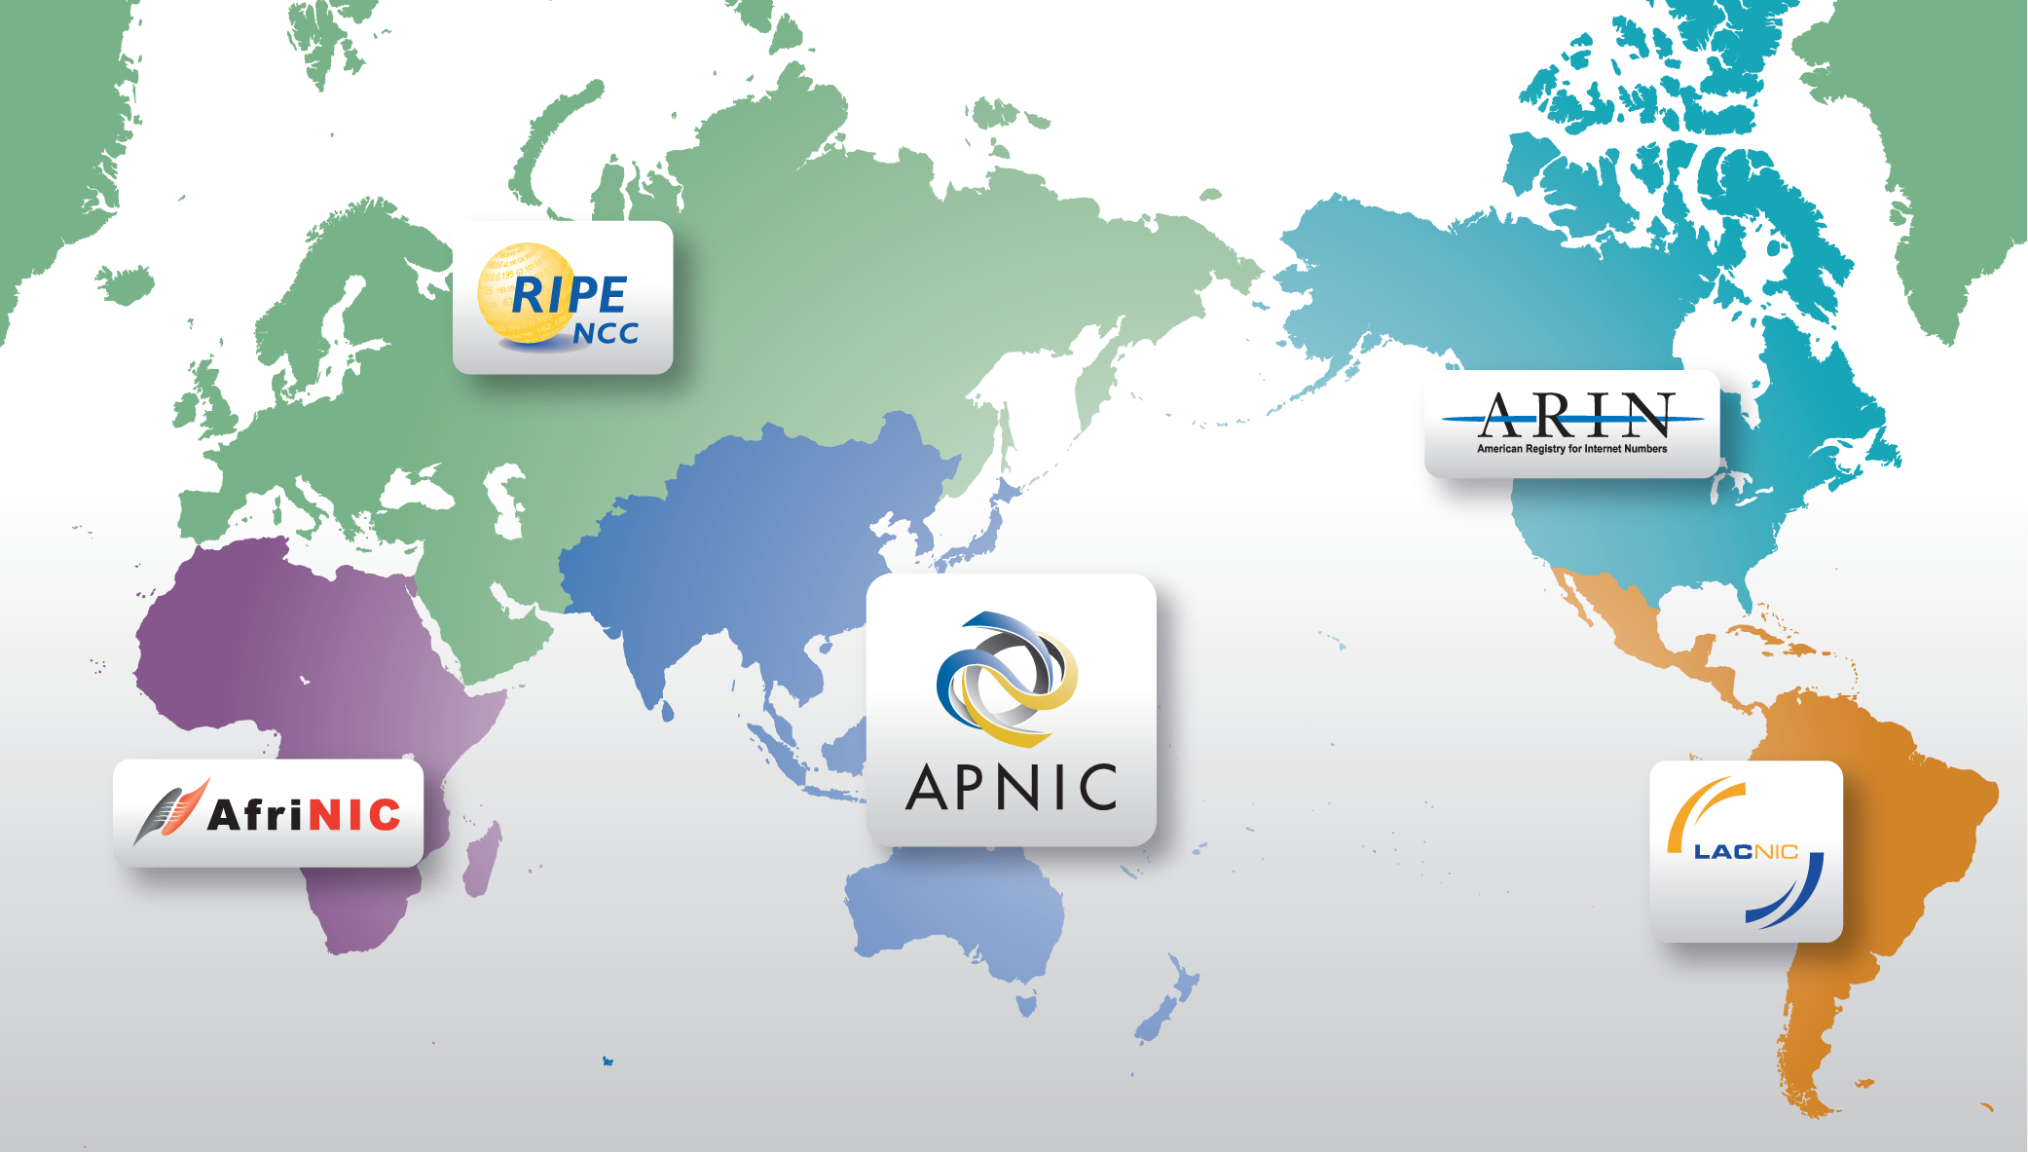
Regional Internet Registries
The Internet community established the RIRs to provide fair and consistent resource distribution and resource registration throughout the world.

Slide 6
APNIC’s Role
Distributes Internet resources
Maintains APNIC Whois Database
Facilitates resource policy development
Manages Reverse DNS delegations
  But NOT a domain name registry
Provides training and outreach on resource management and APNIC services
Supports Internet development

Slide 7
What is an IP address?
The Internet Protocol
  Packets, addressing and routing
  IPv4 (192.168.0.0)
  IPv6 (2001:0DB8::/32)
An IP address is a number
  Every device directly connected to the Internet needs a unique IP address
  IP address space is finite
Not the same as a Domain Name !

Slide 8
On the Internet, you are an IP Address!
www.afrinic.net
196.216.2.1
www.nro.net
www.apnic.net
193.0.0.131
202.12.29.20
202.12.29.142
www.aptsec.org
116.68.148.101
www.arin.net
192.149.252.7
www.isoc.org
www.lacnic.net
206.131.253.68
200.160.2.15
www.ripe.net
192.0.0.214

Slide 9
Internet Resources Management Goals
Internet resources management policies
  Efficient address usage
    Avoid wasteful practices
  Aggregation
    Hierarchical distribution
    Aggregation of routing information
    Limiting number of routing entries advertised
  Registration
    Unique, Fair, & Consistent

Slide 10

Policy Development Process
Need
Anyone can participate
OPEN
Evaluate
Discuss
BOTTOM UP
TRANSPARENT
Implement
Consensus
Internet community proposes
and approves policy
All decisions & policies are documented & available

Slide 11
How are IP Addresses Delegated?
Internet resources management policies
  Criteria for obtaining resources
APNIC to register the delegation in Whois database
APNIC Members are responsible for further distribution and registration

Slide 12
How IP Addresses are Delegated
APNIC
Delegates
to APNIC Member
APNIC Allocation
/8
Registry Realm
/22
Member Allocation
Member (ISP)
Delegates
to customers
ISP customer
/24
Sub-
Allocation
Operators Realm
Customer Assignments
Customer / End User
/27
/26
/25
/26
/27
Notes:
12

Slide 13
Common Questions…
Why does APNIC appear as the source in some abuse search reports?
Can APNIC investigate or stop the network abuse?
Can APNIC reclaim the Internet resources used for the network abuse?
The contacts information in the APNIC Whois Database is invalid. What do I do?

Slide 14
Is APNIC the Culprit?
APNIC is listed by ARIN as holder of all IP space for the AP region
  Some search tools look no further than this
  For details, need to consult APNIC “whois”
APNIC whois may or may not show specific customer assignments for the addresses in question
  But will show the ISP holding APNIC space

Slide 15
Can APNIC Stop Abuse?
No, because…
  APNIC is not an ISP and does not provide network connectivity to other networks
  APNIC does not control Internet routing
  APNIC is not a law enforcement agency
  APNIC has no industry regulatory power

Slide 16
What Can You Do?
Use the APNIC Whois Database to obtain network contact information
Contact the network responsible and also its ISP/upstream
Contact APNIC for help, advice, training, or support

Slide 17
How To Use APNIC Whois
Web browser
  http://www.apnic.net/whois
whois client or query tool
  whois.apnic.net
Identify network contacts from the registration records
  IRT (Incident Response Team) object if present
    Policy for mandatory abuse contact field implemented on 8 Nov 2010
  Contacts: “tech-c” or “admin-c”

Slide 18
Abuse Contact Information
APNIC community reached a consensus to implement dedicated security incident contacts in the Whois Database
Mandatory “Abuse Contact” for all IP and ASN registrations
Assist in network abuse handling in the Asia Pacific Internet community
Notes:
.

Slide 19
What if Whois Info is Invalid?
Members (ISPs) are responsible for reporting changes to APNIC
  Under formal membership agreement
Report invalid ISP contacts to APNIC
  http://www.apnic.net/invalidcontact
  APNIC will contact Member and update registration details

Slide 20
What if Whois Info is Invalid?
Customer assignment information is the responsibility of ISPs
  ISPs are responsible for updating their customer network registrations
Tools such as ‘traceroute’, ‘lookingglass’, and RIS may be used to track the upstream provider if needed
  More information available from APNIC

Slide 21
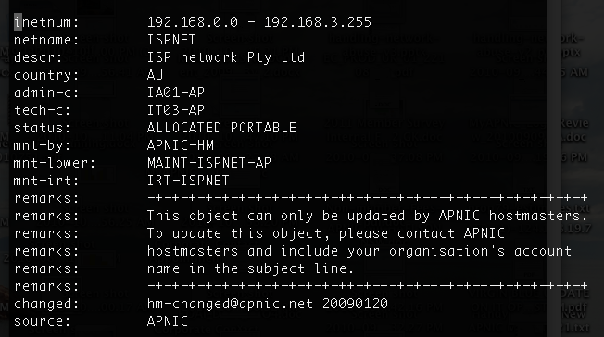
APNIC Whois Registration
IPv4 Object

Slide 22
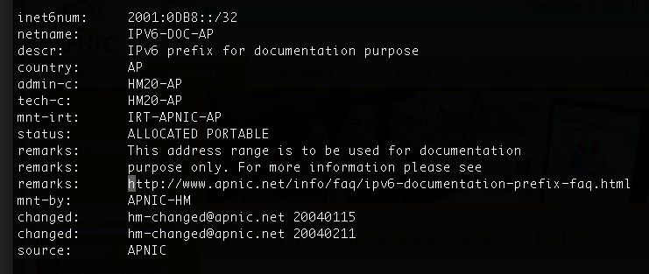
APNIC Whois Registration
IPv6 Object

Slide 23
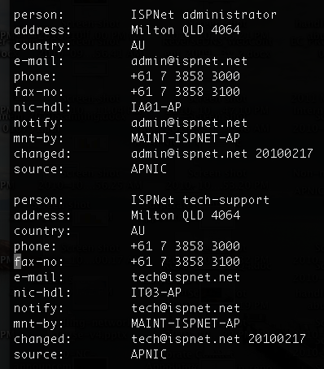
APNIC Whois Registration
Person Object

Slide 24
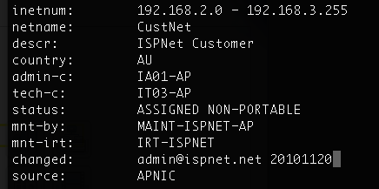
APNIC Whois Registration
IPv4

Slide 25
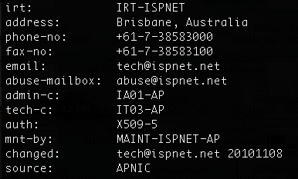
APNIC Whois Registration

Slide 26
Questions?
APNIC Whois inquiry
  www.apnic.net/helpdesk
More information on network abuse
  www.apnic.net/abuse
Report invalid contacts
  www.apnic.net/invalidcontacts
Or
  Send email to helpdesk@apnic.net

Slide 27
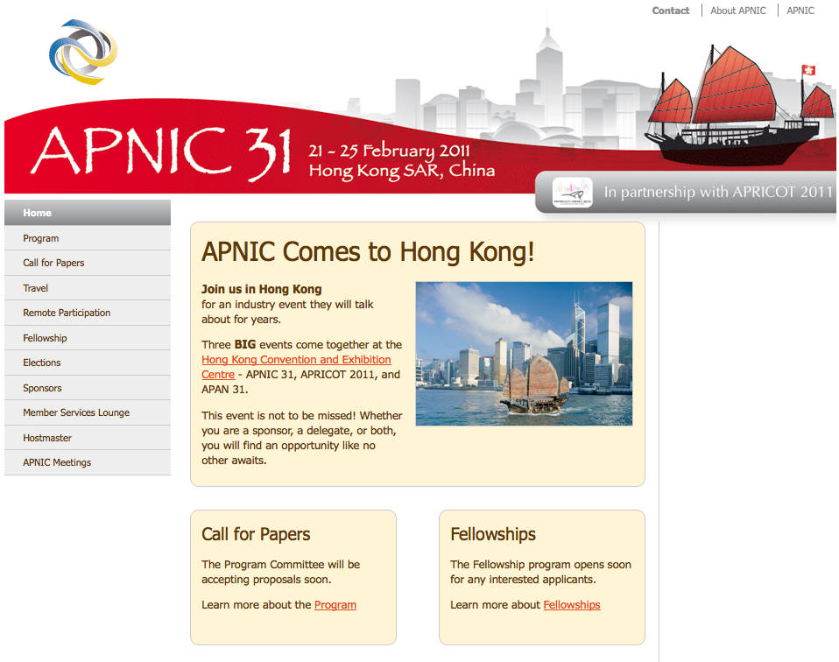

Next APNIC meeting
APNIC 31
Participation is open to everyone in the Internet community.
Join us!
Participate remotely
http://meetings.apnic.net/31/remote

Slide 28
Thanks!
George Kuo
<george@apnic.net>

