Slide 1
Handling Internet Network Abuse Reports at APNIC
21 October 2010
LAP-CNSA Workshop, Melbourne
George Kuo

Slide 2
Overview
Introduction to APNIC
Internet registry structure
Common network abuse questions APNIC receives
APNIC Whois Database registration

Slide 3
What is APNIC?
Internet registry for the Asia Pacific
One of the five Regional Internet Registries
Membership-based organization
Not for profit and services focused
Internet resource policy coordination body
Consensus-based policy development
Open and transparent decision making

Slide 4
APNIC’s Role
Distributes Internet resources
Maintains APNIC Whois Database
Facilitates resource policy development
Manages Reverse DNS delegations
But NOT a domain name registry
Provides training and outreach on resource management and APNIC services
Supports Internet development
Notes:
Root server deployment
Measurement and analysis
Training and education, fellowships, supporting APRICOT
Discounts for LDCs (membership and training fees)

Slide 5
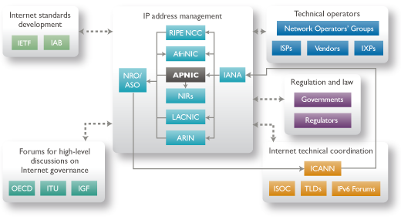
APNIC from a Global Perspective
Notes:
Multi-stake holders participation on policy/training

Slide 6
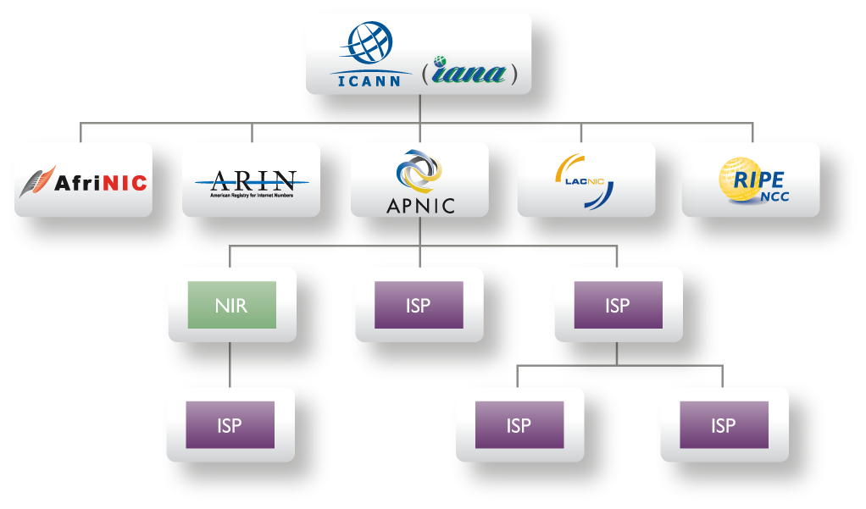
Internet Registry Structure
whois.apnic.net
whois

Slide 7
Internet Resource Delegation
APNIC Delegates to APNIC Member
/8
APNIC Allocation
APNIC Member
/22
Delegates to customers
Member Allocation
ISP customer Delegates to end-user
/24
Sub- Allocation
/27
/26
/25
/26
/27
Customer / End User
Customer Assignments
Notes:
7
Allocation
“A block of address space held by an IR (or downstream ISP) for subsequent allocation or assignment”
Not yet used to address any networks
Assignment
“A block of address space used to address an operational network”
May be provided to LIR customers, or used for an LIR’s infrastructure (‘self-assignment’)
In the case where an APNIC member provides addresses for their customers’ infrastructure, they make an assignment. (These are addresses actually in use.)
In the case where you provide addresses to a downstream provider who then further assigns the addresses, you make a sub-allocation. Your downstream provider then makes assignments to the end-user.

Slide 8
Common Questions…
Why does APNIC appear as the source in some abuse search reports?
Can APNIC investigate or stop the network abuse?
Can APNIC reclaim the Internet resources used for the network abuse?
The contacts information in the APNIC Whois Database is invalid. What do I do?

Slide 9
Is APNIC the culprit?
APNIC is listed by ARIN as holder of all IP space for the AP region
Some search tools look no further than this
For details, need to consult APNIC “whois”
APNIC whois may or may not show specific customer assignments for the addresses in question
But will show the ISP holding APNIC space

Slide 10
Can APNIC stop abuse?
No, because…
APNIC is not an ISP and does not provide network connectivity to other networks
APNIC does not control Internet routing
APNIC is not a law enforcement agency
APNIC has no industry regulatory power

Slide 11
What Can You Do?
Use the APNIC Whois Database to obtain network contact information
Contact the network responsible and also its ISP/upstream
Contact APNIC for help, advice, training or support

Slide 12
How to use APNIC whois
Web browser
http://www.apnic.net/whois
whois client or query tool
whois.apnic.net
Identify network contacts from the registration records
IRT (Incident Response Team) if present
Contact persons: “tech-c” or “admin-c”

Slide 13
What if whois info is invalid?
Members (ISPs) are responsible for reporting changes to APNIC
Under formal membership agreement
Report invalid ISP contacts to APNIC
http://www.apnic.net/invalidcontact
APNIC will contact member and update registration details

Slide 14
What if whois info is invalid?
Customer assignment information is the responsibility of ISPs
ISPs are responsible for updating their customer network registrations
Tools such as ‘traceroute’, ‘lookingglass’ and RIS may be used to track the upstream provider if needed
More information available from APNIC

Slide 15
Can APNIC reclaim addresses?
Sometimes…
Where IP space has been obtained fraudulently or under false pretences (which is often the case)
But…
APNIC does not regulate Internet activity
Current address management policy do not cover network abuse

Slide 16
APNIC Whois Registration

Slide 17
APNIC Whois Registration

Slide 18
APNIC Whois Registration

Slide 19
APNIC Whois Registration

Slide 20
Questions?
APNIC Whois inquiry
www.apnic.net/helpdesk
More information on network abuse
www.apnic.net/abuse
Report invalid contacts
www.apnic.net/invalidcontacts
Or
Send email to helpdesk@apnic.net

Slide 21
You’re invited…
http://www.apnic.net/meetings

Slide 22
Thanks
George Kuo,
APNIC

