Slide 1
Supporting Internet growth and evolution: The Transition to IPv6
CNNOS
14 July 2010
Sanjaya
Services Director, APNIC

Slide 2
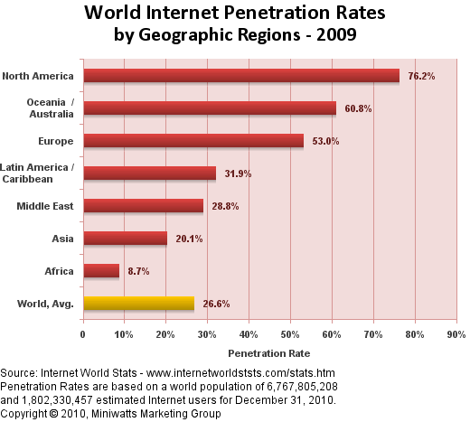
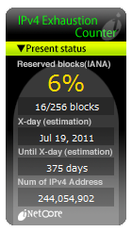
World Internet Penetration
Internet Penetration is only
at 26.6%, but IPv4 address is running out already with only 6% remaining

Slide 3
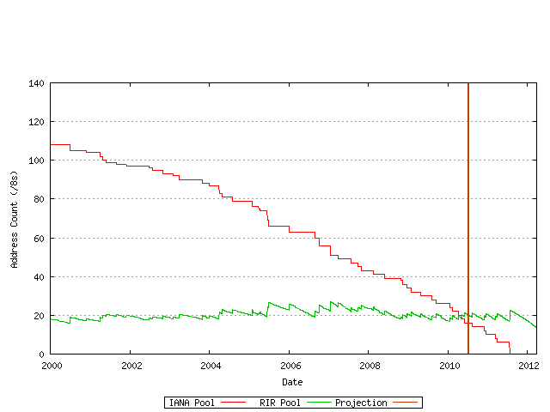
IPv4 Consumption: Projection
Projected IANA exhaustion: 19/07/2011
Projected RIR exhaustion: 24/03/2012
http://www.potaroo.net/tools/ipv4/ 9 July 2010

Slide 4
Transition to IPv6
IPv4 address exhaustion inevitable
4 billion (32 bit) addresses is just not enough!
IPv6 should be inevitable
340,282,366,920,938,463,463,374,607,431,768,211,456 (128 bit) addresses is big enough
The only solution to IPv4 exhaustion
IPv6 protocol is mature
Increasing usage in the past years
How far have we come?
trillion
trillion
trillion

Slide 5
APNIC: Survey 2009
If not, why not considering IPv6?
It’s not about business need.
It’s about business survival
n=118

Slide 6
IPv6 address allocations and assignments (ISPs)
No 29%
Yes 71%
Does your organization have, or consider having an
IPv6 allocation and/or assignment? (Sept 2009)
n=192

Slide 7
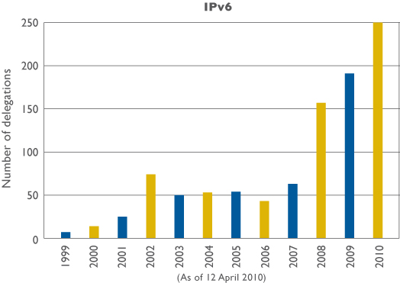
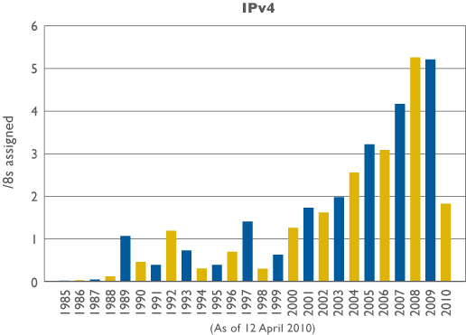
APNIC Resource Delegations
IPv6
IPv4

Slide 8
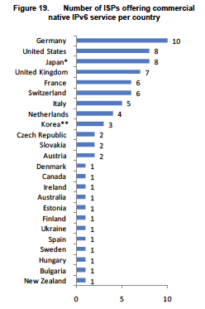
OECD: Latest Report
ISPs offering commercial
native IPv6 service
http://www.oecd.org/dataoecd/48/51/44953210.pdf

Slide 9
Ratio of IPv6 to IPv4 ASes
IPv6:IPv4 ASNs
Measuring IPv6 Deployment by Geoff Huston, APNIC http://www.isoc.org/isoc/conferences/ipv6momentum/

Slide 10
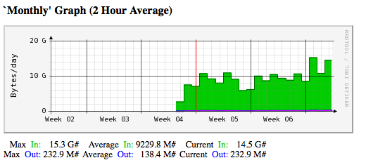
Chicken or Egg?
“Google has quietly turned on IPv6 support for its YouTube video streaming Web site, sending a spike of IPv6 traffic across the Internet…” – 1 Feb 2010 Networld
Monash University, Melbourne, Australia:

Slide 11
In Conclusion

Slide 12
Prepare for IPv6 Now
IPv4 will run out in 2 year’s time
Enable IPv6 in your network
Do something small but DO NOT delay
Future-proof your network with IPv6!

Slide 13
“What’s the Killer App for IPv6?”
The Internet !

Slide 14
Thank You!
<sanjaya@apnic.net>

