Slide 1
IPv6 deployment status: Where are we now and way forward
26th April 2013, APEC TEL47, Bali, Indonesia
Miwa Fujii <miwa@apnic.net>
APNIC

Slide 2
Table of contents
Dissecting IPv6 adoption
IPv6 deployment status in the AP region
Way forward

Slide 3
Dissecting IPv6 adoption

Slide 4
Dissecting IPv6 adoption
The Internet consists from multi stakeholders
IPv6 deployment has to go through many phases in difference stakeholders realms
Need to have multi dimensional data to have a holistic view
We need to see IPv6 adoption density in a logical order
IPv6 address allocation by Regional Internet Registries
IPv6 address allocation data
IPv6 adoption level in the core networks (Internet transit providers) of the Internet
BGP, ASN data
Content providers and enterprise to enable their website with IPv6
DNS server, and www reachability data
Access networks that allow end users to access to IPv6 resources
End user IPv6 readiness data

Slide 5
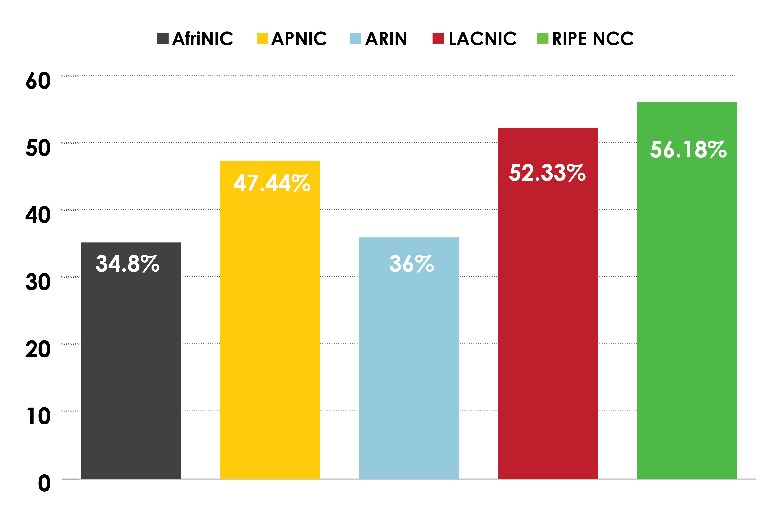
Percentage of members with both IPv4 and IPv6 in each RIR
NRO data: Dec 2012
http://www.nro.net/wp-content/uploads/NRO_Q4_2012.final_.pptx

Slide 6
IPv6 address allocation (cumulative) APNIC
Unit: /32
http://stats.apnic.net/o3portal/index.jsp as of 7/3/2013

Slide 7
Sum up 1: IPv6 address allocation
IPv6 address allocation has happened and is happening very smoothly

Slide 8
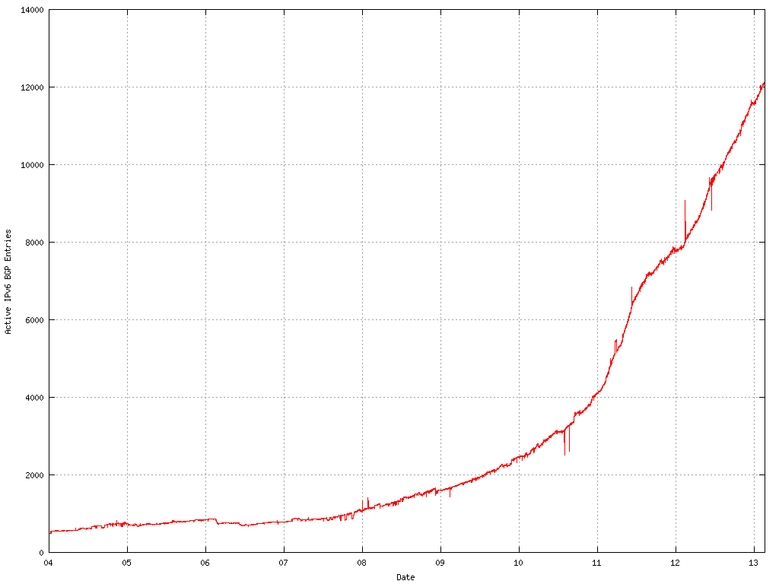
Network with IPv6
14000
IPv6 BGP Table Size
2012 – 2013: 48% YoY
8000
2011 – 2012: 50% YoY
0
2010
11
12
13
http://bgp.potaroo.net/stats/nro/v6/ as of Jan 2013

Slide 9
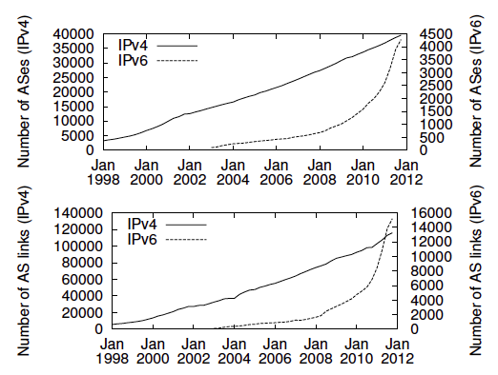
Growth of AS nodes and links
http://www.caida.org/publications/papers/2012/measuring_deployment_ipv6/, p2 Sept 2012 paper

Slide 10
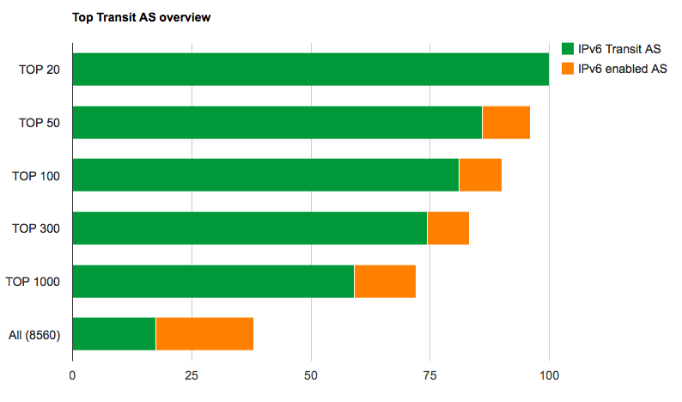
IPv6 adoption in Internet core networks
http://6lab.cisco.com/stats/cible.php?country=world

Slide 11
Sum up 2: IPv6 BGP and ASN
IPv6 prefix announcement into the global routing table, and ASNs announcing IPv6 prefixes shows healthy growth, especially after two World IPv6 launch events in 2011 and 2012
So called Tier1 network operators shows very high level IPv6 readiness: we can safely say the Internet core is ready with IPv6
However, we need more work in regional and local transit networks

Slide 12
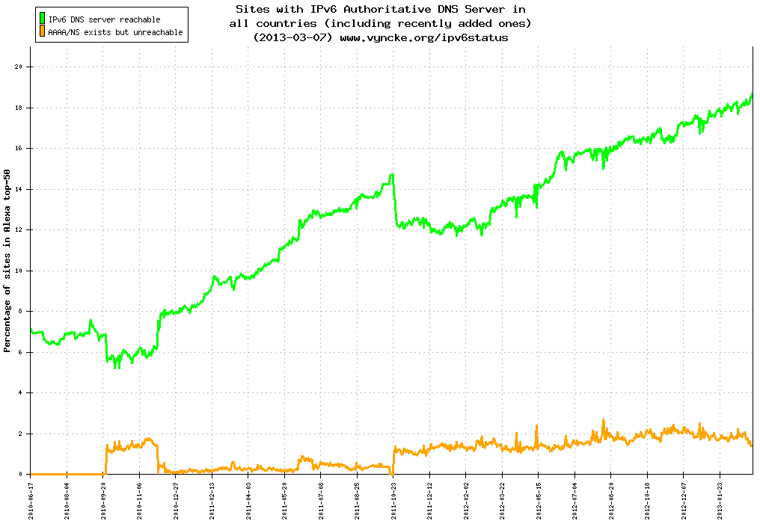
IPv6 enabled DNS servers
Sites with IPv6 Authoritative DNS Server www.vyncke.org/ipv6status
20
IPv6 DNS server reachable
AAAA/NS exists but unreachable
% of site in Alexa top-50 sites
10
0
2010-06
2010-12
2011-12
2012-12

Slide 13
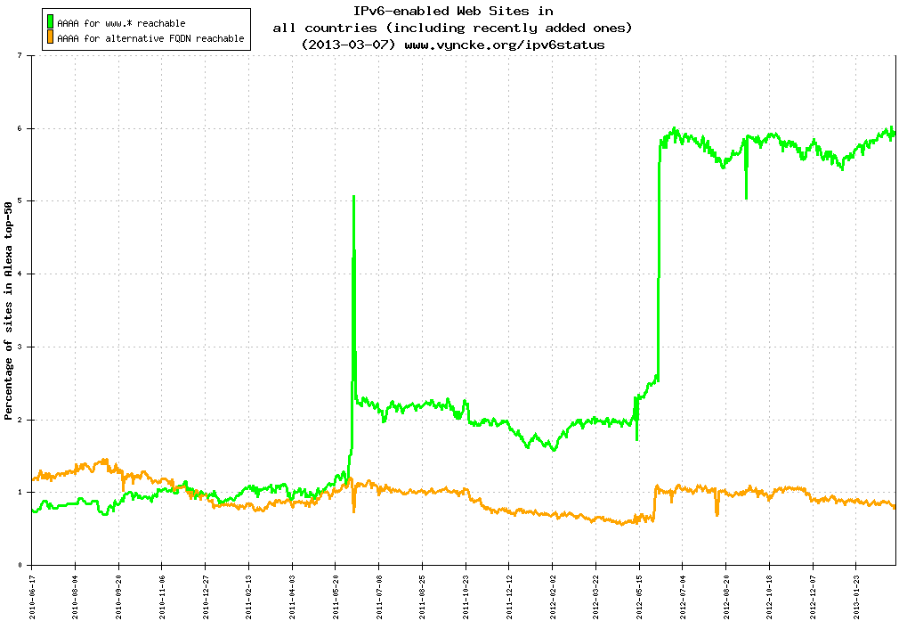
IPv6 enabled www sites
www.vyncke.org/ipv6status
7
AAAA for www.* reachable
AAAA for alternative FQDN reachable
4
% of site in Alexa top-50 sites
0
2010-06
2010-12
2011-12
2012-12

Slide 14
Sum up 3: Content providers and enterprises
20% of DNS servers of Alexa Top50 websites are ready with IPv6 and the IPv6 readiness is growing
6% of www servers of Alexa Top50 websites are ready with IPv6
“No content available on IPv6” is a myth
ISPs and network operators need to pay attention to this growth trend of IPv6 ready content while they are preparing their networks for future growth, especially their access networks
Do not forget about rapidly increasing Internet access from mobile devices (will talk more in details later)
Still, content providers (especially local content) and enterprise customers need to keep working on enabling IPv6 in their Internet resources

Slide 15
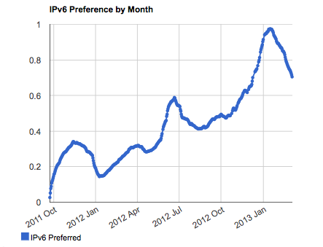
IPv6 measurement End user readiness: World
http://labs.apnic.net/ipv6-measurement/Regions/001%20World/ as of 07/03/2013

Slide 16
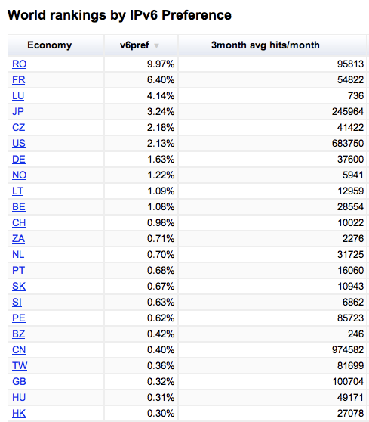
IPv6 measurement End user readiness: World rankings
http://labs.apnic.net/ipv6-measurement/Economies/

Slide 17
Sum up: 4 End user IPv6 readiness
Although the absolute number of end user IPv6 readiness for the world average is still quite small, the growth rate is robust, and there are great disparities across economies
We start observing IPv6 adopter economies with high level of IPv6 readiness among end users
End users’ IPv6 readiness depends on IPv6 readiness in last miles – i.e., access networks
Local ISPs need to make an informed decision
Deploying NAT444 CGN without deploying IPv6 transition technologies does not scale the future growth

Slide 18
IPv6 deployment status in the AP region
Examples of anecdotal activities

Slide 19
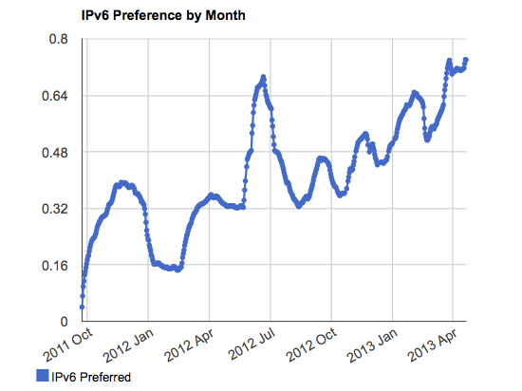
IPv6 measurement End user readiness: APEC
http://labs.apnic.net/ipv6-measurement/Organizations/APEC/

Slide 20
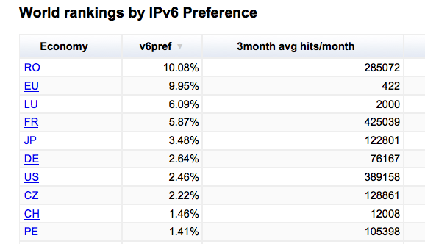
IPv6 measurement End user readiness: World rankings
http://labs.apnic.net/ipv6-measurement/Economies/
Notes:
Australia 1989 Brunei 1989 Canada 1989 Indonesia 1989 Japan 1989 Republic of Korea 1989 Malaysia 1989 New Zealand 1989 Philippines 1989 Singapore 1989 Thailand 1989 United States 1989 Chinese Taipei^{[4]} (Republic of China) 1991 Hong Kong, China ^{[5]} 1991 People's Republic of China 1991 Mexico 1993 Papua New Guinea 1993 Chile 1994 Peru 1998 Russia 1998 Vietnam

Slide 21
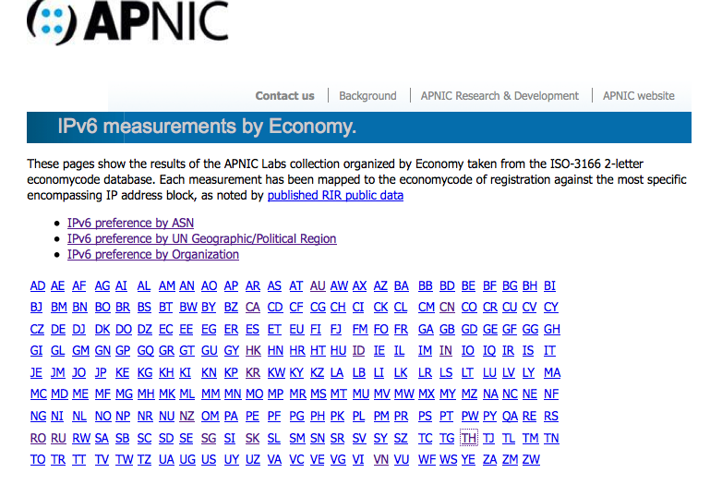
How’s your economy doing?
http://labs.apnic.net/ipv6-measurement/Economies/

Slide 22
Who are ahead in the game?
AS Numbers with high IPv6 ready end users
AS8708 RCS-RDS Cable Service Provider (Romania) 24%
AS12322 Free (France) 27%
AS2516 KDDI (Japan) 25%
AS18126 Chube Telecommunications (Japan) 21%
AS15169 Google (USA) 13%
AS4739 Internode (Australia) 10%

Slide 23
APEC TEL IPv6 Guidelines in action
Many encouraging activities have been seen in the region
Updating government ICT procurement criteria with IPv6
Policies to support deploying IPv6 in government networks with clear mandate goals and timeframe
Leading the industry by examples in adopting IPv6
Partnership between public and private sectors, e.g.,
Establishing certification mechanism to recognize “IPv6 ready” products
Launching IPv6 project to raise IPv6 awareness among key stakeholders
Promoting IPv6 activities through media, events, competitions, awards etc.
Human capacity development
Supporting IPv6 skill up trainings to the industry
Need to keep providing positive support to speed up IPv6 adoption in the region

Slide 24
Way forward
IPv6@APNIC

Slide 25
APNIC’s IPv6 key messages
IPv6 deployment has experienced large growth in the last two years
Eight times growth in IPv6 enabled end users globally in the last 12 months
IPv6 is prerequisite for ubiquitous broadband penetration, and for the Internet as we know it to keep growing
Given there is no other way to manage IPv4 address exhaustion, IPv6 is an ultimate solution
Some large network operators start seeing this fact and taking proactive actions by deploying IPv6
New networks of service providers are a good place to start enabling IPv6: Default IPv6 for new customers

Slide 26
APNIC’s IPv6 key messages
Large Scale NAT (LSN), Carrier Grade NAT (CGN), or any other type of technologies to provide IPv4-to-IPv4 NAT platforms (AKA NAT444) are NOT a transition mechanism to IPv6
Their goal is to extend IPv4 address lifetime
Selection of transition technology should align with the long term vision of the operator
Less iteration to achieve such vision is better
Minimize iterations in order to keep lower CAPEX and OPEX

Slide 27
Rapidly increasing mobile devices
The business competency of mobile network operators is shifting from being a traditional voice and messaging provider to a mobile broadband service provider
Services on voice, messaging and data are converging on IP based services
Rapidly increasing LTE deployment in the region
Given the rapid increase in the number of mobile devices, rich media applications and content:
Investing in techniques just to extend IPv4 lifetime is ultimately limited from a business continuity point of view

Slide 28
IPv6 in mobile networks
We must avoid put the largest growth engine, i.e., use of mobile devices in mobile networks, in a small cage
Need to avoid mobile networks from being indefinitely bounded to IPv4 addresses (exhausting!) and being caught in fragile NATed networks
It’s not a simple growth of number of devices. These devices keep holding IP addresses longer and making more number of connections
IPv4 does not support today’s business needs
IPv6 is ready to be used in mobile networks, and it will save cost of network operators
No need to spend limited financial resources on NAT, CGN (NAT444) or sourcing IPv4 addresses

Slide 29
IPv6@APNIC
APNIC Survey 2012 revealed collective input from the AP Internet community
“APNIC should step up efforts regarding IPv6 deployment and training”
Best current practice information on IPv6 deployment
Advice and consultation on IPv6 deployment
More practical hands-on trainings on IPv6 deployment
Raise awareness among stakeholders on IPv6
More facilitation with local Internet communities to help IPv6 uptake
APNIC is responding to such requests: Plans in 2013
More hands-on IPv6 trainings
Engineering assistance on IPv6 deployment
More community outreach on IPv6

Slide 30
www.apnic.net/ipv6

Slide 31
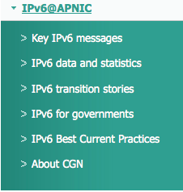
www.apnic.net/ipv6

Slide 32
Thank you!

