Slide 1
IPv6 Deployment Status
APEC TEL45, 11/04/2012, Da Nang, Vietnam
Miwa Fujii
APNIC Senior IPv6 Program Specialist

Slide 2
Overview
IPv6 in 2011
Address allocation data
IPv6 prefix announcement
Where are we now?
Way Forward

Slide 3
APNIC IP Delegations
IPv6 Delegation Count
IPv4 Delegation Count
APNIC statistics data sa of 02/04/2012

Slide 4
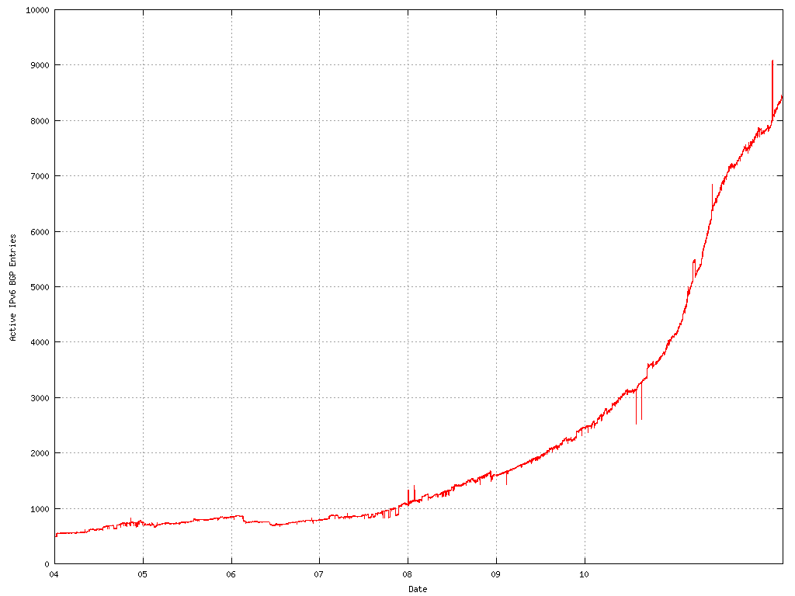
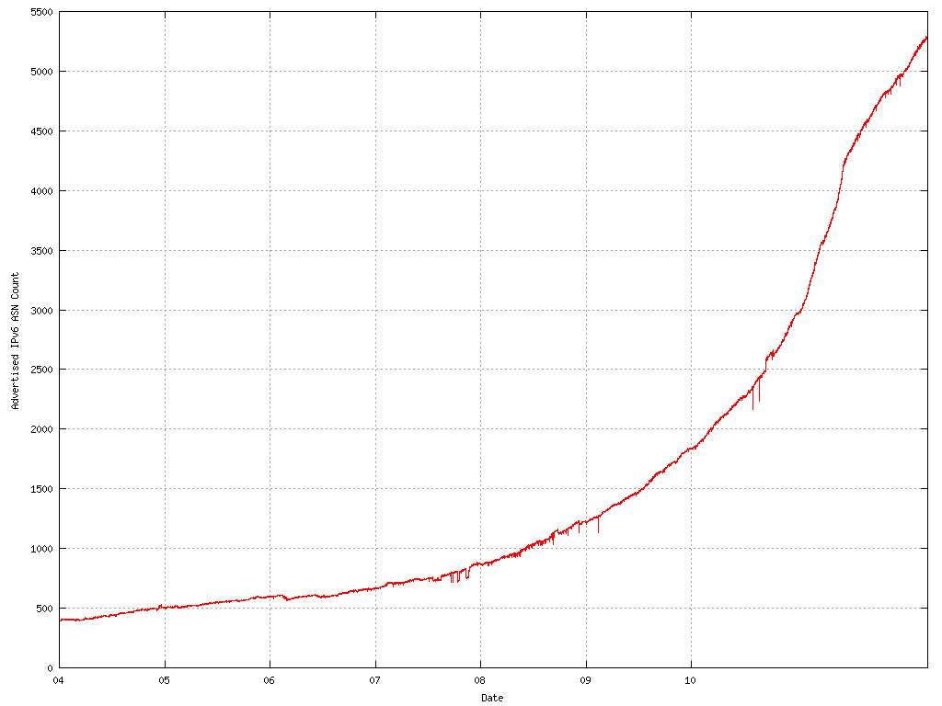
IPv6 Prefix Announcements
10000
IPv6 AS count
5000
5500
0
2005
2011
2500
IPv6 BGP table size
0
2005
2011
http://bgp.potaroo.net/stats/nro/v6/

Slide 5
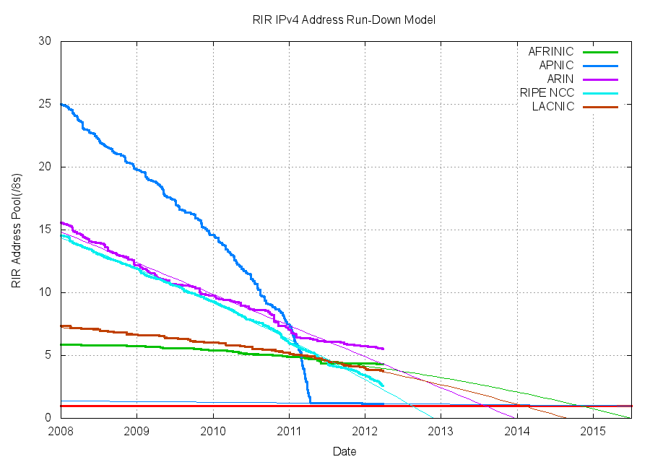
IPv4 Address Exhaustion 2012
http://www.potaroo.net/tools/ipv4/plotend.png

Slide 6
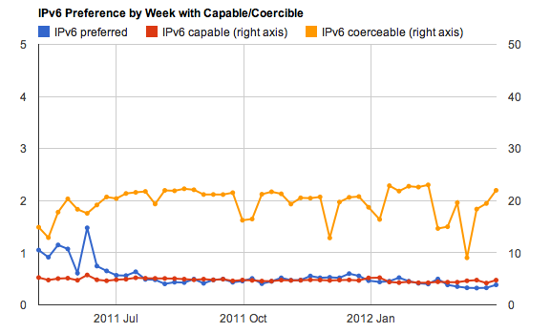
Where are We Now?
http://labs.apnic.net/ipv6-measurement/Organizations/APEC/

Slide 7
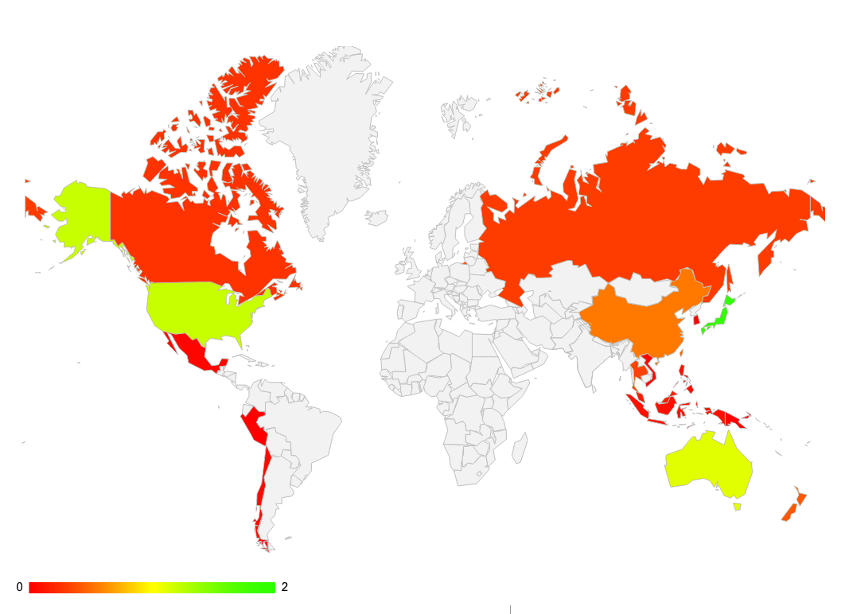
Where are We Now?
%
Level of IPv6 preference
http://labs.apnic.net/ipv6-measurement/Organizations/APEC/

Slide 8
Where are We Now?
IPv6 availability for end users does not look good.
Access networks are not ready to provide IPv6 access to end users.
%
Level of IPv6 preference
http://labs.apnic.net/ipv6-measurement/Organizations/APEC/

Slide 9
Way Forward
The Internet is a catalyst for job creation and growth
Currently 2 billion Internet users globally
By 2016, there will be 3 billion
Across the G-20, the Internet economy is 4.1% of GDP
The Internet contributes up to 8% of GDP in some economies, powering growth and creating jobs
Prediction for Internet access in 2015:
via mobile connections will reach 2,134 million users
via fixed connections will reach 573 million users
https://www.bcgperspectives.com/content/articles/media_entertainment_strategic_planning_4_2_trillion_opportunity_internet_economy_g20/

Slide 10
Way Forward
APEC TELMIN8 Okinawa Declaration
“…. and the transition to IPv6 will facilitate the achievement of universal broadband access in the APEC region. We support the IPv6 Guidelines developed by TEL.”
http://www.apec.org/Meeting-Papers/Ministerial-Statements/Telecommunications-and-Information/2010_tel.aspx
APEC TEL Strategic Action Plan: 2010 – 2015
“Develop ICT to Promote New Growth”
“Expand networks to achieve universal access to BB in all APEC economy by 2015”
How can we achieve these goals after IPv4 address exhaustion?
Need your leadership to enable IPv6 access

Slide 11
Way Forward
IPv6 deployment among Internet stakeholders such as governments, services providers, content providers, system integrators etc.
Need to develop realistic plans to
Manage IPv4 address shortage
Deploy IPv6 in their access networks
Scalability of selected transition technologies is key
Next few years will be critical time for IPv6
World IPv6 Launch
Turn on IPv6 on 6 June 2012
Network engineering initiative from ISPs, ICPs, and vendors

Slide 12
APNIC Can Support APEC TEL Economies
APNIC is here to support real and tangible IPv6 deployment
Outreach and training programs are available
Practical and useful skill training, advice, and information services
IPv6 workshops for network engineers with hands-on IPv6 configuration experience
Review on pro and cons of various IPv6 transition methods
Feel free to contact us

Slide 13
Thank you!
<miwa@apnic.net>

