Slide 1
MyNOG 01
APNIC Update
Anna Mulingbayan
Senior Internet Resource Analyst/
Liaison Officer, South East Asia, APNIC

Slide 2
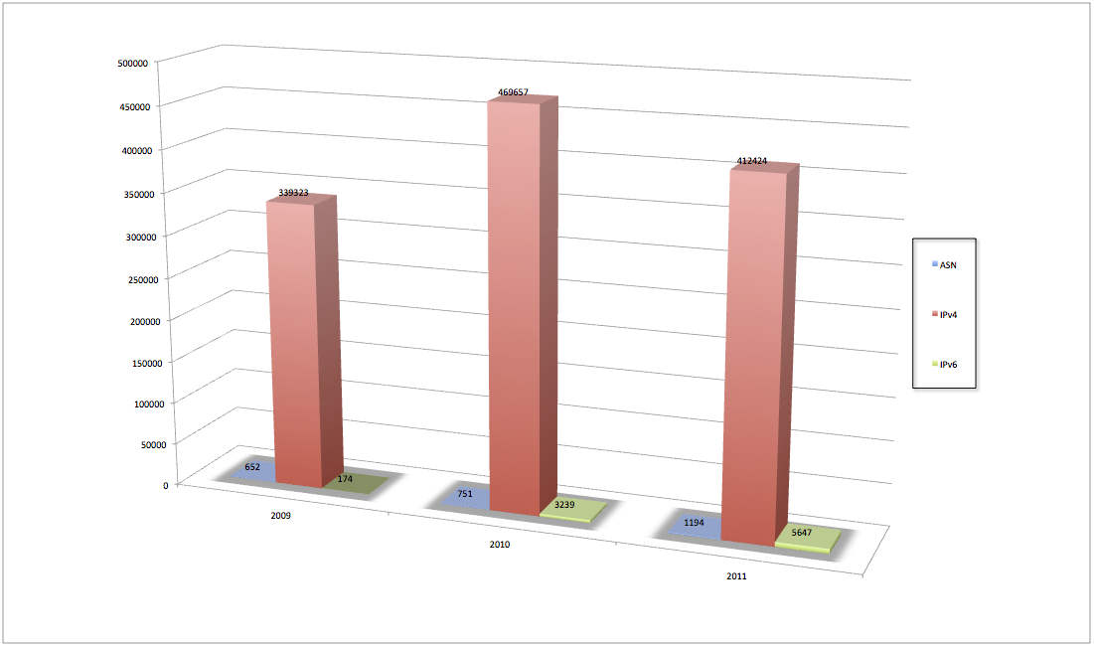
IP address and ASN delegation in the AP region
(Dec 2011)

Slide 3
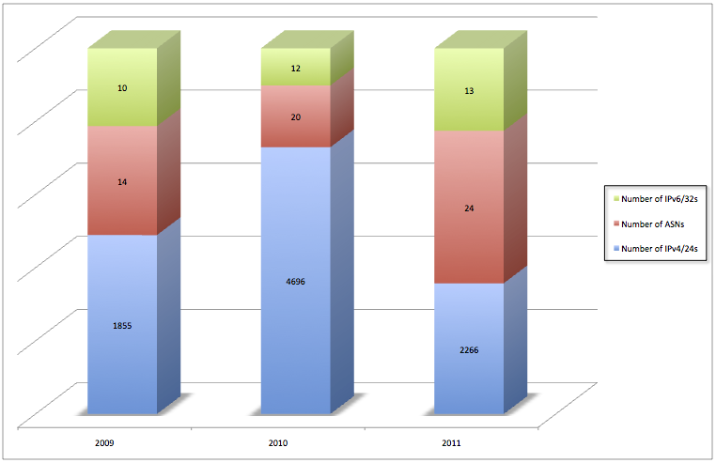
IP address and ASN delegation in Malaysia
(Dec 2011)
Notes:
Resource delegation rates. IPv4 tallest bar most of this happened at the beginning of this year. With IPv6 we most likely will not delegate the same amount as last year. ASN’s is steady growth.

Slide 4
IPv4 exhaustion
Reached “Final /8” on 15 April 2011
  103.0.0.0/8
New allocation policy activated
  Limited to a single maximum delegation of /22
  Minimum delegation size is a /24
From 15 April to 11 January 2012, made 901 delegations to 32 economies
Notes:
After receiving 3 * /8s at the beginning of this year. At that point we activated the final /8 policy, which was a rationing policy It was passed through the policy process a few years ago. Purpose was to ensure certainity of availability of IPv4 address space. As you can see that it has slowed down the rate of delegations it is expected to last another 10yrs.

Slide 5
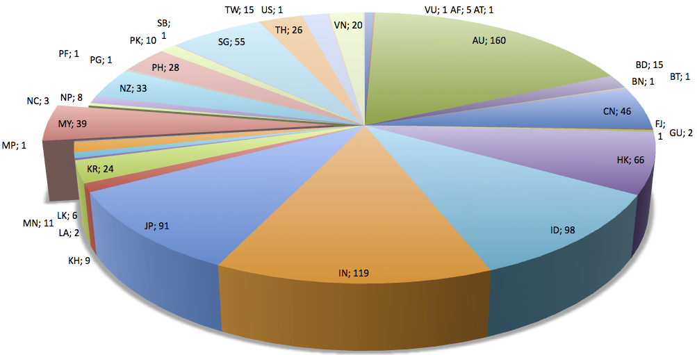
Last /8 Delegations
(11 Jan 2012)
Notes:
Illlustration of how the final /8 delegations have been made. When we reached the end of IPv4 pool of conventional allocation model we had 180 requests in the queue, which were informed that they would receive a /22 instead. Only 6 complaints. Therefore transition was smooth and quite from conventional allocation model into final /8, and attributed to the amount of information dessimination before hand.

Slide 6
Policies implemented in 2011
prop-088: Distribution of IPv4 addresses once the final /8 period starts
prop-093: Reducing the minimum delegation size for the final /8 policy
prop-094: Removing renumbering requirement from final /8 policy
Notes:
3 policy implemented in the first part of this year after the March meeting. Any address space is which is returned will be allocated according to the same policy until some adjustment is made.

Slide 7
Policies at APNIC 32
Consensus…
  prop-096: Maintaining demonstrated needs requirement in transfer policy after the final /8 phase
  Endorsed by APNIC EC, 3 Nov 2011
No consensus – returned to mailing list
  prop-100: National IP address Plan – allocation of country-wide IP address blocks
  prop-099: IPv6 reservation for large networks
  prop-098: Optimizing IPv6 allocation strategies (simplified)
Notes:
We now have a change to the transfer policy, which requires a recipient of transfer in AP region to demonstrate their requirement of a transfer under the previous allocation request process before they can receive approval for the transfer. We started off the policy without the needs based transfer policy, but it created inconsistency between the regions in terms of expectations of transfers in other regions. So now there is global consistencies
Allocations of IPv6 address space to countries, another on IPv6 reservations and optimizing IPv6 allocation strategies all details available on the website

Slide 8
Learning and Development
New Area: Director, Philip Smith
Training Lab
  Infrastructure upgraded
  Workshops on IPv6, four-byte ASNs
  More hands-on sessions
Collaborations
  6Deploy, intERlab, NIRs (ID, TW, CN)
APNIC Conference Hubs
  Jakarta and Port Moresby (Feb 2011)
  Phnom Penh (Aug 2011)
Notes:
New area. More work will be done on this next year. Training lab for online access for routers for training sites. Online training seminars (webinars). Also providing live real time hubs into APNIC meetings.

Slide 9
IPv6 Program
Major IPv6 events in the region
  IPv6 Transition Day at APNIC 32 and APRICOT/APAN 2011
  IPv6 Deployment workshop at ICANN 41
Supporting regional IPv6 activities
  Inaugural MyNOG and SGNOG
  China Global IPv6 Summit 2011
  Pacific IGF (New Caledonia)
  Asia Pacific IGF (Singapore)
  Secretariat for APIPv6TF
Notes:
Other activities v6 plennery sessions, supporting v6 activities, NOGS, global submits, IGF, IPv6 taskforce

Slide 10
IPv6 Program
Activities with inter-governmental organizations
  Asia Pacific Economic Cooperation (APEC TEL)
    Continuous engagement with IPv6 information
  Asia Pacific Telecommunity (APT)
    APT Policy and Regulatory Forum (PRF) and Pacific PRF
  Secretariat of Pacific Community (SPC)
    MoU on IPv6 deployment in the Pacific
  Pacific ICT Ministers Meeting
    APNIC’s recommendations in the ministerial communiqué
  ITU Asia Pacific collaboration
    IPv6 capacity-building workshop
Notes:
Activies with inter-governmental space APEC TEL great forum promoting v6 message with widespread broadband deployment process, which can’t do without v6 by 2015 pushed through political process up to ministerial level. APT is regional telecomunications group which feeds into ITU process which we are active in. Pacific based organisation (SPC) . ITU d regional office in AP which we paying attention to.

Slide 11
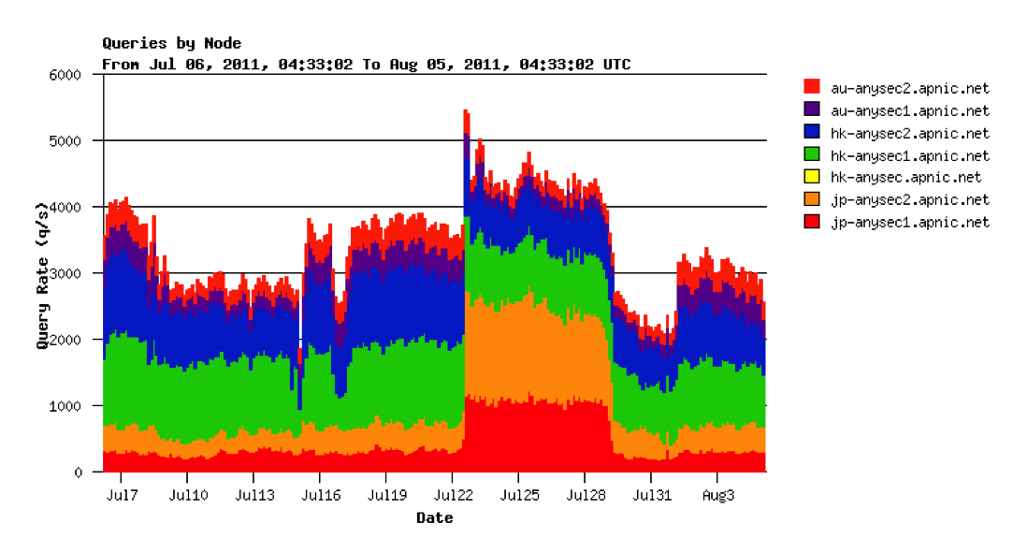
Technical Area
APNIC now serving e.in-addr-servers.arpa and e.ip6-servers.arpa. labels
Notes:
In Tech area a lot of work in the in-addr server e that we host
Transitioned and successfully taken on full load from 8 March 2011
Servers handling about 3,000 queries per second

Slide 12
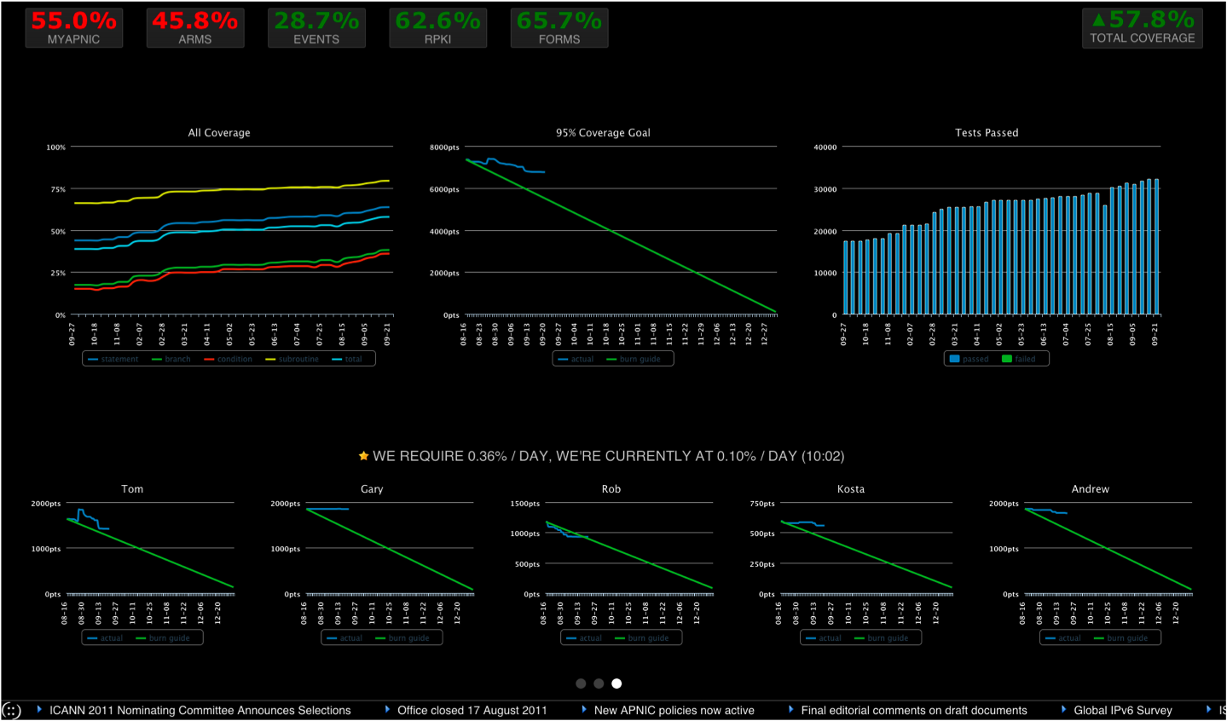
Agile
Notes:
Adopted Agile methodology for project management. Got 95% target implementation by end of 2011 under agile. Screen graph in our tech area for our software development team
Tracking software development with aim to achieve a 95% target implementation by the end of 2011

Slide 13
APNIC Labs
Supporting R&D with remote measurement techniques
  Software expertise provided for client-side IPv6 capability measurements
Google analytics measurements for IPv6 client capability targeted at website owners
http://labs.apnic.net
Notes:
Was launched at beginning this year.
Measuring whether or not you can or can’t use IPv6
Built on google ‘analytics’ method
It runs in the background it uses DNS wildcards uncachable, what it does is feedback into Google basic metrics of the v6 capability of your website
Javascript, highly portable

Slide 14
DNSSEC
3 May 2011, DS records submitted to IANA
  Allows validation to occur from root down to APNIC’s reverse zones
Users can update reverse DNS DS record through MyAPNIC
  Single zone via whois domain objects
  Multiple zones via zone file upload
Notes:
DNSSEC DS records which was submitted to IANA in May
Got users able to update their own ds records through MyAPNIC

Slide 15
Public Affairs
IGF related events
  Second APrIGF in Singapore
  First PacIGF in New Caledonia
  APIL in China
NRO
  Public affairs coordination
  Renewal of IANA contract (comments FNOI)
OECD
  High-level meeting on Internet Economy
Notes:
Involved quite heavily in multistaker holder process, which we are promoting. In collaborations such in IGF, NRO OECD
Organisation for Economic Co-operation and Development - an international organisation helping governments tackle the economic, social and governance challenges of a globalised economy.

Slide 16



New APNIC Corporate Identity
New image for a new era
:: representing our new IPv6 world
() representing our collaborative community
Changing icon represents our dynamic and diverse community
Notes:
New APNIC logo and corporate identity. Four dots come from v6 address enclosed by a collaborative community, and it’s very dynamic so colours change in business cards

Slide 17

Coming up…
APNIC 34
  Phnom Penh, Cambodia, August 2012
APNIC 35:
  Singapore, Singapore, February 2013
Notes:
Change in the original dates, now starting a day before.

Slide 18
Thanks
anna@apnic.net

