Slide 1
APNIC Update
15th TWNIC OPM
2 December 2010
Taipei, Taiwan
George Kuo
Member Services Manager, APNIC

Slide 2
APNIC Policy Updates
Proposal | Title | Overview
Prop-079 Implemented 8 Nov 2010 | Abuse contact information | This is a proposal to introduce a mandatory abuse contact field for objects in the APNIC Whois Database to provide a more efficient way for abuse reports to reach the correct network contact.
Prop-080 Implemented 5 July 2010 | Removal of IPv4 prefix exchange policy | This is a proposal to remove the policy that currently permits resource holders to return three or more noncontiguous IPv4 address blocks and have the prefixes replaced with a single, larger, contiguous block.
Prop-082 Implemented 5 July 2010 | Removing aggregation criteria for IPv6 initial allocations | This is a proposal to remove the aggregation requirement from the IPv6 initial allocation policy.
No policy proposals reached consensus during APNIC 30
http://www.apnic.net/policy/proposals

Slide 3
IRT Object: Dedicated Abuse Contact

Slide 4
New Policy Proposal
prop-088-v001
Distribution of IPv4 addresses once the final /8 period starts
Handle IPv4 space received by APNIC after the final /8 policy is implemented
Part of final /8 pool
Redistribute resources according to final /8 policy

Slide 5
Resource Services
IPv4 requests still strong (5.94 x /8)
Mobile, wireless, ADSL networks
Growth economies: CN, KR, JP, IN, VN
Very high IPv6 take up
584 delegations in 2010 so far (188 in 2009)
Resource Quality Assurance
APNIC tests all IANA allocations prior to distribution
Outreach to network operators to remove outdated filters
36.0.0.0/8 and 42.0.0.0/8 being tested

Slide 6
Resource Delegations in TW
2010 delegation count
IPv4: 26
IPv6: 7
2010 size count
IPv4: 0.2 /8
IPv6: 7 /32
Total distribution up to date
IPv4: 1.82 /8
IPv6: 2319 /32

Slide 7
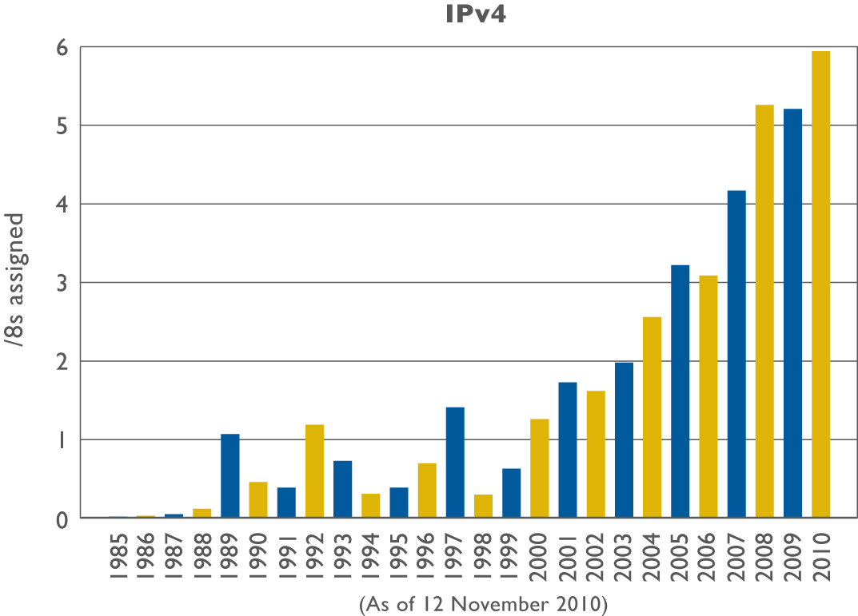
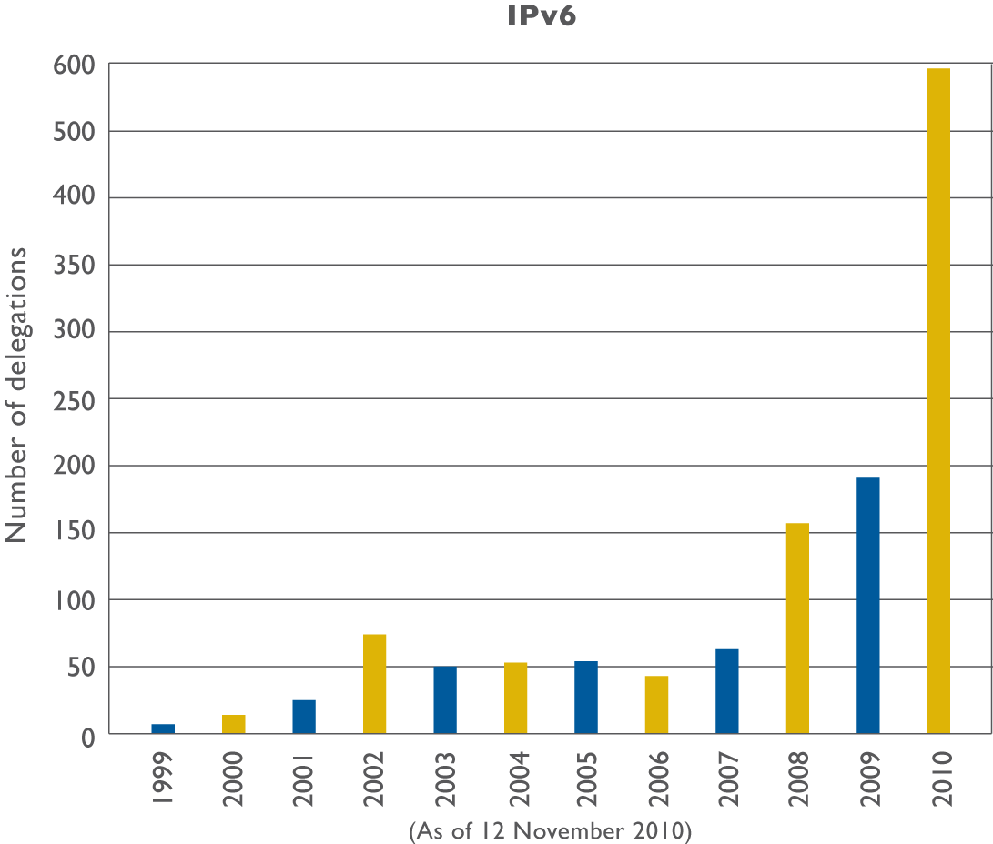
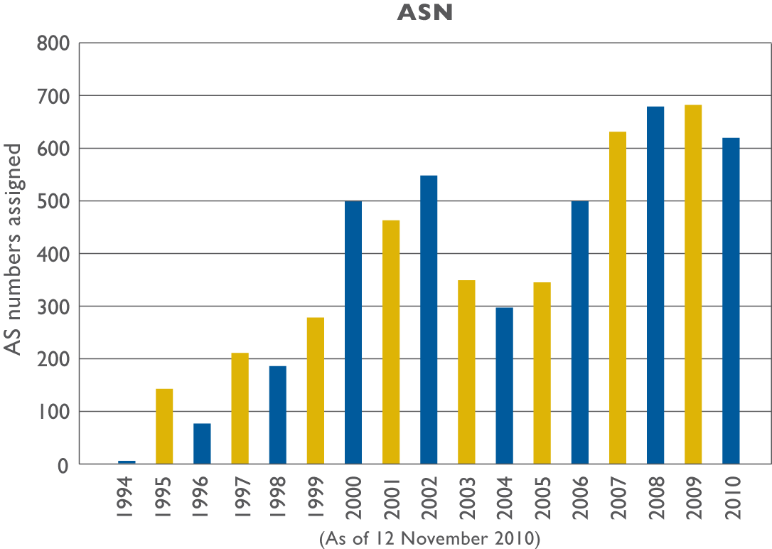
Resource Delegations

Slide 8
A Closer Look at APNIC’s IPv4 Allocations

Slide 9
IPv4 Address Global Distribution (/8)
Available unallocated
Pool 11
AfriNIC 3
42
256 x /8
23 Nov 2010

Slide 10
Final Stages of IPv4 Distribution
2011
2011/2012

Slide 11
How Does APNIC Distribute Last /8?
One /16 is reserved for future use
Each APNIC account holder will be eligible to request and receive a single allocation (/22)

Slide 12
Resource Quality Assurance
APNIC acts to minimize any problems in routability through communication, training, and testing
Testing for new /8 blocks
NOC mailing lists notification
Collaborative testing conducted by APNIC R&D in conjunction with different organizations
APNIC conducts further testing, to quantify the extent to which networks attract “pollution” or “unwanted” traffic

Slide 13
Resource Quality Assurance
Community awareness
Promote responsible administrative practices through APNIC publications and training materials
Inform organizations that maintain bogon/black lists about the changes for recently allocated addresses so they update their DB
Keep the Whois Database accurate
Actively remind resource holders to update their data
Notes:
Reachability index: advertise results of technical testing
Keep the Whois Database accurate
Actively remind resource holders to update their data

Slide 14
Resource Quality Assurance
Is a collaborative effort, you can:
Follow responsible network administration practices to protect users from abuse and security attacks, while allowing legitimate traffic to flow and reach its intended destination
Talk to your customers, upstreams and peers
Keep informed about IANA allocations
Consider whether you should stop any form of bogon filtering
Notes:
Refer to leaflet page 1 section “How do I confirm…”

Slide 15
Training and Education
eLearning Interactive
Successfully offering two sub-regional training courses per month:
20 eLearning web classes
271 attendees
Notes:
First elearning class of the month is IRME, second is about a specific course, DNS, routing, IPv6, IRR

Slide 16
Research and Development
RPKI (joint with other RIRs/NRO)
DNS service dynamics
Expanded network measurement/monitoring
Test Traffic Measurement (TTM)
‘Day In the Life of the Internet’ (DITL)
3.4Tb of data collected over 3 days in 2010
IPv6 deployment measurement activities

Slide 17
Technical Developments
New co-location facility in ‘triangle architecture’ for reliability and disaster recovery plan
DNSSEC implementation
Signing of all APNIC zones completed April 2010
Cooperation with other RIRs on ERX ranges

Slide 18
IPv6 Program Update
APNIC is the new Secretariat for the Asia Pacific IPv6 Task Force (APIPv6TF)
Conducted two IPv6 workshops with APEC TEL WG 2010:
APEC TEL 41: Taipei, Taiwan
Transforming the Internet
APEC TEL 42: Bandar Seri Begawan, Brunei Darussalam
Securing sustainable growth of the Internet

Slide 19
APEC TELMIN8 Ministerial Statement
APNIC participated APEC TELMIN8 in Okinawa, Japan 30 – 31 Oct 2010
Heads of the Ministries of information and communications
APEC TELMIN8 reiterates importance of IPv6 deployment in the Asia Pacific
“We recognize that the free pool of IPv4 addresses is expected to be exhausted around 2012, and the transition to IPv6 will facilitate the achievement of universal broadband access in the APEC region. We support the IPv6 Guidelines developed by TEL.”

Slide 20
Internet Governance
APNIC was one of the main organizers and sponsors of the first Asia Pacific IGF in Hong Kong.
Co-hosted remote hubs in the Asia Pacific region in support of the IGF in Lithuania
Dhaka, Bangladesh
Manila, Philippines
Hong Kong SAR, China
Jakarta, Indonesia

Slide 21
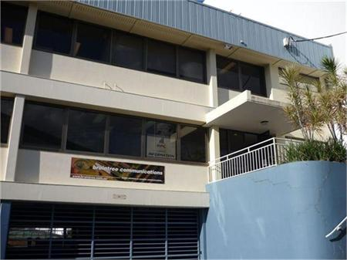
New Building
Lower operating costs
Size and location suits APNIC’s future needs

Slide 22
Next APNIC Meeting APNIC 31
Participation is open to anyone in the
Internet community.
Join us!

Slide 23
More APNIC Meetings..
APNIC 32
29 August – 2 September
Busan, South Korea
APNIC 33 and APRICOT 2012
22 February – 3 March
Delhi, India

Slide 24
Thank You
george@apnic.net

