Slide 1
APNIC Update
LACNIC XIII
May 2010
Guangliang Pan
Resource Services Manager, APNIC

Slide 2
Overview
Services Update
APNIC 29 Policy Outcomes
APNIC Activities
R&D
Technical Developments
IPv6 Program
Training
Other News
Upcoming meetings

Slide 3
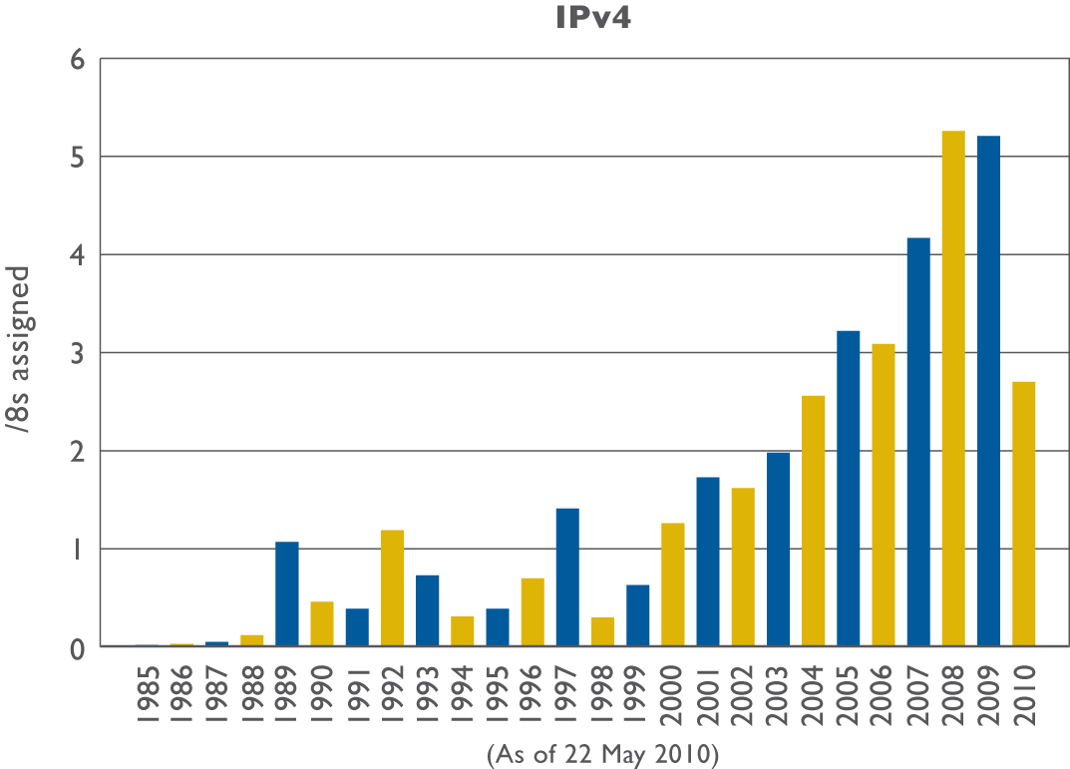
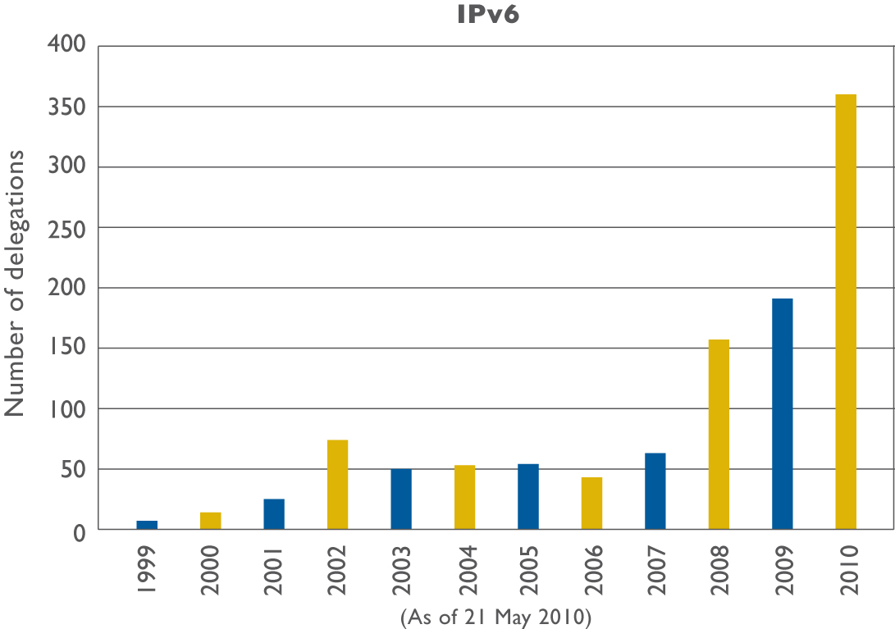
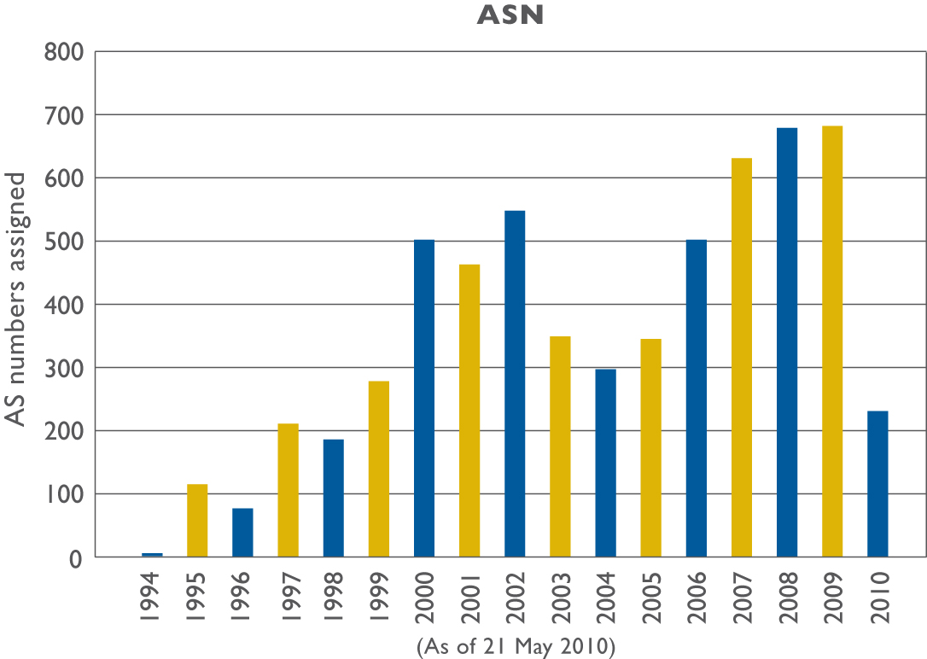
Resource Delegations

Slide 4
APNIC Service Levels
Membership total: 2,264
2009 highest number of new Members: 416
March 2010 was the largest month on record for new membership applications/approvals
54 new accounts
APNIC now averages 1,400+ per month Helpdesk enquiries, a growth of over 55% in the last year
Total MyAPNIC users: 2400

Slide 5
Member Services
CA2
Automated certificate renewal (MyAPNIC)
Manage contacts without a digital certificate
Resource Quality Assurance Initiative
APNIC tests all IANA allocations prior to distribution
27.0.0.0/8 and 1.0.0.0/8 tested
1.0.0.0/8 public report available
Testing preparations for to 14.0.0.0/8 and 223.0.0.0/8

Slide 6
APNIC 29 Policy Outcomes
Proposal | Title | Overview
Prop-079 Reached Consensus | Abuse contact information | This is a proposal to introduce a mandatory abuse contact field for objects in the APNIC Whois Database to provide a more efficient way for abuse reports to reach the correct network contact.
Prop-080 Draft available | Removal of IPv4 prefix exchange policy | This is a proposal to remove the policy that currently permits resource holders to return three or more noncontiguous IPv4 address blocks and have the prefixes replaced with a single, larger, contiguous block.
Prop-082 Draft available | Removing aggregation criteria for IPv6 initial allocations | This is a proposal to remove the aggregation requirement from the IPv6 initial allocation policy.
http://www.apnic.net/policy/proposals

Slide 7
Last Policy and Fee Changes Implementations
Proposal | Title | Overview
Prop-050 | IPv4 address transfers | This policy removes APNIC policy restrictions on the transfer of registration of IPv4 address allocations and IPv4 portable address assignments between current APNIC account holders.
Prop-073 | Simplifying allocation/assignment of IPv6 to APNIC Members with existing IPv4 addresses | IPv6 Kickstart: Available from the public and MyAPNIC websites as a simple, one-click application for current IPv4 address holders to obtain an appropriately sized block of IPv6 addresses.
http://www.apnic.net/policy/proposals
New Fee Schedule, implemented January 1 2010
50% discount for Least Developed Countries

Slide 8
Research and Development
Routing research
RPKI (joint with other RIR/NRO)
DNS service dynamics
DNSSEC implementation
Expanded network measurement/monitoring
Test Traffic Measurement (TTM)
‘Day In the Life of the Internet’ (DITL)
3.4Tb of data collected over 3 days in 2010

Slide 9
Technical Developments
DNSSEC
Phase 3
Resource Public Key Infrastructure (RPKI)
Web services interface with external systems
Secure channel for updating Member reverse delegations
Will be used to link Member DNSSEC signed zones to APNIC DNSSEC signed zones

Slide 10
IPv6 Program Update
10% Media Campaign (with IANA)
About 7% IPv4 remaining
Kickstart IPv6
Implemented 10 Feb 2010
Total allocations since Feb 2010: 275
IPv6 events:
Philippines CIOF IPv6 Event; 16 April
APEC TEL41, Taipei; 8 May
Indonesia IPv6 Summit, Bali; 8-9 June
CommunicAsia 2010; 15-18 June

Slide 11
Training and Education
Face-to-face training
Fully equipped Training lab (IPv6 supported)
Online Interactive eLearning Web classes
Two training courses offered every month
Online self-paced modules
Supplements other modes
Training through collaboration
6Deploy, Team Cymru, IntERLab

Slide 12
Other APNIC News
Community Consultation, APNIC 29
Panellists’ perspectives: ITU, Developing economies, ICANN
Extended comment session
Formal submission to ITU IPv6 Group
Upcoming events
PITA, Solomon Islands; 16 April
WTDC, India; 24 May – 7 June
Asia Pacific Regional IGF, Hong Kong; 14 June

Slide 13
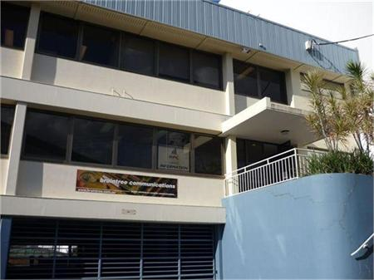
New Building
Lower operating costs
Size and location suits APNIC’s future needs
Google Map Location

Slide 14
Next APNIC Meeting
APNIC 30 Gold Coast, Australia
Participate remotely via webcast, audio streaming, live transcripts.
http://meeting.apnic.net/30

Slide 15
More APNIC Meetings..
APNIC 31 and APRICOT 2011
Hong Kong
21 to 25 February
Joint meeting with APAN
APNIC 33 and APRICOT 2012
22 February – 3 March
Delhi, India

Slide 16
Thank You
you@apnic.net

