Slide 1
Number Resource Policy Development Activities
Louie Lee
Chair, ICANN ASO Address Council
ICANN 39
Cartagena, Colombia
8 December 2010
The ASO is a supporting organization of ICANN

Slide 2
Agenda
About the ASO: MoU, Global Policy, Address Council
RIR PDP: Principles, Roles, Basic Steps
Global Process: Overview, Statistics, “Global Coordinated Policy”
IANA Update
NRO Update
Mitigating the Effects of IPv4 Exhaustion
Global Number Policy and Global Proposals
Regional Activities: AfriNIC, APNIC, ARIN, LACNIC, RIPE
Closing: Questions and Answers, How to Participate
Please ask questions at the end of each section.
2
The ASO is a supporting organization of ICANN

Slide 3
About the ASO: ASO MoU
ASO MoU (dated 21 October 2004)
Agreement between ICANN and the Numbering Resource Organization (NRO)
NRO fulfills the role of the ASO
The NRO Number Council fulfills the role of the ASO Address Council
Defines the Global Policy Development Process (PDP) as a 15-step process
From proposal through adoption by the ICANN Board
Based on the RIR’s PDPs… “…the global policy proposal [will] be placed on the agenda for next open policy meeting in each region, in accordance with the applicable policy process…”
3
The ASO is a supporting organization of ICANN

Slide 4
About the ASO: Global Number Policy
Global Policy
“Global policies are defined within the scope of this agreement as Internet number resource policies that have the agreement of all RIRs [Regional Internet Registries] according to their policy development processes and ICANN, and require specific actions or outcomes on the part of IANA or any other external ICANN-related body in order to be implemented.”*
For the most part global proposals/global policies determine number allocation policy for requests from the RIRs to the IANA (RIRs receive their number resources from IANA)
*Defined in the ASO MoU (dated 21 October 2004)
4
The ASO is a supporting organization of ICANN

Slide 5
About the ASO: The Address Council
Comprised of 15 elected and appointed individuals from all 5 regions
Independent body separate from RIR management and board to:
Oversee global policy development
Appoint 2 ICANN Board of Directors
Serve on ICANN bodies: NomCom, AoC Review Teams
Advise ICANN Board on number resource matters
5
The ASO is a supporting organization of ICANN

Slide 6
RIR PDP: Principles
Open Forum
Open Policy Mailing List
Open Policy Meetings
Transparent
PDP documented
Policies documented
Meetings documented
Bottom Up
Consensus-based
RIRs do not dictate policy, they implement
6
The ASO is a supporting organization of ICANN

Slide 7
RIR PDP: Roles
Community
Submit policy proposals
Discuss policy proposals (in favor or not?)
Consensus Evaluator
Determine consensus
Board
Provide fiduciary and process oversight
Ratify policy
Staff
Conducts assessments of proposal impacts
Implement ratified policy
7
The ASO is a supporting organization of ICANN

Slide 8
RIR PDP: Basic Steps
Community individuals and groups submit a proposal
Community discusses the proposal on the mailing list
Community discusses the proposal at an open policy meeting
Consensus evaluation
Last Call
Adoption
Implementation
8
The ASO is a supporting organization of ICANN

Slide 9
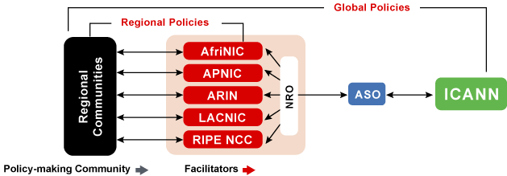
Global Process: Overview
Global proposal discussed/presented at all 5 RIRs per their PDPs
ASO AC members follow and participate in discussions
After adoption by all 5 RIRs proposal forwarded to the ASO AC
9
The ASO is a supporting organization of ICANN

Slide 10
Global Process: Overview (cont.)
ASO AC Proposal Review
Process (RIR PDP) review
Common agreement among RIRs on common text
Adequate consideration of viewpoints
ASO AC forwards proposal to ICANN Board for adoption
ICANN Board adopts, and IANA implements
10
The ASO is a supporting organization of ICANN

Slide 11
Global Process: Statistics
8 Global Proposals (since 2001)
Adopted and implemented as policy = 6
Under discussion = 1
Did not become a global policy = 1
Details of these policies/proposals in later presentation
http://nro.net/policy/index.html#regional
11
The ASO is a supporting organization of ICANN

Slide 12
Global Process: Globally Coordinated Proposal
Review
Global Proposal
Policy about IANA and RIRs
RIR Proposal
Policy about RIRs and their customers
Globally coordinated proposal
Same proposal discussed/presented at each of the RIRs
Normally the goal is to have the same policy worldwide
Processed as normal RIR proposals without triggering action by IANA
Examples include original IPv6 allocation policy and transition policy to 4-byte AS numbers
12
The ASO is a supporting organization of ICANN

Slide 13
IANA Status Update
ICANN, Cartagena
Elise Gerich
VP, IANA
December 2010

Slide 14
Overview
New IANA Whois Server
IDN ccTLDs
AS Numbers Global Policy
IPv4 Status
In other news… multicast

Slide 15
A new whois.iana.org
It now provides responses for:
Unicast IP addresses
Multicast registrations
AS Numbers
DS records

Slide 16
AS Numbers Global Policy
The policy allows each RIR to maintain 2 separate pools of AS Numbers until the end of 2010
The ASO AC sent a proposal (ripe-496) to the ICANN board
The public comment period ended on 13 August
The proposal was ratified in September and is now policy

Slide 17
IPv4 Status 2010
19 /8s have been allocated so far this year
8 have been allocated to APNIC
ARIN & RIPE NCC have each received 4
LACNIC has received 2
AfriNIC has received 1

Slide 18
IPv4 Status 2010
7 unallocated /8s remain
2 will be allocated under the global policy that was ratified in 2005
Then the last 5 blocks will be allocated simultaneously as per the special global policy ratified in 2009
About 3% of total IPv4 space left in the pool.
This equals approximately 100 Million unique addresses.

Slide 19
In other news… multicast
draft-ietf-mboned-ipv4-uni-based-mcast-06 approved
Everyone with a /24 of IPv4 unicast space has also has a multicast /32
234/8 is used for this algorithmic assignment mechanism

Slide 20
In other news… multicast
We are introducing an annual review process for multicast address assignments
We’ll be updating registrant names and contact information as appropriate

Slide 21
Thank you
Questions?

Slide 23
INTERNET NUMBER RESOURCE STATUS REPORT
As of 30 September 2010
Prepared by
Regional Internet Registries
AfriNIC, APNIC, ARIN, LACNIC and the RIPE NCC

Slide 24
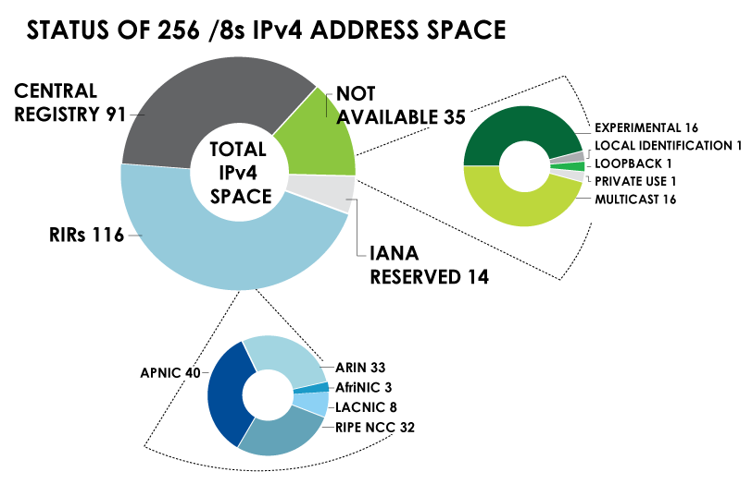
IPv4 ADDRESS SPACE What is the status of each of the 256 /8s?

Slide 25
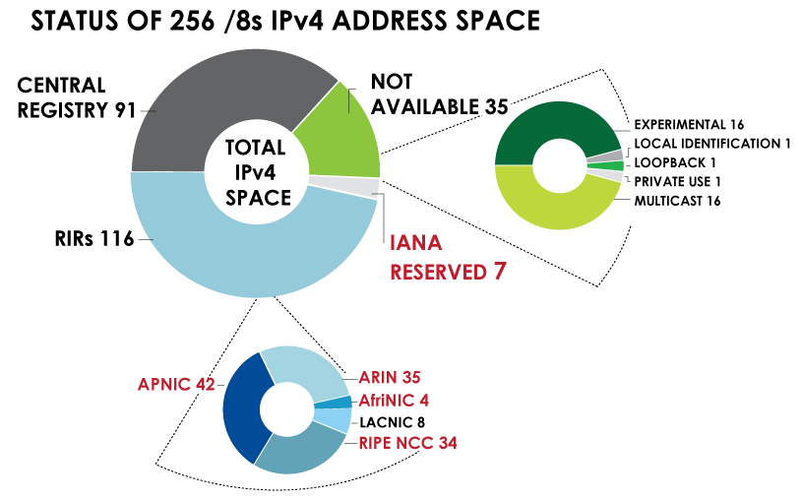
IPv4 ADDRESS SPACE What is the status of each of the 256 /8s? *as of December 2, 2010

Slide 26
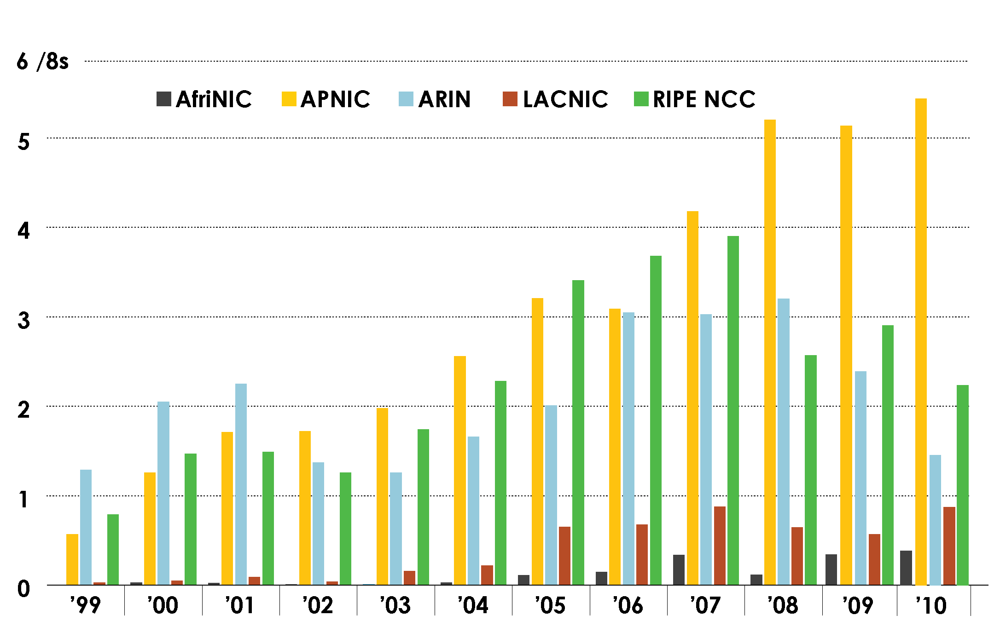
IPv4 ADDRESS SPACE ISSUED (RIRs TO CUSTOMERS) In terms of /8s, how much space did each RIR issue by year?

Slide 27
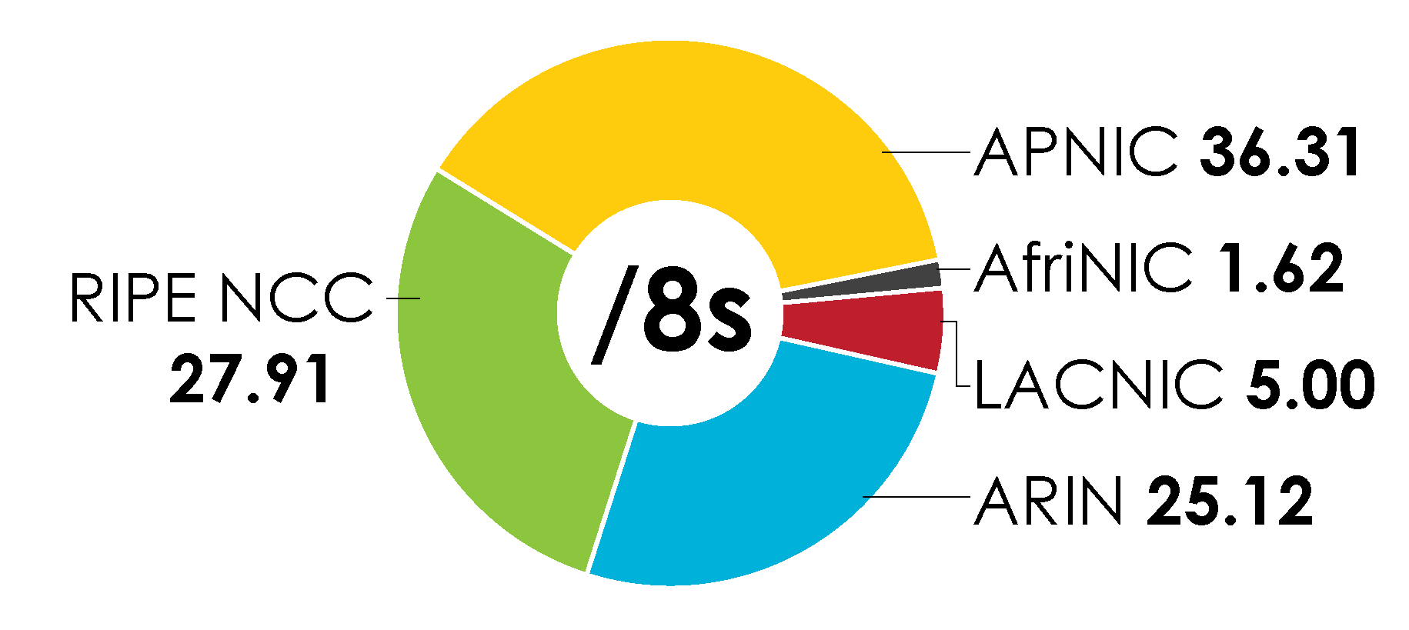
IPv4 ADDRESS SPACE ISSUED (RIRs TO CUSTOMERS) In terms of /8s, how much total space has each RIR issued? (Jan 1999 – Sept 2010)

Slide 28
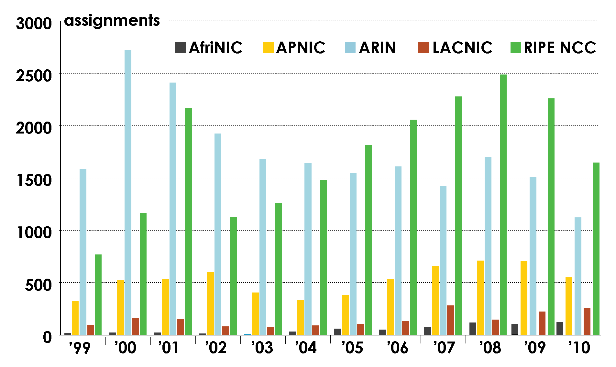
ASN ASSIGNMENTS (RIRs TO CUSTOMERS) How many ASNs has each RIR assigned by year?

Slide 29
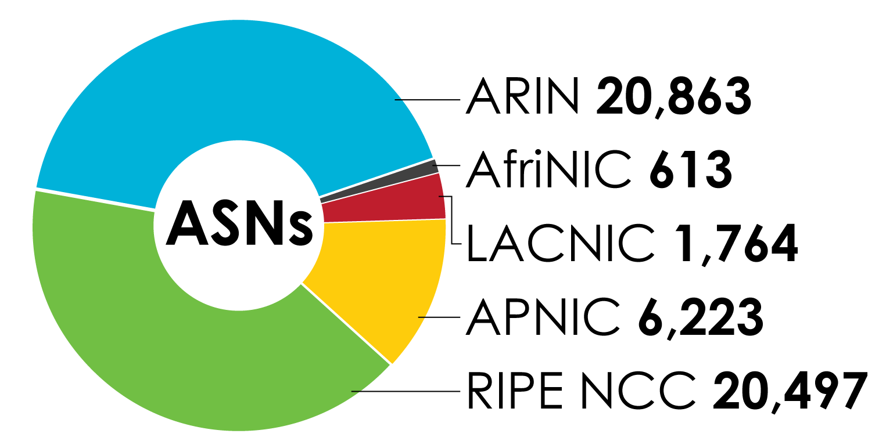
ASN ASSIGNMENTS (RIRs TO CUSTOMERS) How many total ASNs has each RIR assigned? (Jan 1999 – Sept 2010)

Slide 30
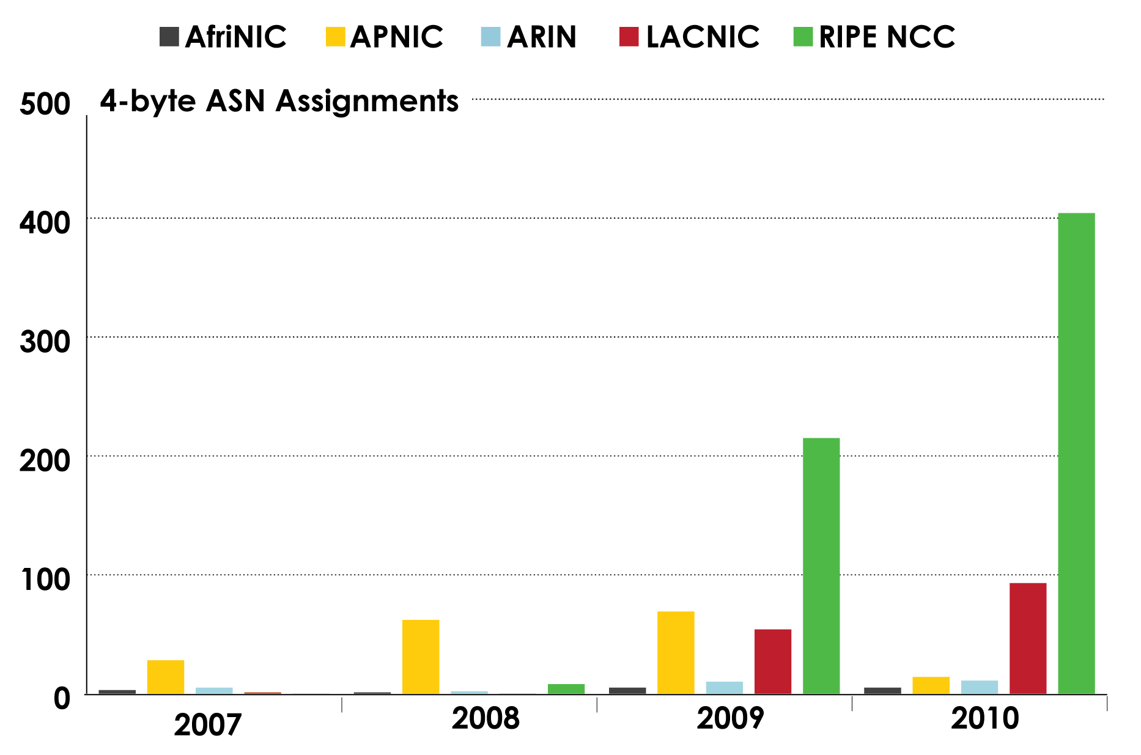
4-BYTE ASN ASSIGNMENTS How many 4-byte ASNs has each RIR assigned by year?

Slide 31
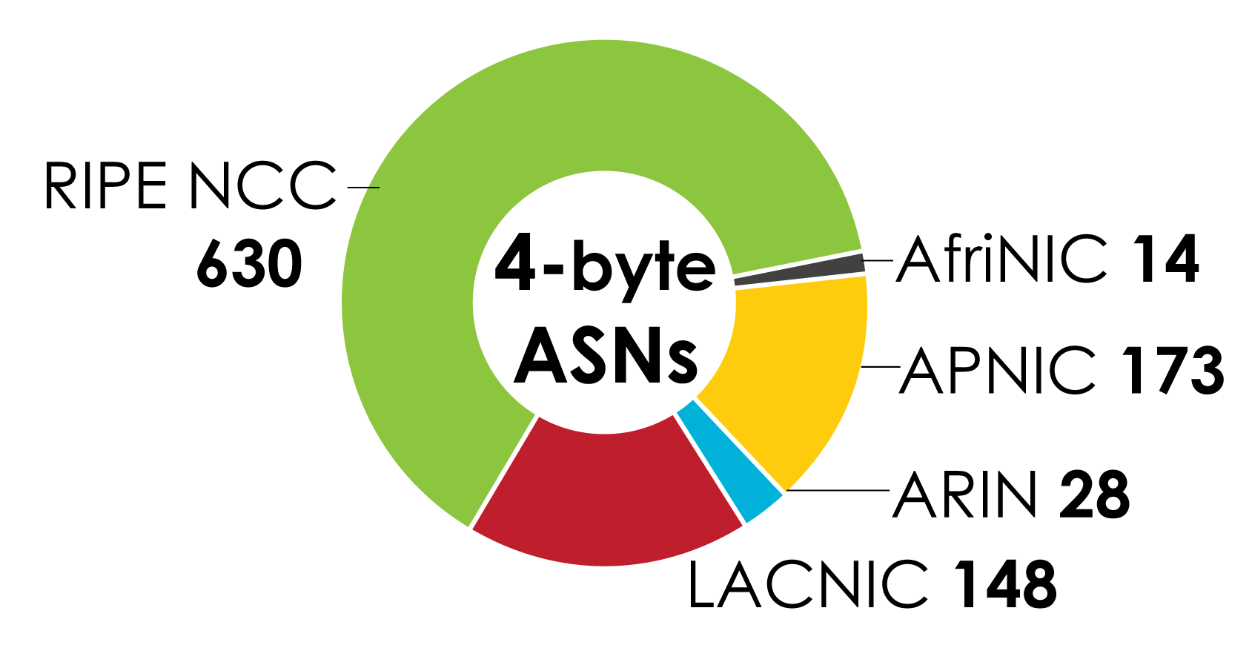
4-BYTE ASN ASSIGNMENTS How many total 4-byte ASNs has each RIR assigned? (Jan 2007 – Sept 2010)

Slide 32
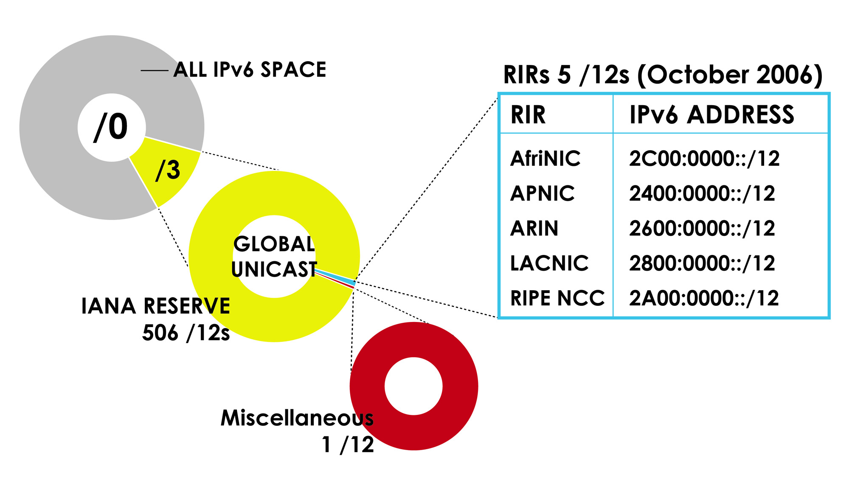
IPv6 ADDRESS SPACE How much has been allocated to the RIRs?

Slide 33
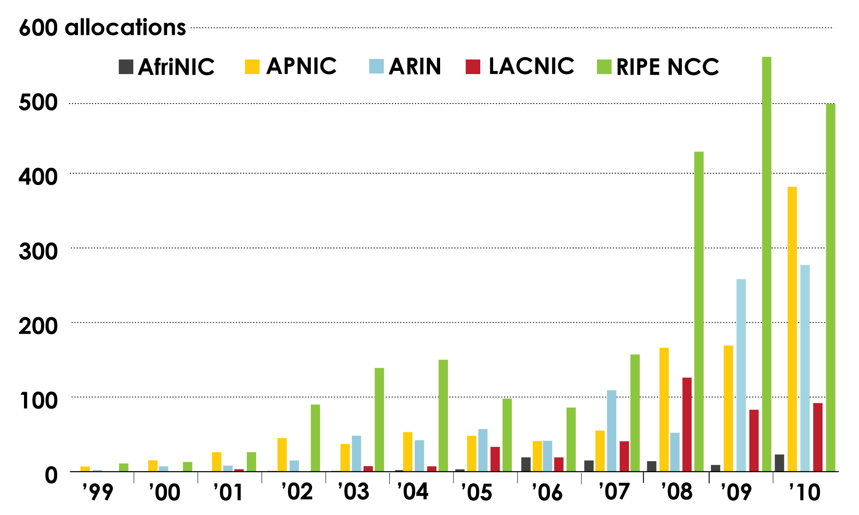
IPv6 Allocations RIRs to LIRs/ISPs How many allocations have been made by each RIR by year?

Slide 34
IPv6 ALLOCATIONS RIRs to LIRs/ISPs (Jan 1999 – Sept 2010)
How many total allocations have been made by each RIR?
In terms of /32s, how much total space has each RIR allocated?

Slide 35
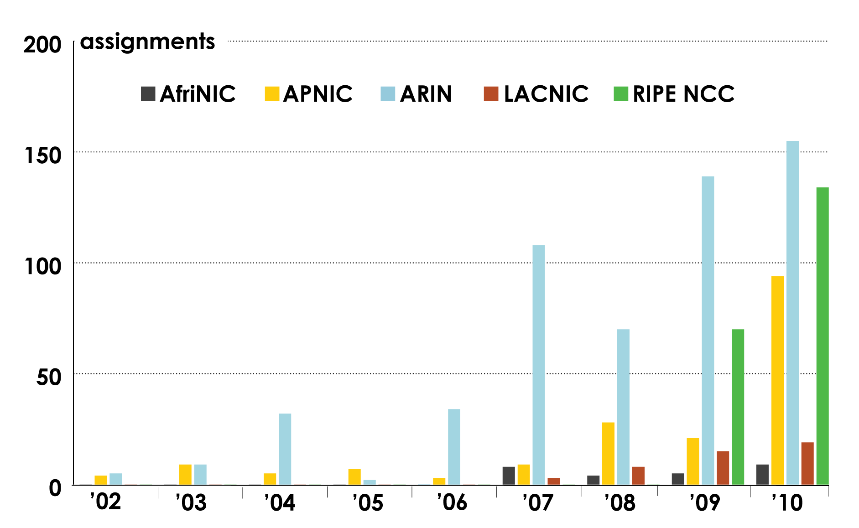
IPV6 ASSIGNMENTS RIRS TO END-USERS

Slide 36
LINKS TO RIR STATISTICS
RIR Stats: www.nro.net/statistics
Raw Data/Historical RIR Allocations: www.aso.icann.org/stats
www.iana.org/assignments/ipv4-address-space
www.iana.org/assignments/as-numbers
www.iana.org/assignments/ipv6-unicast-address-assignments

Slide 37
thank you

Slide 38
Mitigating the Effects of IPv4 Exhaustion
IPv4 activities
Transfer policies
Between organizations within a region
Between RIRs
Soft landing policies
Setting aside special-use address blocks for transition mechanisms (e.g. NAT, infrastructure)
Reducing maximum size address blocks to be allocated
Return to and redistribution by IANA – Global policy
Allows IANA to receive address space from the RIRs
Allows IANA to allocate space back to the RIRs
38
The ASO is a supporting organization of ICANN

Slide 39
Mitigating the Effects of IPv4 Exhaustion
IPv6 activities
Remove certain requirements for obtaining space directly from RIRs
Add alternate means of justification
IPv6 education and outreach
Overall education and outreach
In-person outreach: industry conferences, conventions, ISOC events, etc.
Online education: “how-to”s, compatibility lists, etc.
39
The ASO is a supporting organization of ICANN

Slide 40
Break….
The ASO is a supporting organization of ICANN

Slide 41
Global Number Policy and Global Proposals
Louie Lee
Chair, ICANN ASO Address Council
The ASO is a supporting organization of ICANN

Slide 42
Existing Global Policy
Criteria for Establishment of New Regional Internet Registries (ICP-2* “Internet Coordination Policy”)
Adopted by ICANN Board per ASO AC recommendation on 4 June 2001
October 2002 LACNIC was recognized by ICANN as an RIR
April 2005 AfriNIC was recognized by ICANN as an RIR
Global policy on IANA Allocation of IPv4 address space to the Regional Internet Registries
IPv4 allocations from IANA to the RIRs (unit is /8s, 18-month needs)
Adopted by ICANN Board per ASO AC recommendation on 8 April 2005
Global Policy for Allocation of IPv6 Address Space
IPv6 allocations from IANA to the RIRs (unit is /12s, 18-month needs)
Adopted by ICANN Board per ASO AC recommendation 7 September 2006
*ICP-1 and ICP-3 are DNS policies
42
The ASO is a supporting organization of ICANN

Slide 43
Existing Global Policy (cont.)
Global Policy for Allocation of ASN Blocks to Regional Internet Registries
Autonomous System Numbers allocations from IANA to the RIRs (unit is blocks of 1024 AS numbers)
Adopted by the ICANN Board per ASO AC recommendation 31 July 2008
Global Policy for the Allocation of the Remaining IPv4 Address Space
The last five /8s are reserved, one /8 per RIR from the IANA at the end
Adopted by the ICANN Board per ASO AC recommendation on 6 March 2009
Global IANA Policy for Allocation of ASN Blocks to RIRs
Modified the global ASN policy to allow IANA to process separate 2-byte and 4-byte requests through 2010.
Adopted by the ICANN Board per ASO AC recommendation on 22 July 2010
43
The ASO is a supporting organization of ICANN

Slide 44
Global Proposals
Global Policy for Allocation of IPv4 Blocks to RIRs (2009/2010 timeframe)
Passed in 5 RIRs, but passed in one with revised text
Does not meet the criteria to be advanced by the NRO EC to the ASO AC in its current state
44
The ASO is a supporting organization of ICANN

Slide 45
Global Proposals (cont.)
Global Policy for IPv4 Allocations by the IANA Post Exhaustion
Allows IANA to receive address space from the RIRs
Allows IANA to allocate space back to the RIRs
Status:
AfriNIC – Discussed/presented and sent back to the list for more discussion
APNIC – Discussed/presented and sent back to the list for more discussion
ARIN – Recommendation to adopt (revised, Nov. 2010)
LACNIC – Discussed/presented and sent back to the list for more discussion
RIPE – Discussed/presented and sent back to the list for more discussion
45
The ASO is a supporting organization of ICANN

Slide 46
AfriNIC Policies and Proposals
Alan Barrett
AfriNIC representative, ICANN ASO Address Council
The ASO is a supporting organization of ICANN

Slide 47
AfriNIC Policy Development Process
Anybody can propose a policy
Discussion on Resource Policy Discussion mailing list
Anybody can participate
Discussion at public policy meeting
Two meetings per year
Consensus
Last call on mailing list
Ratification by Board
47
The ASO is a supporting organization of ICANN

Slide 48
AfriNIC IPv4 Policies Discussed in 2010
IPv4 Soft Landing Proposal (AFPUB-2010-GENv4-005)
Deals with IPv4 after the last /8 block is allocated by the IANA
Going to Last Call
Global Policy for IPv4 Allocations by the IANA Post Exhaustion (AFPUB-2010-v4-006)
Under Discussion
48
The ASO is a supporting organization of ICANN

Slide 49
AfriNIC ASN Policy Discussed in 2010
IANA Policy for Allocation of ASN Blocks to RIRs (AFPUB-2009-ASN-001)
Global policy, dealing with the transition from 16-bit to 32-bit AS numbers
Adopted
49
The ASO is a supporting organization of ICANN

Slide 50
AfriNIC Other Policies Discussed in 2010
Policy Development Process (AFPUB-2010-GEN-005)
Minor changes to the policy development process
Adopted
Abuse Contact Information (AFPUB-2010-GEN-006)
Making it easier to report abuse
Going to Last Call
Addition of Real Contact Email into ASN Whois Bulk Data (AFPUB-2010-GEN-007)
Changing the way email addresses are published
Under Discussion
50
The ASO is a supporting organization of ICANN

Slide 51
Participate in AfriNIC Policy Development
View policies and proposals on web page
http://www.afrinic.net/policy.htm
Discuss on Resource Policy Discussion mailing list
https://lists.afrinic.net/mailman/listinfo.cgi/rpd
Discuss at Public Policy Meetings
Next meeting is in Dar es Salaam, Tanzania, 4 to 9 June 2011
Open to everybody
You do not need to be a member of AfriNIC
You do not need to live in Africa
51
The ASO is a supporting organization of ICANN

Slide 52
Thank you
Alan Barrett apb@cequrux.com
AfriNIC representative, ICANN ASO Address Council
The ASO is a supporting organization of ICANN

Slide 53
APNIC Policies and Proposals
Naresh Ajwani
APNIC representative, ICANN ASO Address Council
The ASO is a supporting organization of ICANN

Slide 54
APNIC Recently Implemented IPv4 & IPv6 Policies
Removed IPv4 prefix exchange policy
Permits resource holders to exchange three or more non-contiguous IPv4 blocks in return for a single, larger, contiguous block
Removed aggregation requirement from the IPv6 initial allocation policy
Reduces overall requirements to obtain IPv6 addresses
Other RIR communities are discussing removing aggregation requirements from their policies
Implemented July 2010
54
The ASO is a supporting organization of ICANN

Slide 55
Other Recently Implemented Policies
Removed Abuse contact information
Mandatory reference to IRT objects in the inetnum, inet6num, and aut-num objects in the APNIC Whois Database
55
The ASO is a supporting organization of ICANN

Slide 56
APNIC IPv4 Proposals Under Consideration
Proposals under consideration
Distribution of IPv4 addresses once the final /8 period starts
To handle any IPv4 address space received by APNIC after the final /8 policy
Eligibility for critical infrastructure assignments from the final /8
Each account holder to request & receive a single assignment from the remaining /8 worth of space
Global Policy for IPv4 Allocations by the IANA Post Exhaustion

Slide 57
APNIC IPv6 Proposals Under Consideration
Proposals under consideration
IPv6 address allocation for deployment purposes
Adds alternative criteria for receiving larger than /32 initial IPv6 during deployment phase.
Alternative criteria for subsequent IPv6 allocations
Account holders with existing IPv6 allocations to receive subsequent IPv6 allocations for use in networks that are not connected to the initial IPv6 allocation.

Slide 58
APNIC Other Proposals Under Consideration
Proposals under consideration
Frequent whois information update request
Accuracy of Member’s database.

Slide 59
For more information about APNIC’s activities, please see:
http://www.apnic.net/policy

Slide 60
Next APNIC Open Policy Meeting APNIC 31
Thank You!

Slide 61
ARIN Policy and Proposals
Martin Hannigan
ARIN representative, ICANN ASO Address Council
The ASO is a supporting organization of ICANN

Slide 62
ARIN IPv4 Policies Implemented in 2010
IPv4 Equitable IPv4 Run-Out (2009-8)
Reduces the size of allocations to providers after ARIN receives its last /8
/24 End User Minimum Assignment Unit (2010-2)
Makes it easier for end users to get IPv4 address space (/24s)
62
The ASO is a supporting organization of ICANN

Slide 63
ARIN IPv6 Policy Implemented in 2010
IPv6 for Community Networks (2008-3)
Makes it easier for community networks to request IPv6 space
IPv6 Multiple Discrete Networks (2009-5)
Makes it easier for providers to request multiple/additional IPv6 allocations
Rework of IPv6 allocation criteria (2010-4)
Makes it easier for providers to get initial IPv6 allocations
63
The ASO is a supporting organization of ICANN

Slide 64
ARIN Other Policy Implemented in 2010
POC Validation (2008-7)
Helps to increase the accuracy of POC records
Simplified M&A transfer policy (2010-6)
Makes it simpler to accomplish M&A transfers
Reiterates that unused space must be returned to ARIN
IANA Policy for Allocation of ASNs to RIRs (2009-6)
Extends IANA’s ability to process separate 2-byte and 4-byte ASN requests for the RIRs through 2010
64
The ASO is a supporting organization of ICANN

Slide 65
ARIN Proposal Highlights in 2010
Rework of IPv6 assignment criteria (2010-8)
Makes it easier for end users to obtain larger portions of IPv6 address space
Last call
IPv6 Subsequent Allocation (2010-12)
Makes it easier for providers to obtain additional IPv6 address space (eg. for 6rd)
Moving towards adoption
Global Policy for IPv4 Allocations by the IANA Post Exhaustion (2010-10)
Allows returns to IANA and allows IANA to issue smaller blocks to the RIRs
Moving towards adoption
65
The ASO is a supporting organization of ICANN

Slide 66
ARIN - Brand New Proposals
Globally Coordinated Transfer Policy (PP 119)
RIR to RIR transfers
“Any RIR's resource registrant may transfer IPv4 addresses to the resource registrant of another RIR as long as the two RIRs agree and exercise Internet stewardship and the values expressed in RFC 2050.”
Protecting Number Resources (PP 120)
IPv4 reclamation
“ARIN shall use any reasonable and practical methods to proactively look for fraudulently obtained or abandoned number resources and seek the return of those resources to ARIN.”
66
The ASO is a supporting organization of ICANN

Slide 67
ARIN - Brand New Proposals (cont.)
Sensible IPv6 Allocation for ISPs (PP 121)
Current policy means many requests for /32s.
Easier to get larger IPv6 allocations (nibble boundaries)
Reserved Pool for Future Policy Development (PP 122)
Current policy reserves an IPv4 /10 to facilitate IPv6 deployment (when ARIN gets its last /8).
Keeps the /10 reserved, but more discussion needs to happen to decide how to use it.
Reserved Pool for Critical Infrastructure (PP123)
Reserves an IPv4 /16 for critical infrastructure (exchange points, TLD servers, etc.).
67
The ASO is a supporting organization of ICANN

Slide 68
ARIN - Brand New Proposals (cont.)
Clarification of Section 4.2.4.4 (PP 124)
Currently ISPs can request a 12-month supply of IPv4 address space. At the moment ARIN gets its last /8, supply period reduced to 3-months.
Grandfathers in process requests (lets them get 12-month supply)
Efficient Utilization of IPv4 Requires Dual-Stack (PP 125)
Current policy does not require dual-stack.
Portion of policy text, “All new IPv4 addresses assigned, allocated or transferred to an organization must be deployed on dual-stacked interfaces along with IPv6 addresses.”
68
The ASO is a supporting organization of ICANN

Slide 69
Thank you
Martin Hannigan marty@akamai.com
ARIN representative, ICANN ASO Address Council
The ASO is a supporting organization of ICANN

Slide 70
LACNIC Policy and Proposals
Francisco Obispo
ICANN ASO Address Council
The ASO is a supporting organization of ICANN

Slide 71
LACNIC IPv6 Policies Discussed in 2010
LAC-2007-01 Modifications to the IPv6 Prefix Initial Allocation Policy
The proposal consisted on eliminating the requirement of announcing an IPv6 without the possibility of disaggregation.
Approved and ratified by the board.
71
The ASO is a supporting organization of ICANN

Slide 72
LACNIC IPv4 Policies Discussed in 2010
LAC-2009-04 Transfers of IPv4 Blocks within the LACNIC Region
This proposal enables and defines the rules for performing IPv4 address block transfers between ISPs or end users within the LACNIC region.
Approved and ratified by the board.
LAC-2009-09 Modification: 2.3.3.3. Direct Allocations to Internet Service Providers
To allow ISPs to obtain blocks of their own in those cases that require establishing interconnections with other providers.
Didn't reach consensus. Was presented again at LACNIC XIV.
72
The ASO is a supporting organization of ICANN

Slide 73
LACNIC IPv4 Policies Discussed in 2010 (cont.)
LAC-2010-05 Initial allocation and assignment of IPv4 addresses for ISPs
LAC-2010-06 Assignment to End Users with need of interconnection
To update the “Multihoming” requirement with a more flexible one like “Interconnection Needs”.
Consensus reached
LAC-2010-04 Global Policy for IPv4 Allocation by the IANA post exhaustion
This is a proposal to create a policy allowing for the allocation of IPv4 address space after the depletion of the IANA IPv4 address pool.
Returned to discussion by Policy Forum chairs. Requires more discussion
73
The ASO is a supporting organization of ICANN

Slide 74
LACNIC Other Policies Discussed in 2010
LAC-2010-01 One Public Policy Forum Chair per linguistic community
That the Public Policy Forum be moderated by three chairs, each belonging to one of the linguistic communities corresponding to LACNIC's three working languages: Spanish, Portuguese and English.
Didn't reach consensus. Was abandoned by the proposer.
LAC-2010-02 Election of Chairs through electronic mechanisms
To change the process for electing Public Policy Forum Chairs so that they are elected by electronic means and later ratified by those in attendance at the Public Policy Forum.
Approved and ratified by the board.
74
The ASO is a supporting organization of ICANN

Slide 75
LACNIC Other Policies Discussed in 2010 (cont.)
LAC-2010-03 Inclusion of ASN in the whois when available
Inclusion of origin ASN (provided that it is available) in the information of WHOIS of all the LACNIC’s received prefixes.
Consensus reached
75
The ASO is a supporting organization of ICANN

Slide 76
How to participate…
Public policy mailing list. https://mail.lacnic.net/mailman/listinfo/politicas
List is totally open
In order to submit a policy, you first have to subscribe to the list
Proposals must be submitted using the following web form:
http://lacnic.net/cgi-bin/formpoliticas/sp/formpoliticas.cgi
76
The ASO is a supporting organization of ICANN

Slide 77
Thank you
Francisco Obispo
francisco@obispo.com.ve
ICANN ASO Address Council
The ASO is a supporting organization of ICANN

Slide 78
RIPE Policies and Proposals
Wilfried Woeber
RIPE representative, ICANN ASO Address Council
The ASO is a supporting organization of ICANN

Slide 79
RIPE IPv4 Policy Implemented in 2010
Run Out Fairly (2009-03)
IPv4 address space will be allocated/assigned based on a decreasing allocation/assignment period
9months (now)
6 months (from January 2011)
3 months (from July 2011)
80% Rule Ambiguity Cleanup (2010-04)
clarification of the ’80% rule’ for sub-allocation requests
80% of the utilisation ratio is calculated on all the already allocated space
79
The ASO is a supporting organization of ICANN
Notes:
Run Out Fairly started implementation from Dec 09. Proposal meant to preserve the fairness in the resources distribution even during depletion. Shorter allocation periods reduce overallocations and underutilisation. Requesters of IPv4 address space must present an implementation plan to use the resources at least up to 80% in the following
-9 months now
6 months (Jan 11)
3 months (Jul 11)

Slide 80
RIPE Other Policy Implemented in 2010
Direct Assignment to End User from the RIPE NCC (2007-01)
Defines mandatory for IPv4 assignments the contractual relationship between End Users and IR (LIRs or RIPE NCC)
IANA Policy for Allocation of ASNs to RIRs (2009-07)
IANA and the RIRs will operate ASN allocations from an undifferentiated 4-byte ASN allocation pool from 1 January 2011
80
The ASO is a supporting organization of ICANN
Notes:
2009-07 is a global policy

Slide 81
RIPE Proposal Highlights in 2010
Temporary Internet Number assignment Policies (2010-01)
Collects under only one policy section all the rules for temporary assignments
Last call
Allocations from the last /8 (2010-02)
Defines the distribution of IPv4 address space from the final /8 available
Last Call
Global Policy for IPv4 Allocations by the IANA Post Exhaustion (2010-05)
Some changes to the text were presented at RIPE 61
The new text is available and will enter the PDP
81
The ASO is a supporting organization of ICANN
Notes:
2010-01: Relevant discussion at the RIPE 61 too
2010-05: the new text arrived to the NCC Dec 5 2010.

Slide 82
RIPE - Brand New Proposals
Registration Requirements for IPv6 End User Assignments (2010-06)
Creates an improved and structured registration in the RIPE database for multiple IPv6 sub-allocation
Will enter the Review Phase with the new proposal version
Ambiguity Cleanup on IPv6 Address Space Policy for IXP (2010-07)
Clarifies the conditions for an IXP to receive IPv6 allocations
Will enter the Review Phase
82
The ASO is a supporting organization of ICANN
Notes:
2010-06: the new proposal version translates the Community’s feedback to the proposal. It will be published with the NCC’s assessment (Impact Analysis) in the coming week.
2010-07: the NCC is running the impact analysis.

Slide 83
RIPE - Brand New Proposals
Abuse Contact Information (2010-8)
Defines rules to improve the registration and the availability of the abuse contact data in the RIPE database
Discussed at RIPE 61, proposal text will be revised
Globally Coordinated Transfer Policy
Presented by authors at RIPE 61
Plans to start the PDP
83
The ASO is a supporting organization of ICANN

Slide 84
Thank you
Wilfried Woeber
Woeber@CC.UniVie.ac.at
RIPE representative, ICANN ASO Address Council
The ASO is a supporting organization of ICANN

Slide 85
Closing: Questions and Answers
Louie Lee
Chair, ICANN ASO Address Council
The ASO is a supporting organization of ICANN

Slide 86
How to Participate
Watch the ASO AC site for news about new global proposals
http://aso.icann.org/
Participate in the Policy Discussions in your RIR region
Global proposals are discussed on the RIR’s policy mailing lists and at open policy meetings
Subscribe and participate on the appropriate list and attend open public policy meetings (remote participation enabled)
Open, no membership requirements
State your opinion
86
The ASO is a supporting organization of ICANN

Slide 87
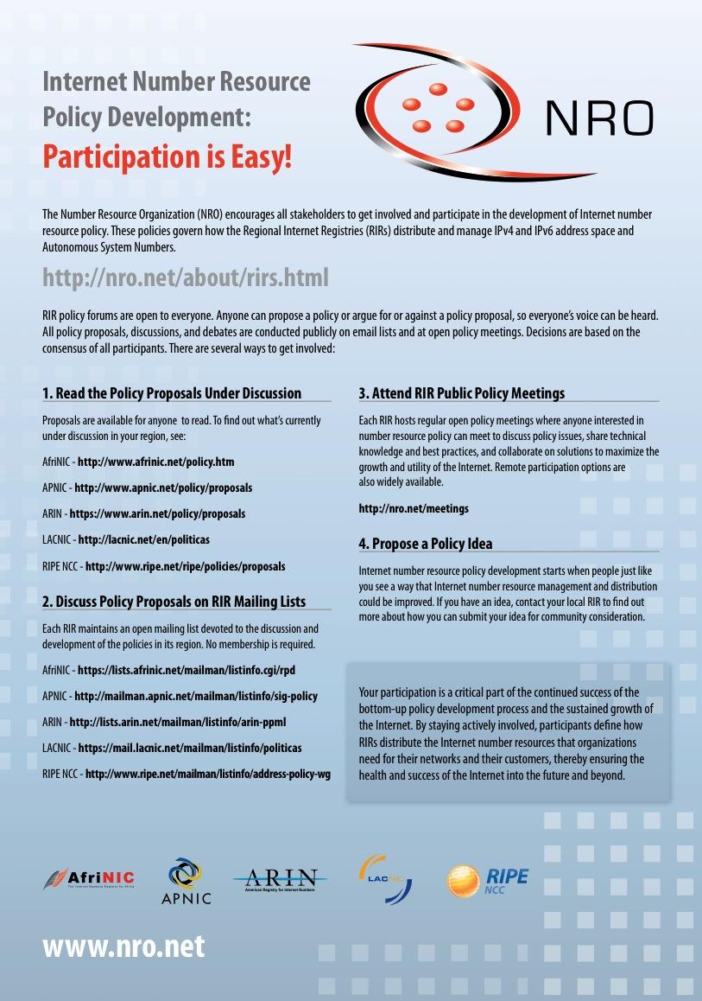
Participation is Easy!
Subscribe to the RIR policy list(s)
No membership requirements
Attend RIR meetings
In person (open, nominal fee)
Remote (free)
87
The ASO is a supporting organization of ICANN

Slide 88
Visit the NRO Booth
88
The ASO is a supporting organization of ICANN

Slide 89
Thank you. Questions?
Louie Lee
louie@louie.net
Chair, ICANN ASO Address Council
The ASO is a supporting organization of ICANN

