Slide 1
IPv6 end client measurement
George Michaelson
ggm@apnic.net

Slide 2
Setting the scene
Adding IPv6 to your website may have risks
  Will your clients still be able to ‘see’ you?
  What % of clients will experience issues?
Finding out in advance what to expect is useful
  A way to measure end-user behavior
  Without affecting your own website investment
Measuring failure is hard!
  Website logs only measure successful connections

Slide 3
Adding IPv6 to your website may have risks
Windows hosts experience problems with dual-stack (IPv4, IPv6) DNS records
  May refuse to connect to the IPv4 address
Some hosts cannot process IPv6 DNS properly
  Not supported in all DHCP backed configurations
‘Partial IPv6’ problems
  Locally IPv6 enabled, no IPv6 route to global Internet
Loss of eyeballs = Loss of revenue?
  When your core business presents via the web, what risks to loss of web access are you willing to take?

Slide 4
Finding out in advance what to expect
Find a way to measure client behavior
without having to add IPv6 to your website
  Leverage cross-site URL fetches
Integrate measurements into existing tracking methods, and analytics framework
  Avoids key business intelligence leakage to third parties
  No new tools needed

Slide 5
Measuring failure is hard!
Web logs record completed TCP/IP events
  Even 4xx and 5xx responses in logs are completed valid TCP/IP sessions
What about the people who failed to connect?
  Not in access- or error- logs
Only partially visible on-the-wire
  Characteristic missing ‘SYN/ACK’ sequence in TCP signals failure to complete a 2-way handshake
But (inside a time limit) client knows what worked or failed: and can report back.

Slide 6
APNIC’s web measurement system
Built on google ‘analytics’ method
  Javascript, highly portable
  Asynchronous, runs in the background
    after page render already complete
  Uses DNS wildcards, uncacheable
Data integrated into google analytics reports
  Graphs of ‘events’ to monitor IPv4, IPv6 and dual-stack
Configurable by website manager
  Sample or every connection, extra tests etc

Slide 7
Measuring by 1x1 invisible pixels
Javascript requests sequence of 1x1 pixel images
  Images fetched but not included in the DOM so not displayed
  Image fetches take place after DOM render,
  do not add delay to page view, invisible
    (may be seen in browser status bar, error report windows)
  Javascript callback records success/time
Image fetches from unique DNS names
  Every client is a fresh name, no cached state
  Nothing in DNS name identifies your website, unique number to distinguish testcases in APNIC weblogs only
Client reports timing, connect failures
  to your analytics report as a results/summary field
  Can account for ‘unable to connect’ TCP/IP failure

Slide 8
What is tested?
Basic test set is dual-stack, IPv4, IPv6
  Dual stack enabled DNS behind all fetches
Additional (optional) tests
  IPv6 literal
    (bypasses many IPv6 suppression settings)
  IPv6 DNS
    (can be visible to user, stress-tests DNS)
  Tunnel detection
    URLs only reachable from Teredo and 6to4 source IP addresses
Results reported over IPv4 only URL to APNIC
  Aggregate stats reporting, trends etc. Anonymous

Slide 9
Adding the measurement

Slide 10
Adding the measurement
….To your web-page Markup….

Slide 11
Adding the measurement
….To your web-page Markup….

Slide 12
Adding the measurement
Find your ‘Google Analytics’ Block (or add one)

Slide 13
Adding the measurement
Add the ‘APNIC’ analytics block

Slide 14
And login to Analytics!

Slide 15
Results in Analytics

Slide 16
Results in Analytics

Slide 17
Results in Analytics

Slide 18
Results in Analytics

Slide 19
APNIC Aggregate Results
APNIC is collating measurement results online at
http://www.potaroo.net/stats/1x1/
Along with some interesting specific-site sub reports

Slide 20
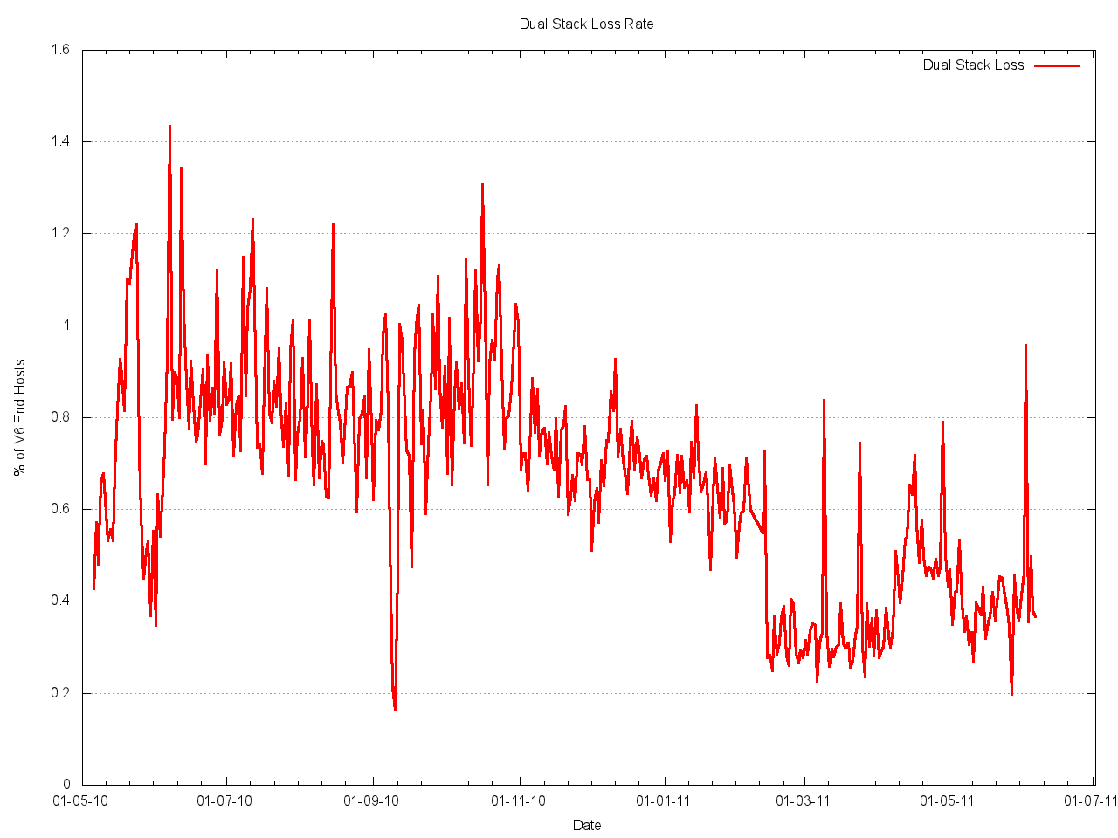
APNIC Aggregate Results
Dual Stack Loss rate

Slide 21
Dual Stack Loss
4 in 1000 clients are unable to fetch a web URL if presented with a dual-stack DNS name
Older (windows XP) hosts, browsers
If you are in a mission-critical role, something to think about,
  but not necessarily a reason to hold off on IPv6 deployment
  Consider comparisons to other loss rates caused by un-related problems
    Noisy links, adblockers, congestion/packetloss

Slide 22
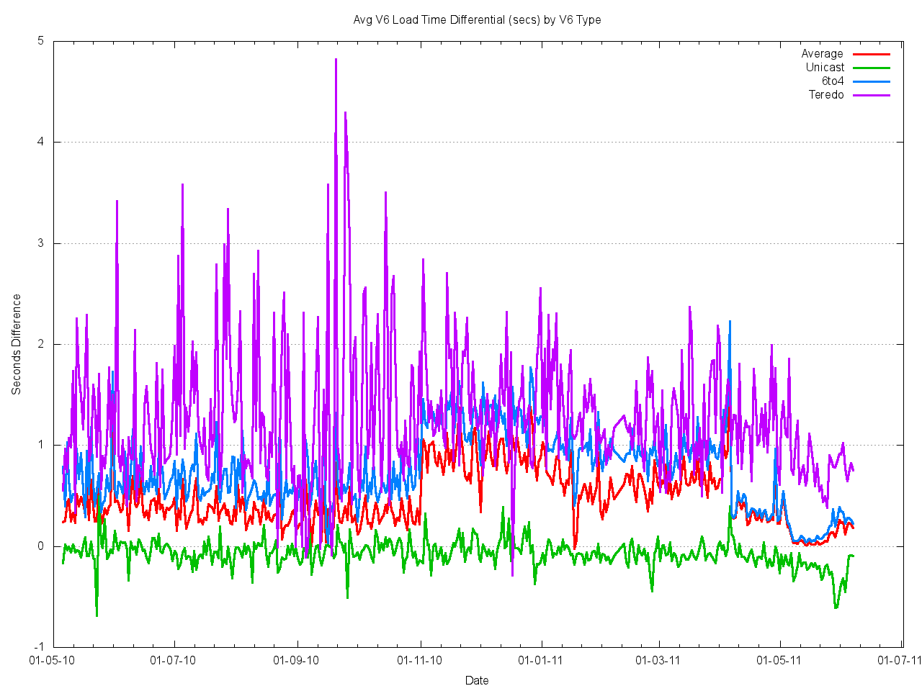
APNIC Aggregate Results
V6 Load time differential

Slide 23
V6 Load time differential
IPv6 is not necessarily slower than IPv4 on average
  Sub-1sec additional delay, sometimes faster
Tunneled IPv6 can be significantly slower
  Tunnel establishment costs, sub-optimal routing can add multi-second delay
  Teredo significantly slower
  Another indication ‘ad hoc’ tunnels are bad.

Slide 24
‘Can’ vs ‘Will’
IPv6 de-preferenced in DNS, browser
  Teredo/6to4 lower preference than IPv4
But.. If you bypass DNS and give a literal IPv6 address in a URL, you can explore who actually CAN do IPv6, if they try.
  If you try a bit harder, who CAN use IPv6?

Slide 25
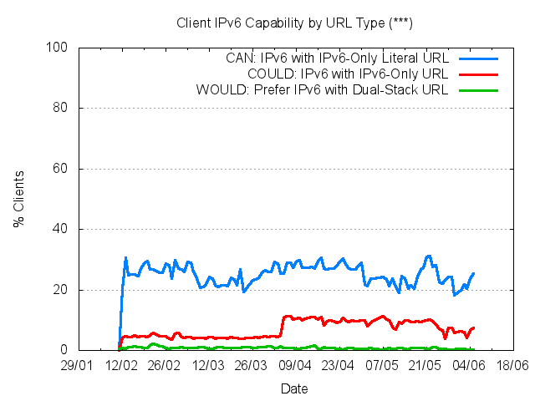
‘Can’ vs ‘Will’

Slide 26
20% IPv6 capable!
Increases Teredo/6to4 Tunnel connection rate
  Higher failure rate follows, so demonstrates issues in automatic tunneling
Encouraging signs end-user hosts now increasingly able to use IPv6, if deployed

Slide 27
Interested?
HTTP://labs.apnic.net/
  Complete instructions on how to add markup to your website
  ‘Test your own IPv6’ feature displayed too!
Aggregated results updated daily
Other measurement methods being explored
  Will be updated on the labs.apnic.net site.

