Slide 1
APNIC Update
AfriNIC-14
4-10 June 2011
Sanjaya
Services Director, APNIC

Slide 2
Overview
Registry Update
Policy Update
2011 Member and Stakeholder Survey
New Building & Business Continuity Plan
Upcoming Meetings

Slide 3
Resource Delegations
IP address & ASN delegation count
Notes:
IPv6 delegations more than tripled in 2010
In 2010, we had 121 million IPv4 addresses delivered to our customers. But we have 212 million /48 iPv6 networks deployed. Now it’s a matter of seeing how people start routing them.

Slide 4
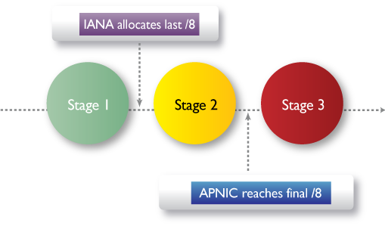
Registry Update
IPv4 exhaustion
Now in stage 3, as of 15 April 2011
IANA handed out APNIC’s last /8 block, 103/8, on 3 February 2011

Slide 5
Registry Update
2010 IPv6 delegations more than tripled
650 delegations in 2010
Strong response to “Kickstart IPv6” with over 402 new applications
Members with existing IPv4 allocations or assignments may instantly qualify for an IPv6 block
Notes:
Kickstart IPv6:
- A result of prop-073
Using MyAPNIC, users click the appropriate link to receive delegation
Members with an IPv4 allocation, eligible for a /32 of IPV6
Members with an IPv4 assignment, eligible for a /48 of IPv6

Slide 6
Policy Update
Implemented in 2010
Proposal | Title | Overview
Prop-079 * Implemented November 2010 | Abuse contact information | A proposal to introduce a mandatory abuse contact field for objects in the APNIC Whois Database to provide a more efficient way for abuse reports to reach the correct network contact
Prop-080 * Implemented July 2010 | Removal of IPv4 prefix exchange policy | A proposal to remove the policy that currently permits resource holders to return three or more noncontiguous IPv4 address blocks and have the prefixes replaced with a single, larger contiguous block.
Prop-082 * Implemented July 2010 | Removing aggregation criteria for IPv6 initial allocations | A proposal to remove the aggregation requirement from the IPv6 initial allocation policy

Slide 7
Policy Update
Reached consensus at APNIC 31
Proposal | Title | Overview
Prop-083 | Alternative criteria for subsequent IPv6 allocations * Reached consensus on revised text | A proposal to enable current APNIC account holders with existing IPv6 allocations to receive subsequent IPv6 allocations from APNIC for use in networks that are not connected to the initial IPv6 allocation.
Prop-088 | Distribution of IPv4 addresses once the final /8 period stars | A proposal to handle any IPv4 address space received by APNIC after the final /8 policy is implemented as being part of the final /8 pool and to redistribute these resources according to the final /8 policies.
Prop-093 | Reducing the minimum delegation size for the final /8 policy | A proposal to change the minimum size of IPv4 delegations to a /24 when the final /8 policy is activated.
Prop-094 | Removing renumbering requirement from final /8 policy * Reached consensus on revised text | A proposal to remove the requirement for organizations receiving their initial allocation from APNIC to renumber out of their previously deployed space when they are allocated addresses under the final /8 policy.

Slide 8
Policy Update
Reached consensus at APNIC 31
Proposal | Title | Overview
Prop-095 | Inter-RIR IPv4 address transfer proposal * Reached consensus on revised text | A proposal to allow and define a mechanism for the transfer of IPv4 address space between APNIC account holders and organizations in other RIR region(s), providing that the counterpart RIR has a policy that allows transfers of address space with APNIC account holders.
Prop-097 | Global policy for post exhaustion IPv4 allocation mechanisms by the IANA | This proposal describes the process that IANA will follow to allocate IPv4 resources to Regional Internet Registries (RIRs) after the central pool of addresses is exhausted. The processes for how IPv4 space may be placed in the IANA Recovered IPv4 Pool is out of the scope of this proposal.

Slide 9
Member Survey
2011 Member and Stakeholder Survey conducted by Prof. Ang Peng Hwa on behalf of the APNIC Executive Council
Overall, membership generally satisfied with APNIC services. Rated 8.09 out of 10.
794 valid responses from 47 economies
Increase of 32% from previous surveys
40% support IPv6, but interestingly, only 20% have the budget for it

Slide 10
Member Survey – Top Ten
A.1.1. Overall, the services provided by APNIC are satisfactory. | 8.09
A.1.3. APNIC communicates in a way that meets my needs. | 7.83
A.2.4. APNIC should provide 24/7 Helpdesk operation for critical services. | 7.79
A.3.1. The APNIC Helpdesk provides timely and appropriate responses for billing and administration enquiries. | 7.76
A.2.3. The APNIC Helpdesk provides timely and appropriate responses to technical and service enquiries. | 7.74
B.4.3. APNIC should establish more partnerships to support training and education for organizations in need. | 7.71
A.2.8. APNIC should spend more effort informing network operator communities on routability/reachability issues. | 7.67
A.2.2. APNIC resource allocation services (IPv4, IPv6 and ASNs) are adequate in response time and relevance. | 7.63
B.1.3.1. The APNIC Whois Database operates at a high level of quality, usability and reliability. | 7.63
B.1.3.2. The APNIC Reverse DNS service operates at a high level of quality, usability and reliability. | 7.63

Slide 11
Member Survey – Bottom Ten
B.5.5. There are suggestions that a Government-Advisory Committee, similar to ICANN's, be formed for APNIC. Do you agree? | 6.28
B.5.1. Should governments in the Asia Pacific region be more involved in APNIC? | 6.35
A.1.4. APNIC should provide support in more languages than it currently supports. | 6.37
B.1.1.2. APNIC needs a Policy Development Process that allows policies to change more frequently. | 6.49
B.4.7. APNIC eLearning contents are relevant to my organization. | 6.60
B.5.2. APNIC's current level of engagement with governments in the Asia Pacific region is fine. | 6.61
B.4.2. I am satisfied with the cost of APNIC training. | 6.70
A.2.7. APNIC should provide consultancy services specific to individual Member's needs on a user-pays basis. | 6.84
B.1.2.2. The remote participation options (video and audio streams, live session transcripts, chat rooms and archived media) at APNIC Meetings are easy to use. | 6.93
A.3.2. The APNIC fee structure is reasonable and justified. | 6.97

Slide 12
Member Survey – Top Ten Resourcing Priorities
A.4.2.2. Support IPv6 deployment. | 1.85
A.4.3.3. Routing and registry security improvements. | 2.17
A.4.3.1. Do more research and development activities, such as network monitoring and measuring. | 2.25
A.4.3.2. Publish statistics, analysis, and articles about Internet development and use. | 2.40
A.4.1.4. Support network engineering education in the Asia Pacific region. | 2.41
A.4.1.1. Expand APNIC involvement in the support and development of regional operator forums (eg, NOGs, IPv6 groups etc.). | 2.42
A.4.1.2. Represent the needs of the Asia Pacific Internet community (including governments, regulators and technical organizations) in Internet Governance. | 2.46
A.4.2.1. Streamline resource requests and allocation processes. | 2.48
A.4.1.3. Expand training activities in scope, geographical coverage, and online options. | 2.48
A.4.2.3. Enhance the reliability and availability of APNIC services. | 2.64

Slide 13
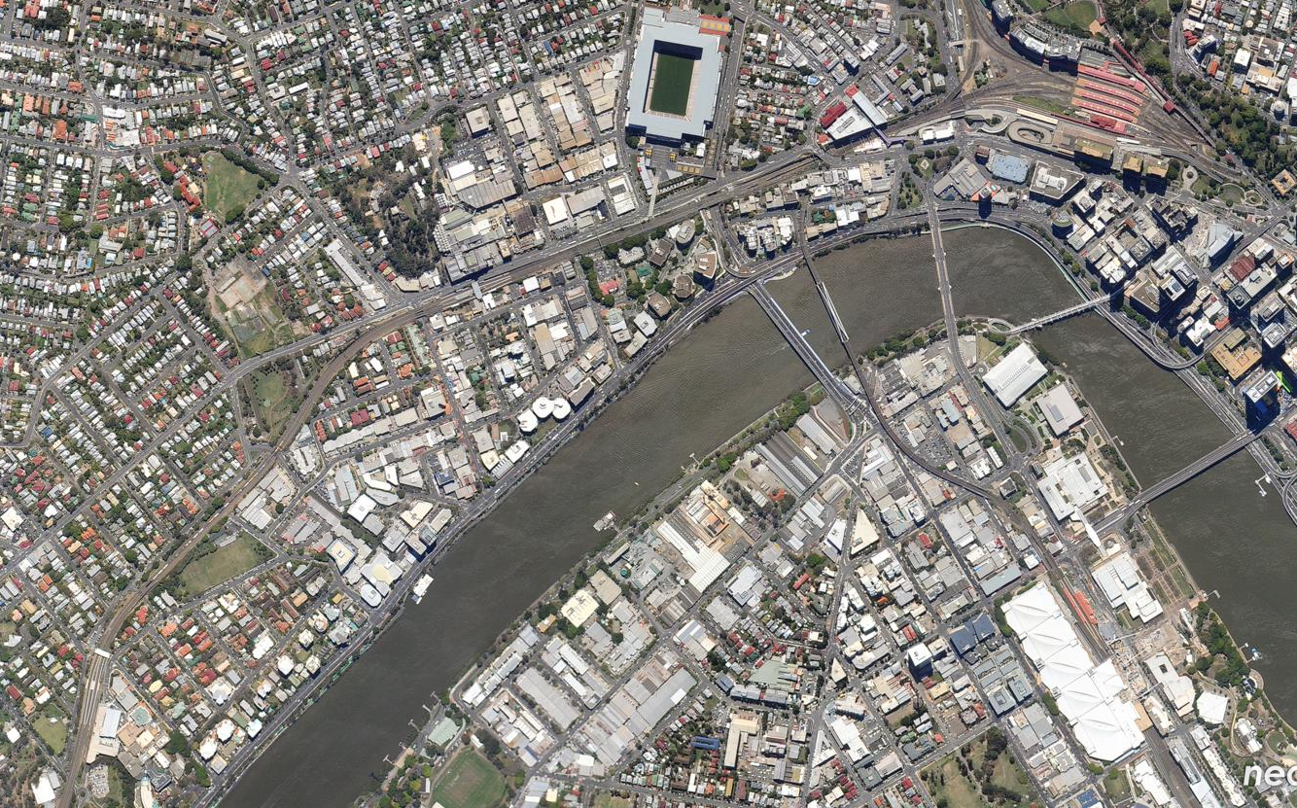
APNIC moved…
12 Jan 2010

Slide 14
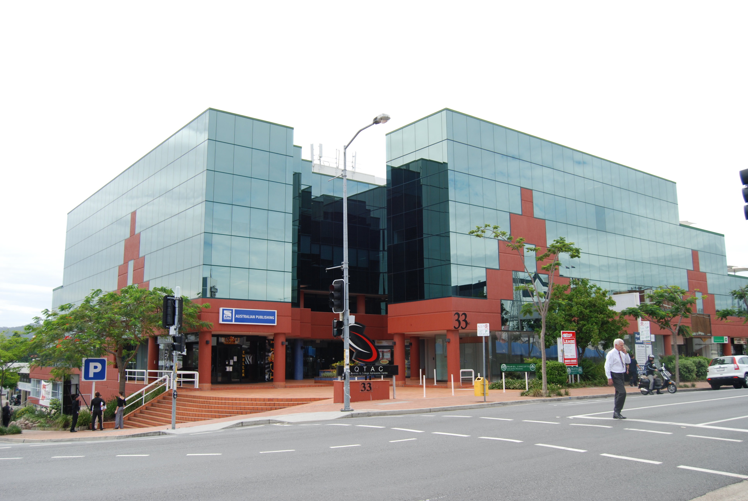
New Building
Moved into new premises at end of 2010
Old
New

Slide 15
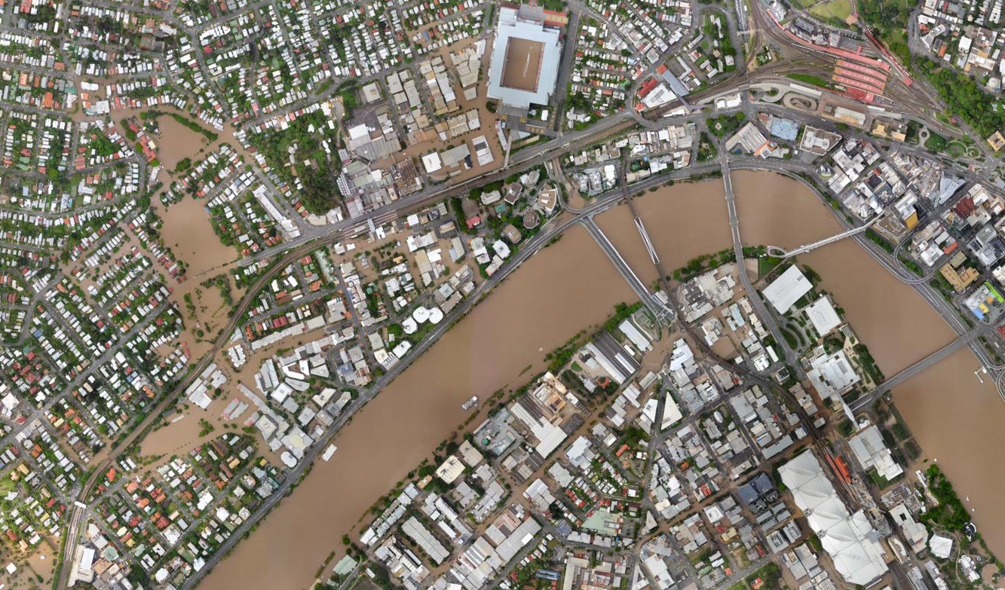
… just in time!
13 Jan 2011

Slide 16
APNIC BCP Incident
Flood event in Brisbane, 10-14 January 2011
BCP Team engaged
Staff safety priority
In monitoring mode as no disaster declared
Continued communication with Members throughout
Post-evaluation and assessment

Slide 17
Next Meeting – APNIC 32
Where: Busan, South Korea
When: Sunday, 28 August - Thursday, 1
September 2011
Notes:
Change in the original dates, now starting a day before.

Slide 18
Following Meetings
APNIC 33, Delhi, India, 21 February - 2 March 2012, New Delhi (with APRICOT)
APNIC 34, TBD
APNIC 35, Singapore, 20 February – 1 March 2013, Singapore (with APRICOT)

