Slide 1
APNIC Update
AfriNIC 13
20-26 November 2010
Johannesburg, South Africa
George Kuo
Member Services Manager, APNIC

Slide 2
Resource Services
IPv4 requests still strong (5.94 x /8)
Mobile, wireless, ADSL networks
Growth economies: CN, KR, JP, IN, VN
Very high IPv6 take up
584 delegations in 2010 so far (188 in 2009)
Resource Quality Assurance
APNIC tests all IANA allocations prior to distribution
Outreach to network operators to remove outdated filters
36.0.0.0/8 and 42.0.0.0/8 being tested

Slide 3
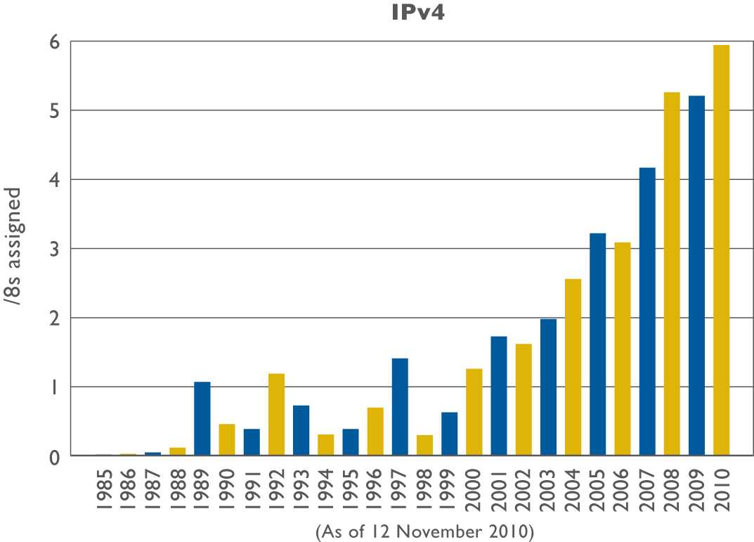
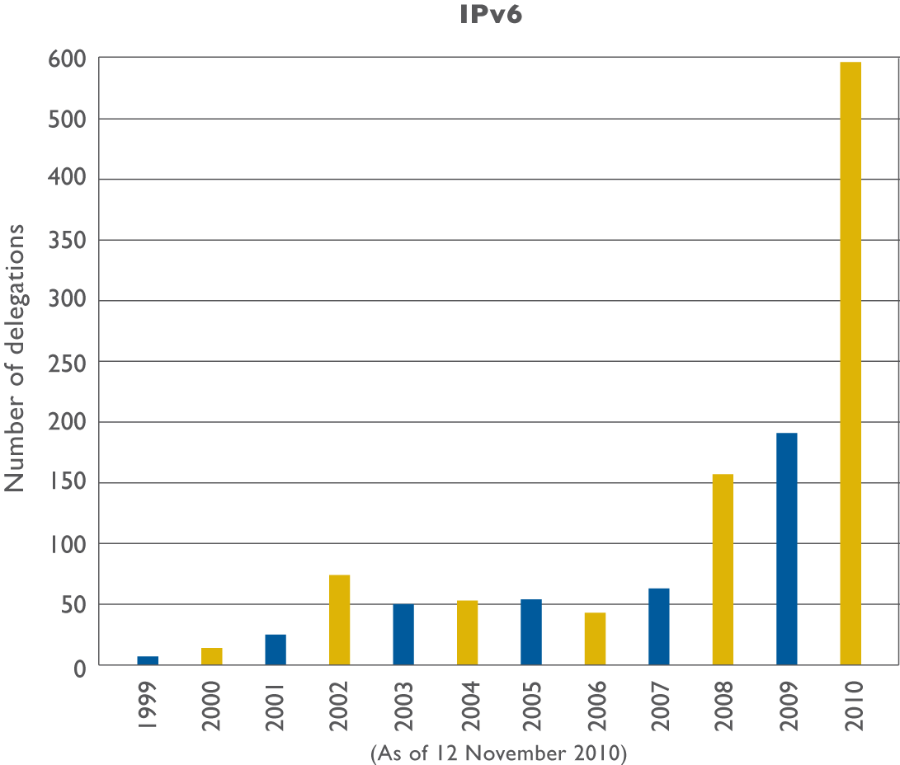
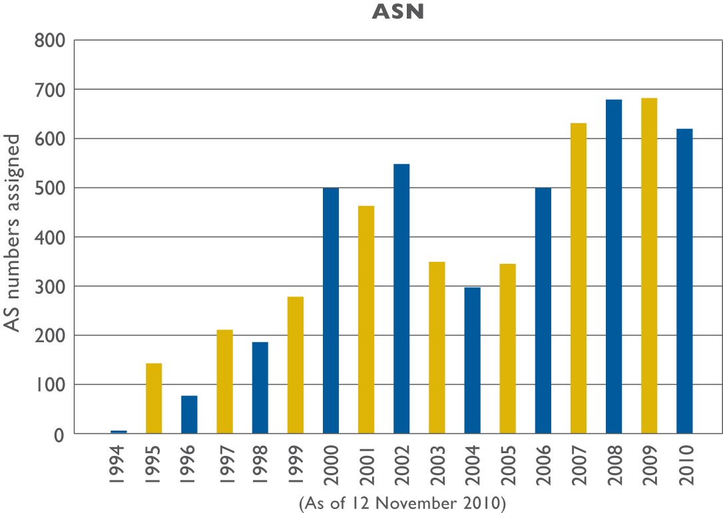
Resource Delegations

Slide 4
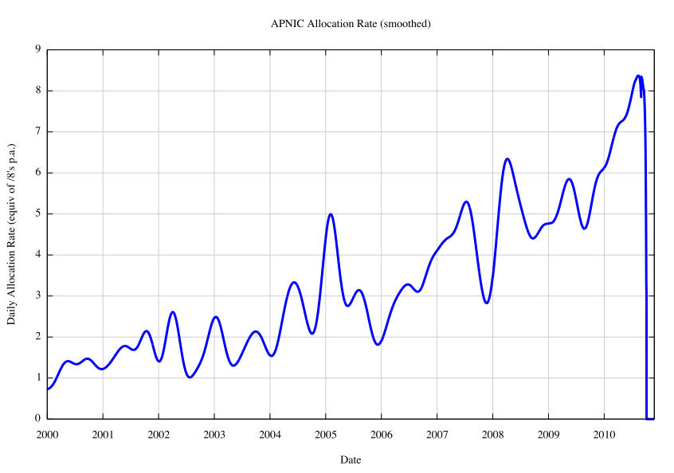
A Closer Look at APNIC’s IPv4 Allocations

Slide 5
Member Services
APNIC Members: 2,432
New Members in 2010: 366
Growth over 300 for the last three years
MyAPNIC
Total users: 3,180
Multiple accounts management
Streamlined CA process
Helpdesk
Email, Phone, VoIP & Chat
Extended hours from 9 am – 9 pm

Slide 6
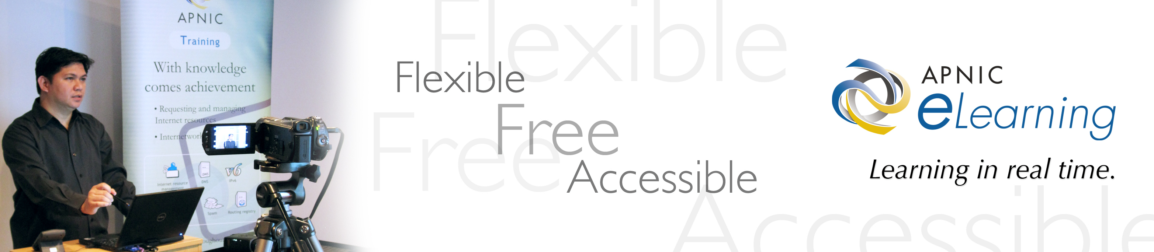
Training and Education
eLearning Interactive
Successfully offering two sub-regional training courses per month:
20 eLearning web classes
271 attendees
Notes:
First elearning class of the month is IRME, second is about a specific course, DNS, routing, IPv6, IRR

Slide 7
APNIC Policy Updates
Proposal | Title | Overview
Prop-079 Implemented 8 Nov 2010 | Abuse contact information | This is a proposal to introduce a mandatory abuse contact field for objects in the APNIC Whois Database to provide a more efficient way for abuse reports to reach the correct network contact.
Prop-080 Implemented 5 July 2010 | Removal of IPv4 prefix exchange policy | This is a proposal to remove the policy that currently permits resource holders to return three or more noncontiguous IPv4 address blocks and have the prefixes replaced with a single, larger, contiguous block.
Prop-082 Implemented 5 July 2010 | Removing aggregation criteria for IPv6 initial allocations | This is a proposal to remove the aggregation requirement from the IPv6 initial allocation policy.
No policy proposals reached consensus during APNIC 30
http://www.apnic.net/policy/proposals

Slide 8
Research and Development
RPKI (joint with other RIRs/NRO)
DNS service dynamics
Expanded network measurement/monitoring
Test Traffic Measurement (TTM)
‘Day In the Life of the Internet’ (DITL)
3.4Tb of data collected over 3 days in 2010
IPv6 deployment measurement activities
Notes:
RPKI: we're working in cooperation with the other RIRs towards the NRO deliverable, in particular we sent a software engineer to AfriNIC to help with their development process
- Expanded monitoring: we're deploying RIPE Test Traffic Measurement devices around the Asia Pacific region, and participating in the large scale data capture and analysis experiment "Day in the Life" for our name servers.
- IPv6 measurement: we're monitoring IPv6 capability for end users via web site scripts, to see what edge uptake is like. - New co-lo facility: we've added another co-lo with a triangle architecture of fibre connecting office, co-lo 1 and co-lo 2, to provide path and site redundancy

Slide 9
Technical Developments
New co-location facility in ‘triangle architecture’ for reliability and disaster recovery plan
DNSSEC implementation
Signing of all APNIC zones completed April 2010
Cooperation with other RIRs on ERX ranges
Implementing Agile software development methodologies
More efficient and better suited to user requirements
Notes:
DNSSEC: we signed our zones, and are working in cooperation with the other RIRs to ensure we can exchange signed zones for the ERX ranges
- Agile: we're using Agile software development to be more responsive to change, more efficient, and better suited to end user requirements.

Slide 10
IPv6 Program Update
APNIC is the new Secretariat for the Asia Pacific IPv6 Task Force (APIPv6TF)
Conducted two IPv6 workshops with APEC TEL WG 2010:
APEC TEL 41: Taipei, Taiwan
Transforming the Internet
APEC TEL 42: Bandar Seri Begawan, Brunei Darussalam
Securing sustainable growth of the Internet
Notes:
The key message is "APNIC significantly contributed APEC TEL on IPv6 and also the Ministerial Statement to include IPv6 in its sentence in relation to APEC's Broadband penetration goal."
APNIC has been participating actively in the Asia Pacific Economic Cooperation Telecommunications and Information Working Group.APECTEL aims to improve telecommunications and information infrastructure in the Asia-Pacific region by developing and implementing appropriate telecommunications and information policies APEC is made of 21 economies from the pacific rim. APNIC is part of APEC as Member Guest.
Workshop on IPv6: Transforming the Internet APEC Tel 41
Building upon knowledge gained at the APEC TEL 40 workshop
Learning about current best practices of IPv6 deployment for governments
Observing demonstrations of IPv6 implementation
Gaining additional technical information
Examining case studies of successful IPv6 implementation
Discussing the possibility of a TEL IPv6 action plan for APEC TELMIN 8 in October 2010
Workshop on IPv6: Securing sustainable growth of the Internet APEC TEL 42
Build upon knowledge gained at the APEC TEL 40 and TEL 41 IPv6 workshops
Learn about global IPv6 deployment status, as well as deployment among APEC TEL member economies
Understand the meaning of a "dual-stack" Internet
Exchange information about IPv6 deployment successes
Learn and understand critical technical information related to IPv6
Learn more about human capacity building opportunities
Encourage cross-fora activities among Infrastructure Development Steering Group (DSG), Security and Prosperity Steering Group (SPSG), and Liberalization Steering Group (LSG) if possible (e.g. inviting speakers and moderators from these fora)
The major outcome of the APEC TEL 41 IPv6 workshop in May 2010 was an agreement among participants that the APEC TELMIN8 Declaration should include a call to action and the recognition of the need for IPv6 adoption. This declaration will be announced in October 2010.
Participants also agreed that the TELMIN8 statement should consider tying the 2015 broadband penetration goal to IPv6 uptake. For more information, please refer to the Report on the APEC TEL 41 IPv6 Workshop - IPv6: Transforming the Internet. The TEL 42 IPv6 workshop will build upon these positive outcomes by focusing on more detailed actions to be taken by the APEC TEL member economies.

Slide 11
APEC TELMIN8 Ministerial Statement
APNIC participated APEC TELMIN8 in Okinawa, Japan 30 – 31 Oct 2010
Heads of the Ministries of information and communications
APEC TELMIN8 reiterates importance of IPv6 deployment in the Asia Pacific
“We recognize that the free pool of IPv4 addresses is expected to be exhausted around 2012, and the transition to IPv6 will facilitate the achievement of universal broadband access in the APEC region. We support the IPv6 Guidelines developed by TEL.”

Slide 12
Internet Governance
APNIC was one of the main organizers and sponsors of the first Asia Pacific IGF in Hong Kong.
Co-hosted remote hubs in the Asia Pacific region in support of the IGF in Lithuania
Dhaka, Bangladesh
Manila, Philippines
Hong Kong SAR, China
Jakarta, Indonesia

Slide 13
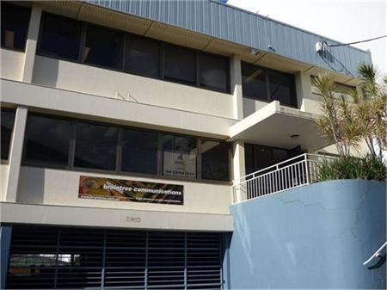
New Building
Lower operating costs
Size and location suits APNIC’s future needs

Slide 14

Next APNIC Meeting
APNIC 31 / APRICOT 2011
February 21 – 25
Hong Kong SAR, China
http://meetings.apnic.net/31

Slide 15
More APNIC Meetings..
APNIC 32
29 August – 2 September
Busan, South Korea
APNIC 33 and APRICOT 2012
22 February – 3 March
Delhi, India

Slide 16
Thank You
george@apnic.net

