Slide 1
IPv6 in Mobile Networks: Lessons Learned and Strategies Forward

Slide 2
APNIC Update
Asia Pacific Network Information Center (APNIC)
One of 5 Regional Internet Registries
Responsible for allocation of Internet numbering resources (IPv4, IPv6 and Autonomous System Numbers (ASN)
IPv4 address space in the APNIC region reached the final /8 block (about 16mil IPv4 addresses) in April 2011
Each organization requiring IPv4 address space can receive the final /22 block (~1000 addresses)
Plenty of IPv6 addresses are available ☺
T-Mobile partnered with APNIC to present at APNIC35 conference held in Singapore in Feb 2013
IPv6 in Mobile Networks
Shared T-Mobile’s experience

Slide 3
Objectives
IPv6 can and must work in mobile networks
IPv4 cannot number the world
IPv6 is achievable and inexpensive
We are all stakeholders in IPv6 adoption
Business and Technology Strategy for IPv6-only
Dual-stack does not solve the IPv4 number problem
464XLAT is a final solution in mobile

Slide 4
T-Mobile US: Who We Are
Headquartered in Bellevue, Washington (USA)
Nationwide HSPA+ (42Mbps) and LTE network
Merged with MetroPCS in May-2013
Currently serves approximately 44M wireless subscribers
LTE network covers 157M POPs as of July 1st 2013

Slide 5
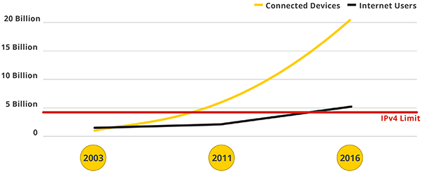
Conclusion #1: IPv4 Does not meet Today’s Business Needs
http://www.google.com/intl/en/ipv6/
More internet devices than IPv4 numbers. (private + public IPv4 is not enough!!)
Growth rate of internet connected devices (e.g. smartphones, tablets, embedded modules) is very high
RIPE and APNIC do not have IPv4 addresses any more
IPv4 cannot number the world. The time to move to IPv6 is NOW!

Slide 6
Conclusion #2: IPv6 Works Today
IPv6 is ready and deployed on large mobile networks in the US and content providers
Verizon Wireless has IPv6 on by default for nearly all LTE devices
T-Mobile US has IPv6 on GSM/UMTS/LTE optionally, and will have IPv6 by default soon
When IPv6 is turned on, a large percentage of content is delivered over IPv6
Many IPv6 enabled edge networks reporting over 50% of traffic is IPv6 when the network is IPv6 and IPv4
Google and Akamai both reporting exponential growth in IPv6 use
IPv6 is great, how do I get there from here?

Slide 7
Strategy: Define end Goal and work backwards
Problem: Global IPv4 exhaustion
Target: End to end IPv6
End to end IPv6
End to end IPv6 + NAT64/DNS64 for ~50% of flows (Possible today)
Squat-space IPv4 + NAT44 (Yesterday)
End to end IPv6 + 464XLAT for long tail

Slide 8
T-Mobile IPv6 Story
Lack of IPv4 address space combined with rapid growth in “always-on” devices prompted a re-think on IP addressing strategy in late 2009
Feasibility study and impact assessment on IPv6 deployment took about 9 months
T-Mobile started IPv6-only + NAT64/DNS64 friendly user trial in 2010 on our 2G/3G/HSPA network

Slide 9
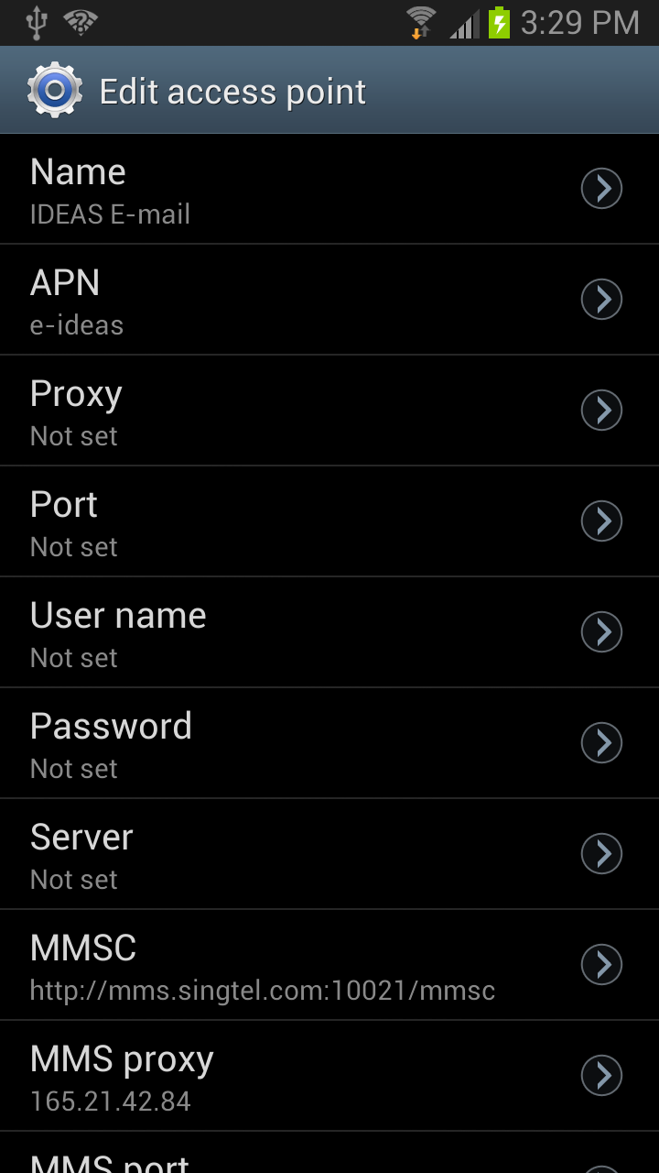
Lessons Learned with IPv6-Only + NAT64/DNS64
Most things work fine with IPv6-only + NAT64/DNS64
Web, email, … work fine. No user impact
~85% of Android apps work fine, similar general experience with Symbian apps (Ovi)
Apps are developed in modern SDKs with high-level APIs that work well with IPv6
Some things don’t work with IPv6-only + NAT64/DNS64
Peer to peer communication using IPv4 referrals (Skype, MSN, …)
IPv4 literals (http://165.x.x.x)
IPv4 sockets APIs
Use of IPv4 literals will break the NAT64/DNS64 model
Use FQDNs!!

Slide 10
What about Dual-Stack Approach?
Dual-Stack approach does not solve IPv4 address scarcity Issue – IPv4 address is still allocated in addition to IPv6 address
It is an interim solution that ensures service continuity till everyone moves to IPv6
Lessons Learned
Incorrect handling of dual-stack parameters by some roaming partner SGSNs results in denial of service to the subscriber
T-Mobile has decided to turn-off dual-stack in the HLR/HSS till the issue is resolved

Slide 11


Making Everything Work with IPv6-Only
A
Wireless Service Provider IPv6-only
IPv6-Only UE
+464xLAT
IPv6-Only
Wireless Service Provider IPv6-only
PLAT
B
IPv6-Only UE
+ 464xLAT
DNS64/NAT64
IPv4-Only
CLAT
Wireless Service Provider IPv6-only
PLAT
C
4→6
6→4
IPv4-Only
IPv6-Only UE
+ 464xLAT
Native IPv4 Socket Calls OR
Use of IPv4 Literals
464xLAT provides limited IPv4 connectivity across an IPv6-only network by combining well-known stateful protocol translation (RFC 6146) in the core and stateless protocol translation (RFC 6145) at the edge
Handsets need to implement 464XLAT (RFC6877)
THIS WORKS TODAY!!!

Slide 12
Conclusion #3: 464XLAT Allows for full functionality on IPv6-only network
Dual-stack does not solve the IPv4 number scarcity issue
IPv6-only + NAT64/DNS64 is very good, but not good enough for full IPv4 replacement (web and email work, but Skype does not work)
IPv6-only + 464XLAT
Solves IPv4 numbering issue by not assigning IPv4 to edge nodes
Decouples edge growth from IPv4 availability
IPv4-only applications like Skype work on an IPv6-only network because 464XLAT translated IPv4 on the phone to IPv6 on the network

Slide 13
Conclusion #4: IPv6 Deployment in 3GPP is Not Difficult
T-Mobile did not spend any CAPEX to deploy IPv6
Some innovative thinking was required to minimize impact:
Truncation of IPv6 address in data CDRs to make them look like IPv4 addresses → No Billing Impact
Policy and Charging Control Function (PCRF) logic to selectively enable IPv6 data sessions per roaming partner when roaming
Introducing feature to handsets is a slow and careful process

Slide 14
Summary of Conclusions
IPv4 does not fit the business need
IPv6 works today and is deployed on some the largest edge networks
464XLAT allows networks to grow without IPv4
IPv6 deployment in 3GPP is easy

Slide 15
What’s Next?
Android 4.3 already supports 464xLAT feature. Work with all Android OEMs to incorporate 464xLAT feature in their handsets
Get OEMs for non-Android ecosystems (Windows Phone, Blackberry) to adopt 464xLAT
Work with Roaming partners to iron out any IPv6 related issues

