Slide 1
2014 Annual Report
AGM March 2015
Paul Wilson, Director General
23 Feb 2015

Slide 2
APNIC’s mission
A global, open, stable, and secure Internet
that serves the entire Asia Pacific community

Slide 3
APNIC in 2014
Serving
Supporting
Collaborating
Notes:
Reflects APNIC’s vision of a “global, open, stable and secure Internet that serves the entire Asia Pacific community:
Serving APNIC Members
Supporting Internet development in the AP region
Collaborating with the Internet community

Slide 4
APNIC in 2014
Serving
Supporting
Collaborating

Slide 5
IPv6 Delegations
By delegation type
By size
By request type
As at 31 December
Notes:
Since Jan 2014, the delegation rate for IPv6 has been quite stable, and we can see that the majority of delegations have been a /32 (65%) which is the default allocation size for providers, followed by /48s which is the default assignment size for end-sites. Most came from normal allocations, instead of one-click.

Slide 6
IPv4 Delegations
By pool
By size
By Member
As at 31 December
Notes:
Since the advent of the recovered pool, there has been a marked increase in IPv4 requests. IPv4 delegations increased 158% in 2014 compared to 2013.
42% of requests have come from the recovered pool and 58% from the last /8 pool. Unsurprisingly, the majority of the v4 delegations are /22s, which is the maximum allowed by the policy. In 2014, APNIC made 175 delegations from the recovered pool.

Slide 7
IPv4 Transfers
Using listing service
Pre-approval usage
As at 31 December
Notes:
IPv4 Transfers remain steady as well, however, we are starting to see some transfers from ARIN to NIR members. 68% of Members are utilising the listing service. 66% of pre-approvals remaining indicates we still have many Members who are looking for sources to transfer from.

Slide 8
ASN Assignments
By type
4-byte return rate
Global ASN use
As at 31 December
Notes:
It is good to note that the return rate for 4-byte is very low (4%), which illustrates acceptance of 4-byte ASN in the region. Overall, 69% of ASNs are 4-byte. 4-byte uptake has been quite good in the region with 70% of new Members using 4-byte now.

Slide 9
APNIC Membership
As at 31 December
Notes:
The total membership figure for 2013 is 4,051. As at 31 December 2014, we now have a total of 4,618 Members, an increase of 12.27% from 2013.

Slide 10
Total NIR Sub-Accounts
As at 31 December

Slide 11
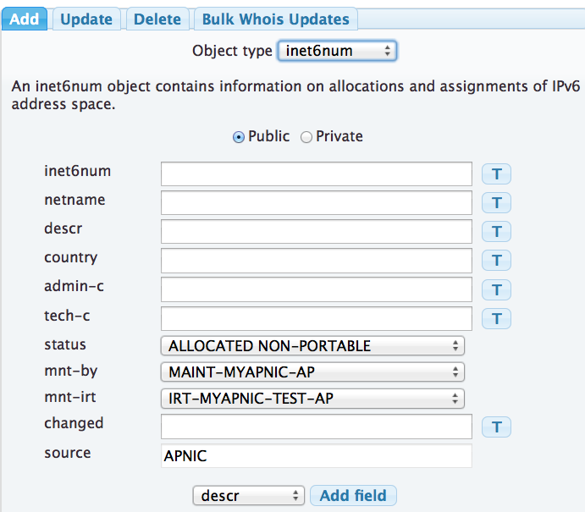
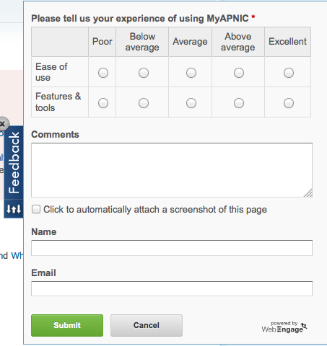
MyAPNIC Improvements
Track your correspondence
Improved Contact tab
with new EC submission form
Rate your MyAPNIC experience
Template
improvements

Slide 12
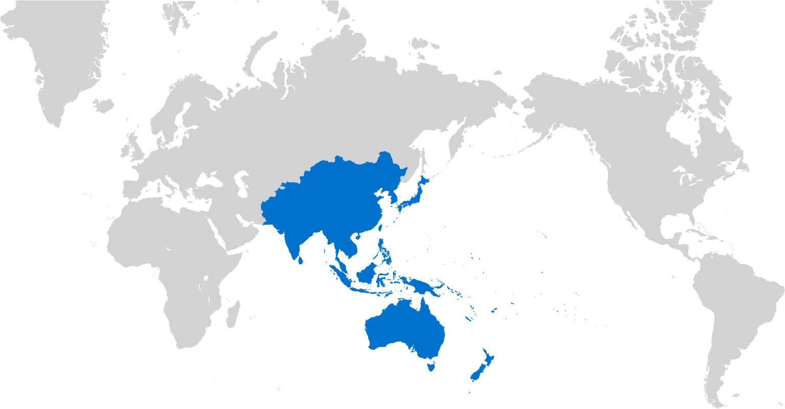
Distributed Whois
Deployed distributed Whois service to improve responsiveness and resilience
4 servers now operating:
Brisbane, Tokyo, London, Fremont
Response times have improved up to 10x for majority of users
Multiple sites to sink attack traffic without bringing the service down
Notes:
Whois is a service that many Internet users rely on daily – with around 200 queries a second, it’s a critical service to have available and responsive at all times.
APNIC has now distributed the Whois service around the globe to improve responsiveness and to make the service more resilient in the face of localised disasters.
Whois query nodes are now operational in Tokyo, London, and California, as well as the set of nodes in Brisbane.
Our testing has shown responsiveness for WHOIS queries has dropped from around 400ms to around 30ms from various sites around the globe, depending on distance from the new query servers – a substantial gain in performance for users of the service.
We are also now using a DNS-based global traffic distribution mechanism that monitors the availability of each site and will direct traffic away from sites experiencing service disruptions, providing higher availability and resiliency.

Slide 13
Distributed Whois

Slide 14
Distributed Whois

Slide 15
Improved System Architecture
Based on Message Bus
integration pattern
MyAPNIC
WHOIS
RPKI
Deployment on Linux (CentOS) Java 7 development environment
Apache ActiveMQ inter-process communications
Apache ActiveMQ
Increased responsiveness provides improved user experience
Faster development cycles for new feature requests

Slide 16
Supporting Infrastructure
VMware virtualization
for increased reliability
(175+ machines)
Deployment of Puppet Configuration Management
for centralized synchronization and updates
DRP audit and exercising
Notes:
In 2014, APNIC conducted a major project aiming to improve our Disaster Recovery arrangements and readiness for our core infrastructure.
All servers were migrated from Citrix to VMware, and the Puppet configuration management platform was deployed. As part of the work, an audit of every APNIC server – 175 of them – was undertaken and a recovery plan was exercised for each.

Slide 17
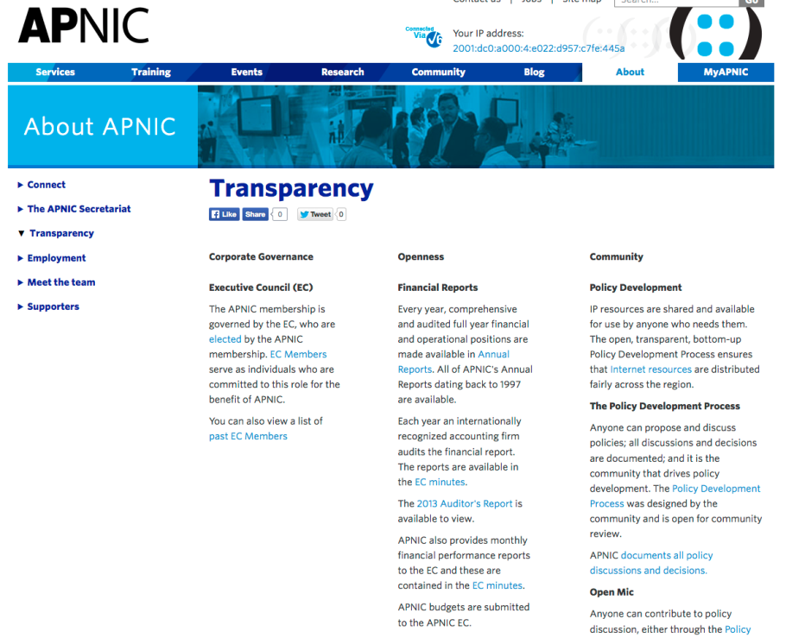
Accountability & Transparency
Transparency web page updated
RIR accountability matrix
Improved internal financial audit process established
Appointment of new external financial auditors
ISO9001 external audit – passed!
Notes:
We passed the annual ISO9001 external audit in August 2014.
Internal audit process established: regular spot checks on travels, requisitions etc. to check for compliance
Price Waterhouse Coopers (PWC) appointed as our next external auditor. Appointment is rotated every 3 year
RIR accountability matrix developed in collaboration with the other RIRs
Transparency page on public website updated. It contains various information on how APNIC ensures proper governance and oversight of all its activities

Slide 18
APNIC Survey 2014
Focus Groups held in 17 economies
1,039 Survey responses from 56 economies
New online survey action tracker
www.apnic.net/survey
Notes:
Compared to 2012 Survey
Quality of services increased from 5.71 to 6.15
Value of services and membership increased from 5.34 to 5.91

Slide 19
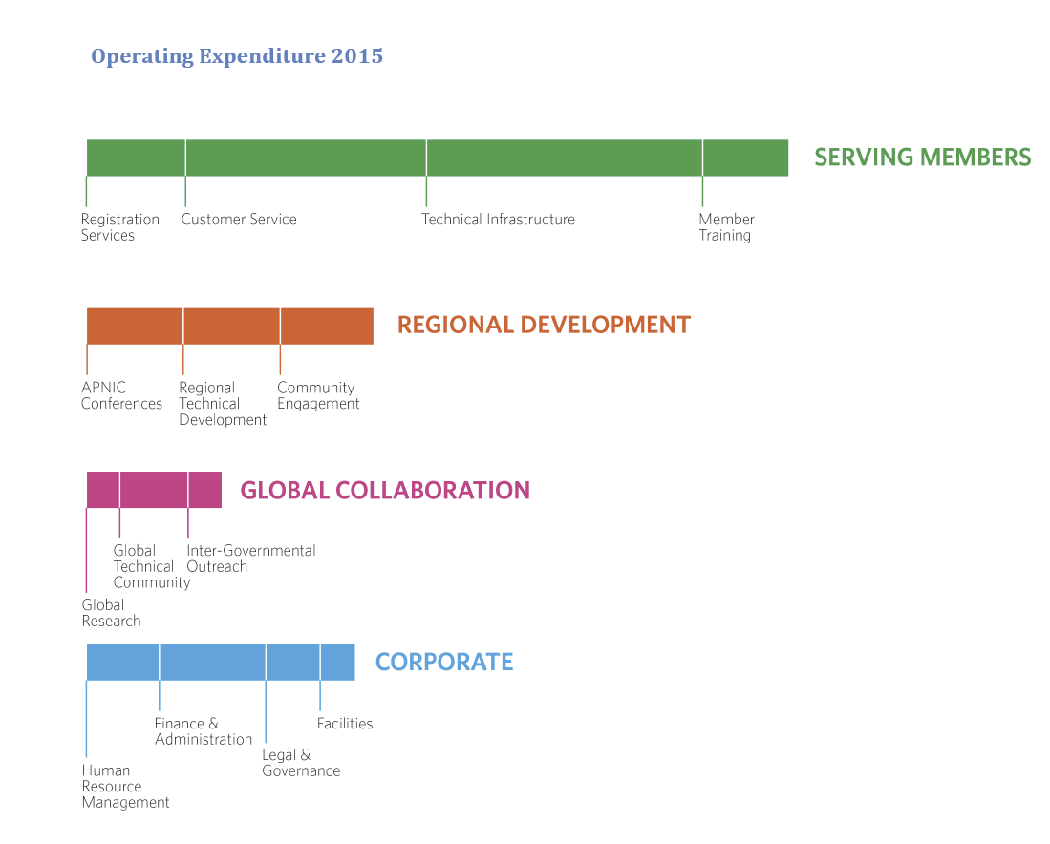
2015 Activity Plan & Budget
Enhanced visibility of planned activities and resource allocation
Notes:
Activity Plan
During 2014, APNIC Members requested greater visibility of APNIC’s planned activities and resource allocation to gain a better understanding of its operations. The 2015 budget submission included a comprehensive Activity Plan to provide Members and the wider community increased visibility of the costs related to APNIC’s activities.

Slide 20
Revised Fee Schedule
Key Points
Effective 1 Jan 2015
Reduced fees for all Account Holders with the aim to provide the greatest benefit to the majority of Members
Changes to fee calculation formula and IP Resource Application fee replaced with reduced Sign-Up fee
New Members will join as tiered Members based on resource allocation size
More information: www.apnic.net/fees

Slide 21
APNIC in 2014
Serving
Supporting
Collaborating

Slide 22
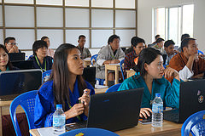
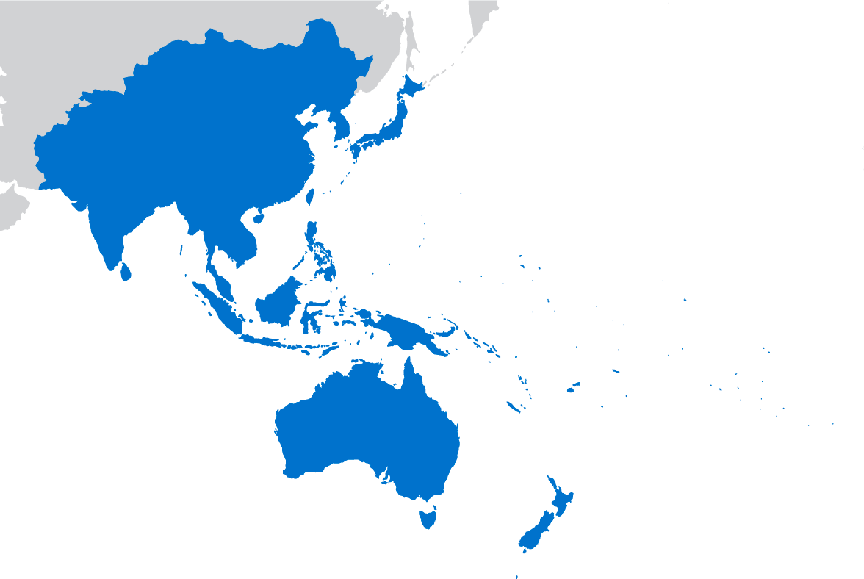
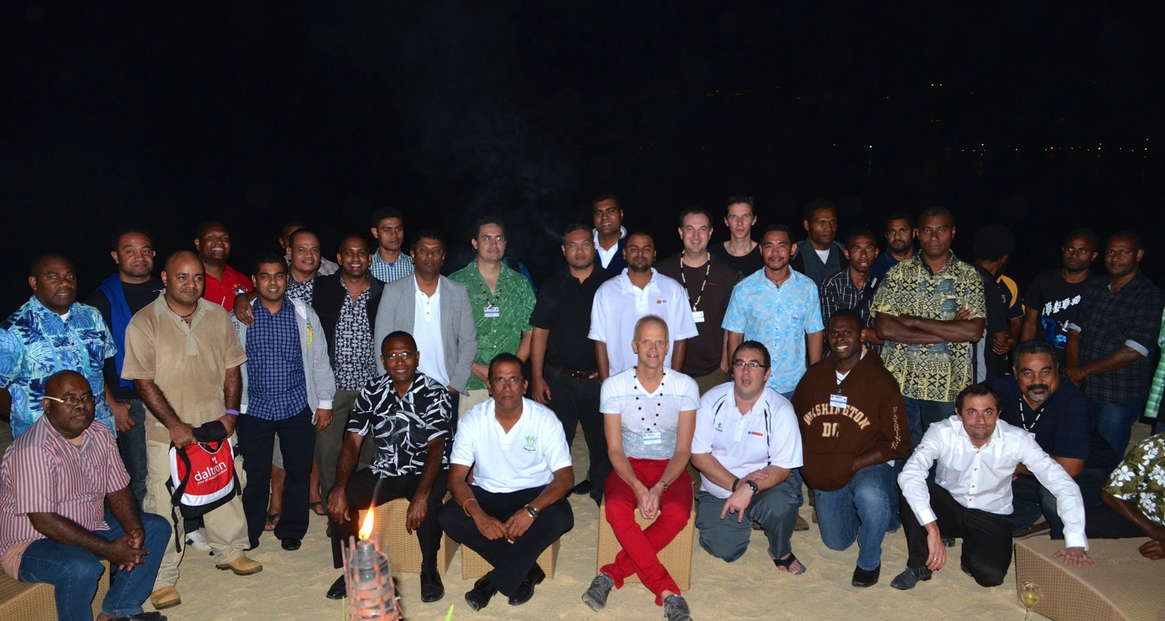
APNIC Training
76 face-to-face courses held in 29 locations
2,352 professionals trained face-to-face
534 professionals trained via 141 eLearning sessions
Video archives
63 videos
177,993 views
Notes:
APNIC training aims to deliver vital skills to network operators across the entire region to help grow the Internet. As you can see, we were very active in 2014.
APNIC is currently assessing the training requirements around the region and I encourage everyone here to take the APNIC Training Survey
http://www.apnic.net/trainingsurvey

Slide 23
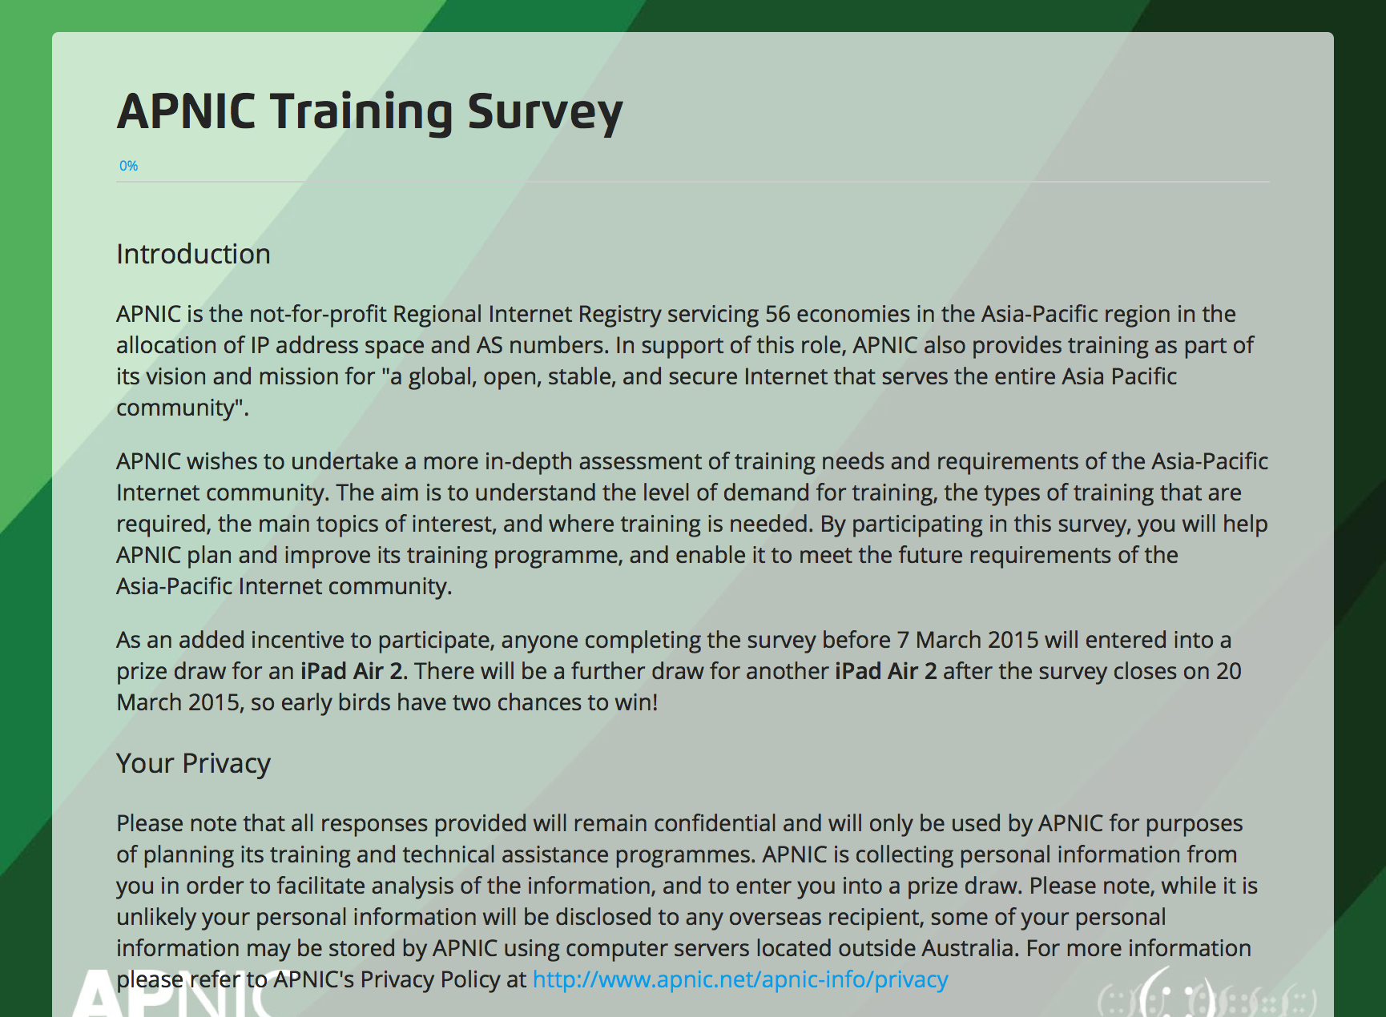
www.apnic.net/trainingsurvey
Notes:
APNIC training aims to deliver vital skills to network operators across the entire region to help grow the Internet. As you can see, we were very active in 2014.
APNIC is currently assessing the training requirements around the region and I encourage everyone here to take the APNIC Training Survey
http://www.apnic.net/trainingsurvey

Slide 24
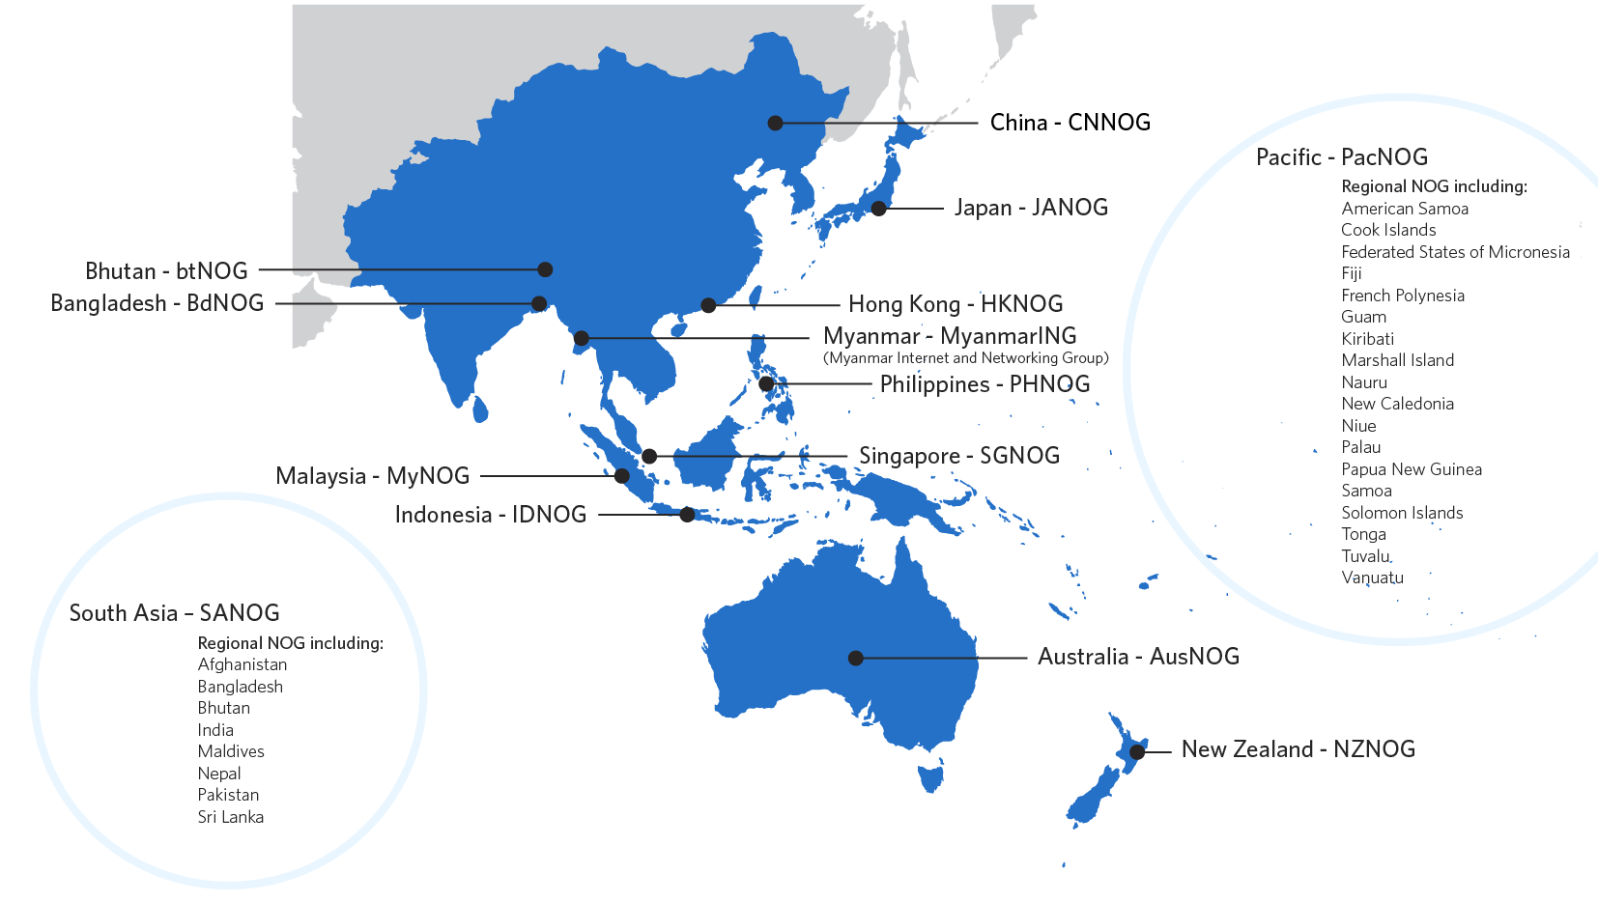
Supporting Network Operator Groups
Notes:
APNIC actively supports and engages with professional communities of network operators, including Network Operator Groups (NOGs), by providing financial and logistical support in addition to participating in various regional conferences.
NOGs are informal forums that bring together network operators, network engineers and the like to discuss matters relating to routing, network security, peering and interconnection and other operational issues. While the forums are generally structured around sharing relevant technical information, they also provide training and other capacity development opportunities to the region's operators.
APNIC has ongoing commitments to various regional NOGs, participating and sharing information on key technologies affecting the Internet, for example, IPv6 deployment, and building capacity where relevant.

Slide 25
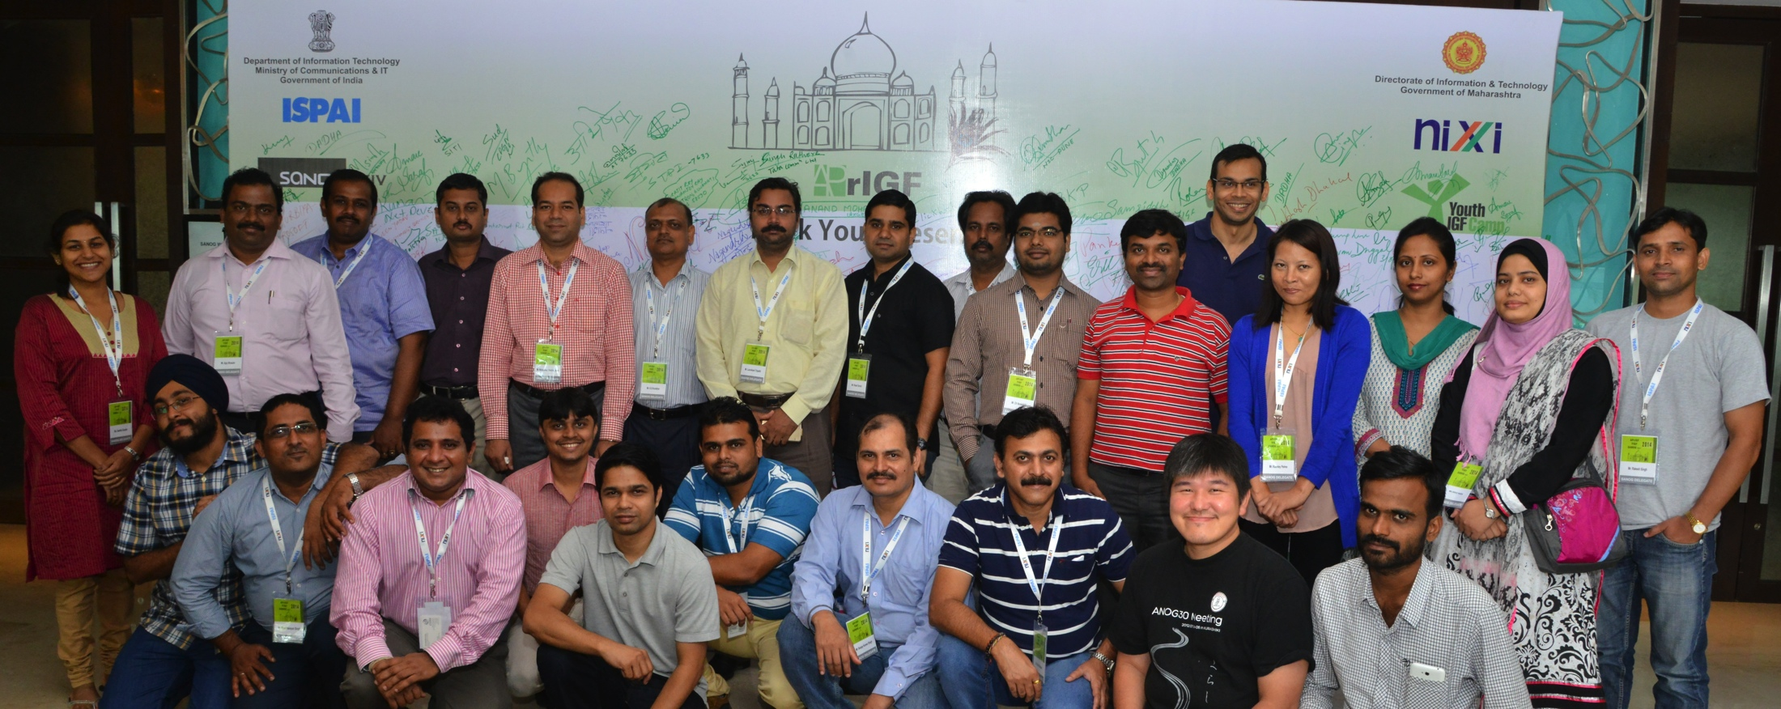
NOG events in 2014
Expert training to build skills
Knowledge sharing on IPv6, network security, transfers
APNIC Hostmaster support to answer Member queries
Financial/logistical support where needed
BTNOG 1
SANOG 24

Slide 26
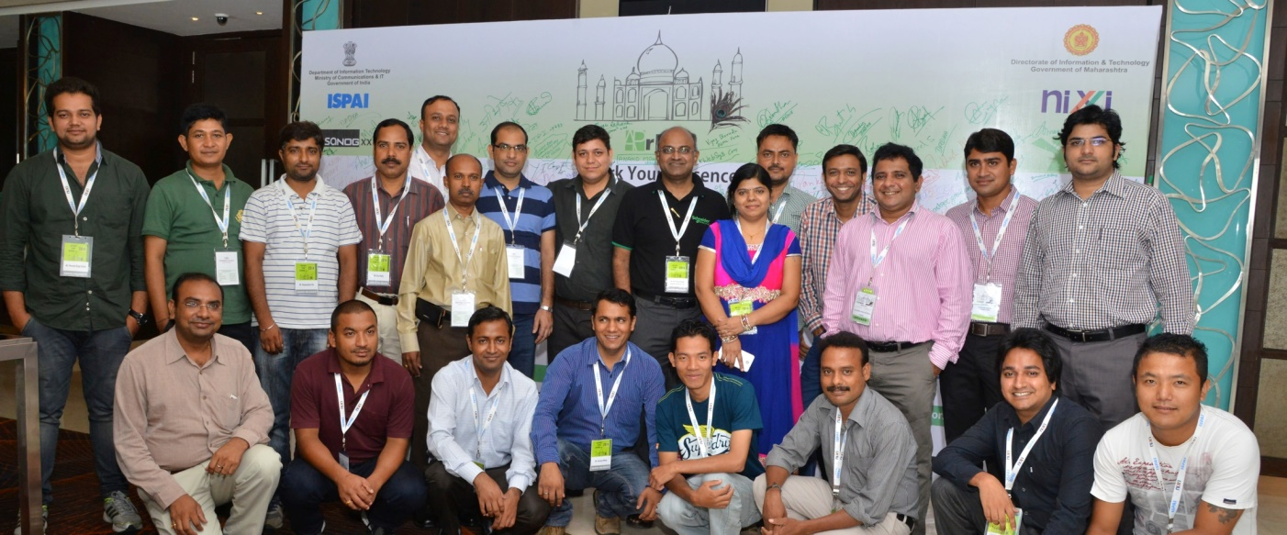
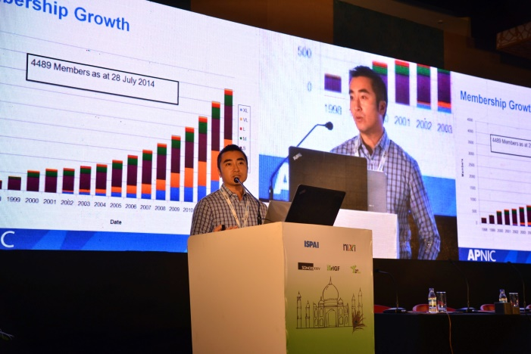
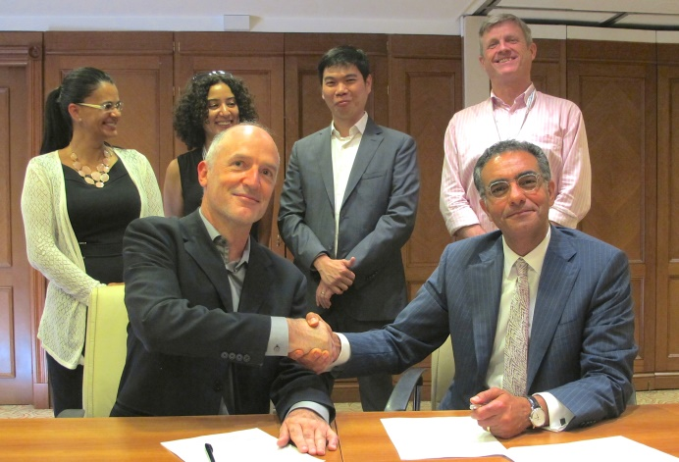
Community Development
SANOG
Technical Assistance in Bhutan, Laos, Tuvalu, Vanuatu
MoU with ICANN for
L-root servers in the Asia Pacific
14 Fellowships supported for APNIC 38
New Youth Fellowships for APNIC 38 – 2 Fellows
L-root MoU signing
SANOG
Notes:
Technical assistance is offered to network operators that need help to tackle projects such as IPv6 deployment. It is provided on a cost recovery basis.
In addition to the existing partnership with F, I and K-root operator, APNIC signed an MoU with ICANN to help distribute L-root servers in the AP region
We provided 14 fellowships for APNIC 38. Fellows are given financial assistance on travel, accommodation and daily expenses. Thanks to Google and APIA for their generous contributions to the fellowships.
We provided our first youth fellowships at APNIC 38.

Slide 27
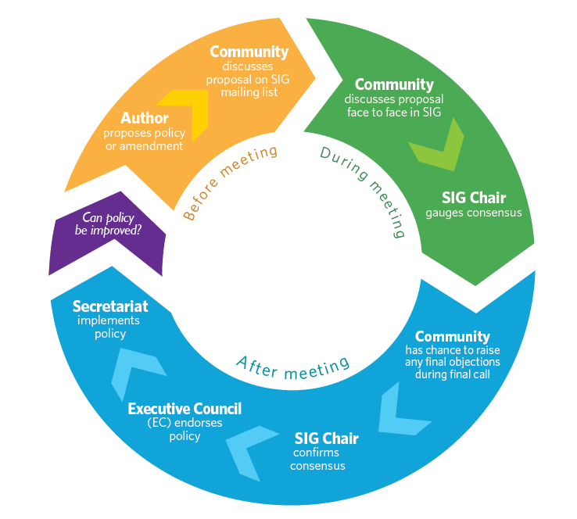
Policy Development
PDP central to APNIC activities
Gauging consensus is critical
Notes:
The PDP is central to APNIC Community activities
Supporting the PDP is a core Secretariat function
APNIC support for the PDP includes
SIG Chair support
Host Mailing list, Remote Participation
Provide documentation and editorial support
Implementation and implementation reports
Support currently provided by Adam Gosling
Assigning one (or two) additional staff members
Will be trained in all aspects of PDP support
Will assist Adam, or provide back-up as required
Policy SIG Chairs must consider several inputs
Mailing list discussion
Comments during the meeting
Comments from electronic chat
To assist, Chairs usually request a show of hands
Remote participation difficult to gauge without counting
We don’t count: a show of hands is a ‘temperature of the room’
Internally, a SIG process was launched for secretariat staff to use and understand the bottom up decision making process and procedures. This mechanism is now a formal channel for secretariat decisions about improving the workplace where possible.

Slide 28
2014 Policy Implementations
prop-107: AS number transfer proposal
16 April
prop-109: Allocate 1.0.0.0/24 and 1.1.1.0/24 to APNIC Labs as Research Prefixes
7 May
prop-105: Distribution of returned IPv4 address blocks (Modification of prop-088)
27 May
Notes:
16 April 2014
prop-107: AS number transfer policy proposal
Permits the intra- and inter-regional transfer of ASNs
7 May 2014
prop-109: Allocate 1.0.0.0/24 and 1.1.1.0/24 to APNIC Labs as Research Prefixes
Delegates 1.0.0.0/24 and 1.1.1.0/24 to APNIC for use by APNIC Labs
27 May 2014
prop-105: Distribution of returned IPv4 address blocks (Modification of prop-088)
Proposal to allow the distribution of IPv4 address blocks delegated to APNIC as a result of the “Global policy for post exhaustion IPv4 allocation mechanisms by the IANA”.
This is great for Members who have been able to get another small delegation of IPv4 space.

Slide 29
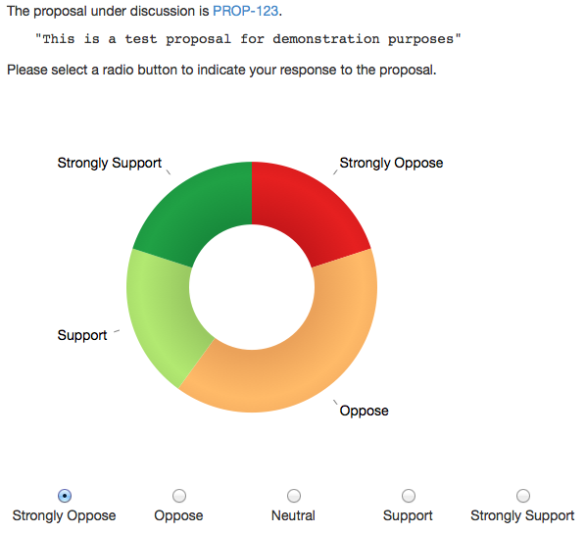
CONFER: Consensus Tool
Captures participants’ views in real time
Piloted at APNIC 38
Supporting tool for future SIGs
Notes:
At APNIC 38, the Secretariat piloted a new tool for measuring consensus, referred to as CONFER, CONsensus FEedback in Realtime. CONFER is an electronic consensus measurement tool which measures consensus in real time. The tool was built in response to the Policy SIG Chair’s and community’s request for a system to more accurately gauge support for policy proposals, especially for those participating remotely.

Slide 30
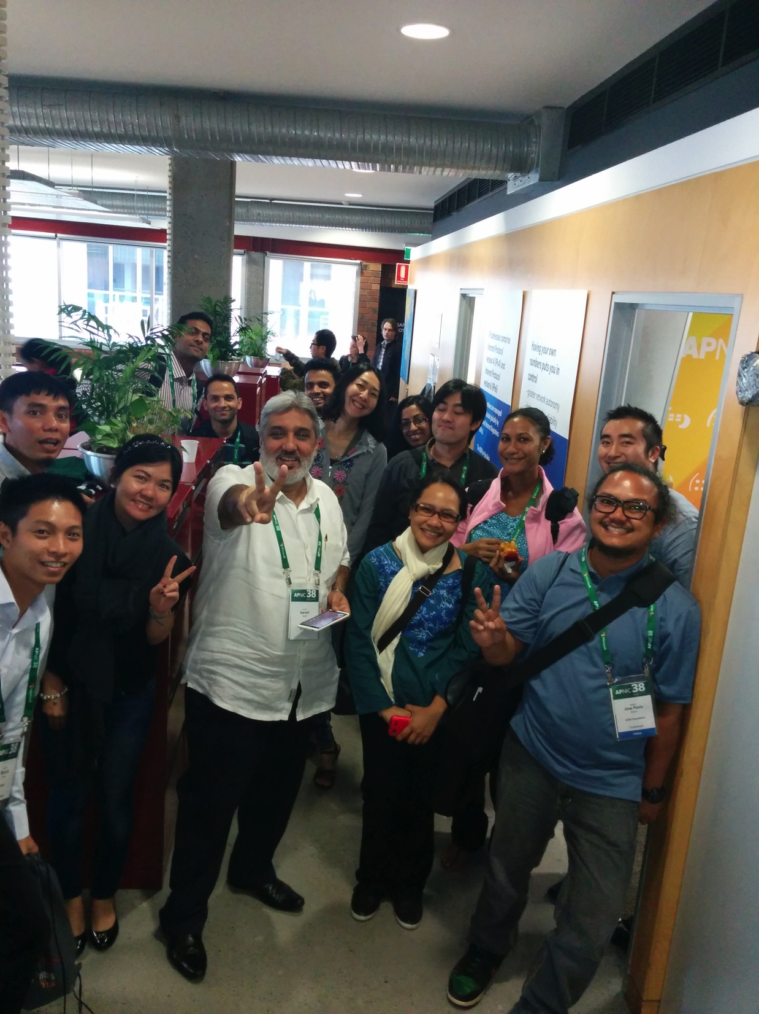
APNIC Events
Mix of small and large regional meetings to effectively reach Members
Improved video and social media coverage
Expanded community meetings at APNIC 38: APTLD, Pacific Workshop, ISOC
Member visits to Brisbane office as part of APNIC 38 experience
‘Meet the EC’ social event introduced
ARM 3
ARM 5
ARM 2
ARM 4
APRICOT 2014
ARM 6
APNIC 38
Notes:
An example of the success of the smaller ARM meetings: Colombo, Sri Lanka in October, at smaller ARM we had 13 out of our 15 Members attend. That’s 87% of our Members in that country who got to hear about the latest APNIC news and speak to our Member Services team in one event. Most had never attended an APRICOT or APNIC conference before – that’s the aim of the ARM program, reach those who can’t attend the major conferences. We are planning six of those ARM events in 2015, first one in Bangkok next week.

Slide 31
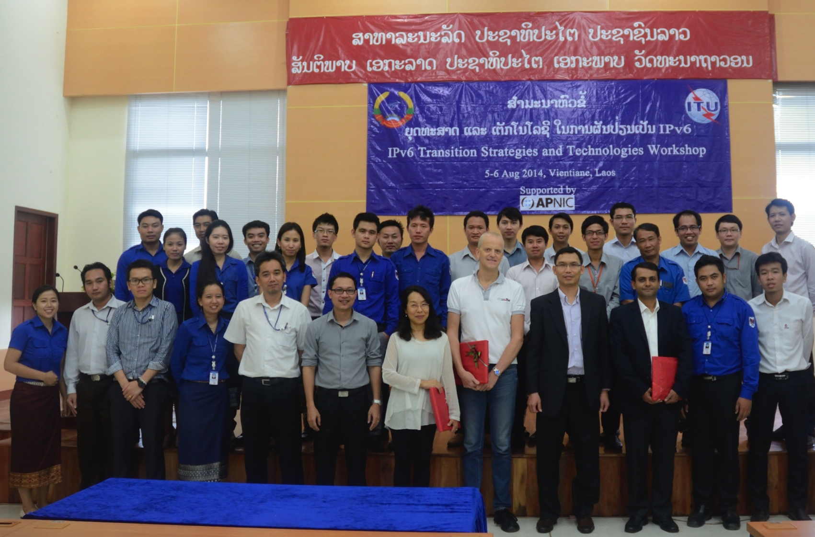
IPv6 in the Region
686 professionals trained in 16 economies
Presented at 24 industry events
Generated 26 pieces of IPv6 media coverage
Joint IPv6 workshops with ITU
Continuous support to APIPv6TF
ITU/APNIC IPv6 Workshop. Lao
Notes:
We remain committed to promoting IPv6 and helping increase its adoption

Slide 32
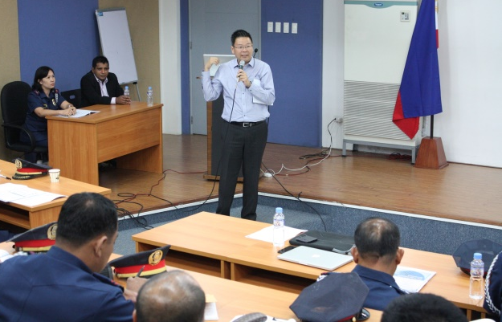
Security Outreach
Adli Wahid
Craig Ng
Participation in NOGs, CSIRTS and LEA events to educate and learn
Training for Pacific LEAs held in NZ, Brunei and Indonesia
Promoting new initiatives & security best practices among Members
Notes:
Appointed security specialist, Adli Wahid, who is working with different teams within APNIC as well as building relationship with potential and new partners that APNIC can leverage.
Build capability through training, providing content on security at APNIC and LEA training
Participation in NOGs, inter-governmental forums, CERTS etc. We take that knowledge and share it with Members to raise awareness
Highlighting relevant initiatives to Members to improve security such as IRT objects in whois, RPKI, and SAVE (BCP 38)

Slide 33
RPKI Initiatives
10 face-to-face and elearning RPKI training courses delivered
RPKI presentations to NOGs and conferences
Development of the ‘Ready to ROA’ Campaign – hands on sessions to help Members create ROAs
New shirts, stickers, web content to promote campaign
Ready to ROA launched in 2015

Slide 34
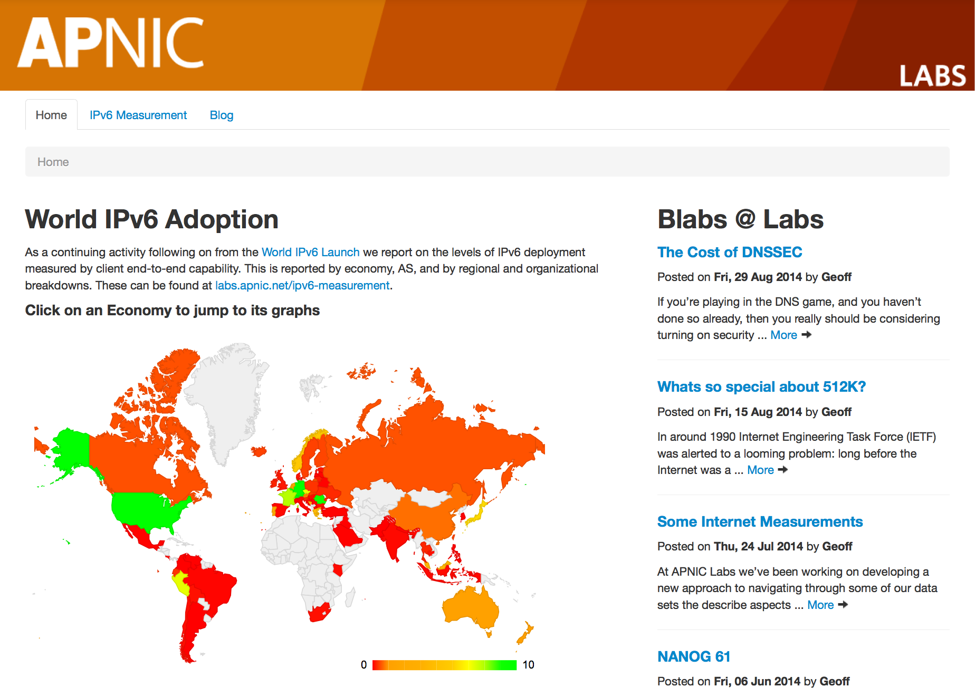
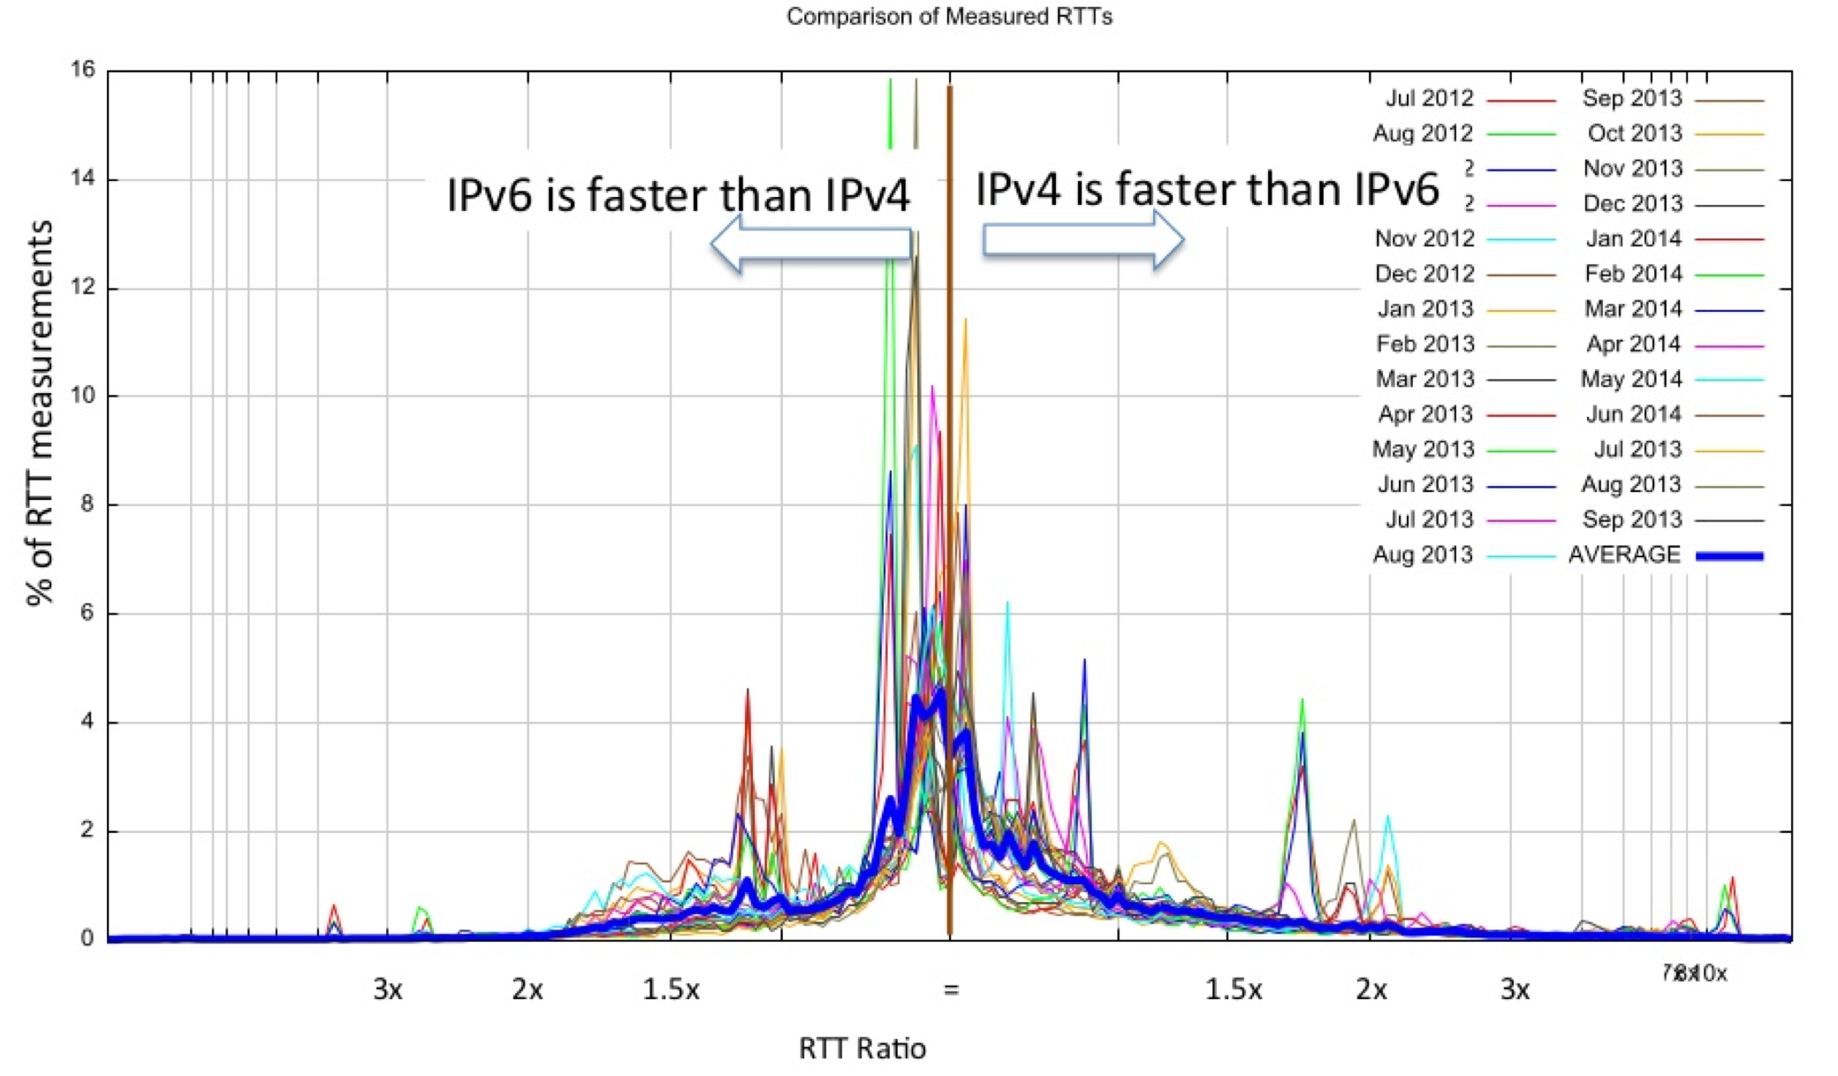
labs.apnic.net
Research statistics and evidence to help the APNIC community make more informed technical decisions. Over 750,000 experiments conducted per day for a global view
IPv4
IPv6
DNS
BGP
Deployed a new unified data access platform for all measurements
50+ research presentations to:
IETF, RIRs
ICANN, DNS OARC, NOGs
OECD

Slide 35
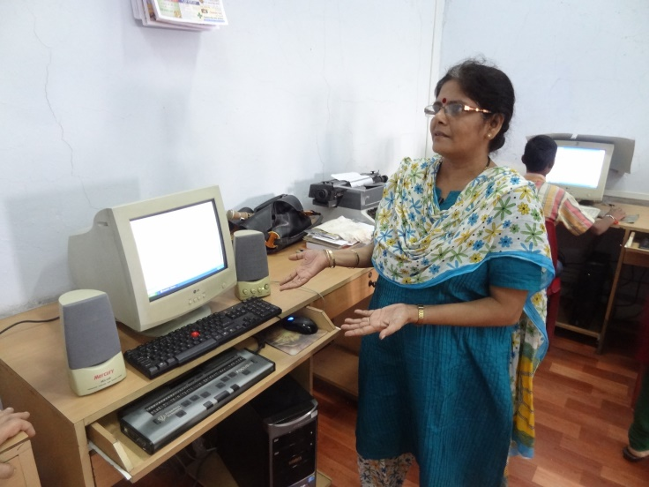
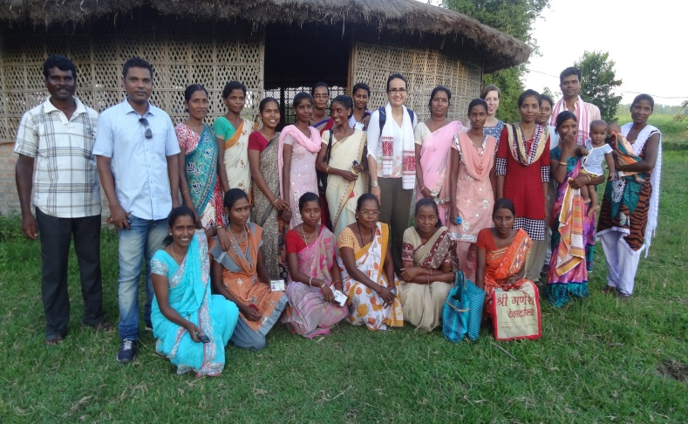
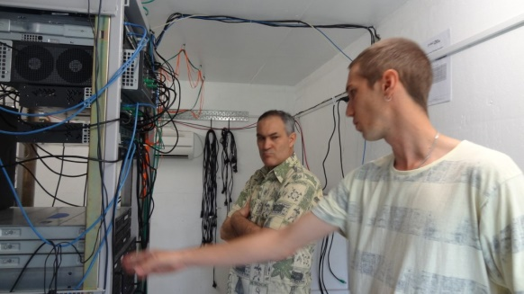
ISIF Asia Awards and Grants
Supporting technical innovation for socio-economic development in the Asia Pacific
www.isif.asia
Awards | Grants | Economies
5 from 93 applications | 12 from 139 applications | Cook Islands, Kiribati, New Zealand, Tuvalu, India, Australia/Indonesia, Thailand, Malaysia, Micronesia, Vietnam, Cambodia, Bangladesh, Philippines, Vanuatu
Notes:
Three projects received additional mentoring on evaluation and communications (India, Cook Islands and Cambodia)
Two site visits conducted in India (Tezpur and Mumbai)

Slide 36
APNIC in 2014
Serving
Supporting
Collaborating

Slide 37
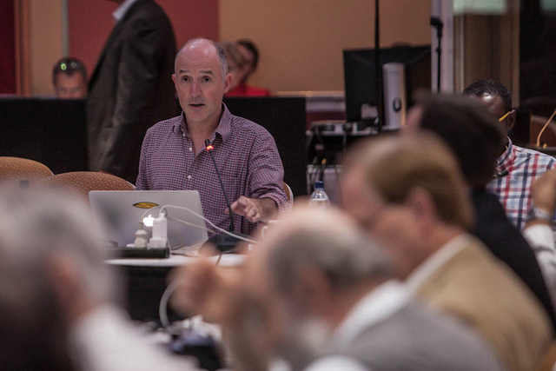
Global Cooperation
IPv6 advocacy
Coordination with RIRs and Internet organizations
Engaging with government agencies in training and skills development
Supporting IANA Stewardship Transition
Promoting the RIR model
Notes:
Our key global coordination activities during this period are:
Providing IPv6 advocacy throughout the region
We continue to work closely with I* organisation to ensure smooth technical coordination that is critical to the Internet operation
We continue to encourage governments to focus on capacity building, particularly on human resources Internet related training and skill development
We represent the Internet number registry position, based on our own community consultation, at the IANA stewardship transition process
We continue to promote the value of multi-stakeholder model in developing the Internet
Continuing to engage and collaborate with intergovernmental and governmental organizations
PTC 14, Hawaii
4th APT Prep Meeting for WTDC-14, Bangkok, Thailand
WSIS+10 3rd MPP, Switzerland
MAG, Switzerland
ICANN 49, Singapore
WTDC-14, UAE
PITA AGM, Vanuatu
APEC TEL 49, China
WSIS Forum, Switzerland
APT Cybersecurity Forum, Mongolia
OECD CISP Working Group Meeting, France
ICANN 50 UK
SATRC-15, Bhutan
AuIGF, Australia
APrIGF, India
IGF, Turkey
ADF-11, Brunei
Asia Pacific ICT Ministerial meeting, Brunei
PacINET, Cook Islands
IETF 89, London, UK
IETF 90, Toronto, Canada
NetHui, Auckland, NZ
VNNIC OPM, Hanoi, Vietnam
NetMundial Iniative for Internet Governance Cooperation and Development, Geneva
ACMA 3rd Prep Meeting for PP-14, Canberra, Australia
11 AP Telecommunication and ICT Development Forum (ADF-11), Brunei,
Y4IT Youth Congress, Manila, Philippines
AP ICT Ministerial Meeting, Brunei
APEC TEL 50, Brisbane, Australia
ICANN 51, LA
ITU Plenipotentiary Conference (PP-14) - Busan – Korea
World Internet Conference-WUZHEN Summit - Hangzhou - People's Republic of China
IGF MAG Meeting - Geneva - Switzerland

Slide 38
IANA Stewardship Transition
Notes:
Top half of this chart shows all the engagement from the APNIC Community – there is a lot!
The Bottom shows the support to the community from the APNIC Secretariat
The Middle shows the timeline to the delivery of the final plan

Slide 39
CRISP Team
Consolidated RIR IANA Stewardship Proposal Team
(CRISP)
ARIN
Bill Woodcock John Sweeting Michael Abejuala (Staff)
AFRINIC
Alan P. Barrett Mwenda Kivuva Ernest Byaruhanga (Staff)
APNIC
LACNIC
RIPE
Nurani Nimpuno Andrei Robachevsky Paul Rendek (Staff)
Esteban Lescano Nico Scheper Andres Piazza (Staff)
Dr Govind Izumi Okutani (Chair) Craig Ng (Staff)
Notes:
The Consolidated RIR IANA Stewardship Proposal Team (CRISP) members.

Slide 40
Community Engagement
Training
NOGs
Events
IPv6
Security
Cooperation
Notes:
In summary, in 2014 we continue to serve and meet our Members in their various economies, engage with the wider AP communities, and collaborate with the global Internet stakeholders – as you can see, focused on our region

Slide 41
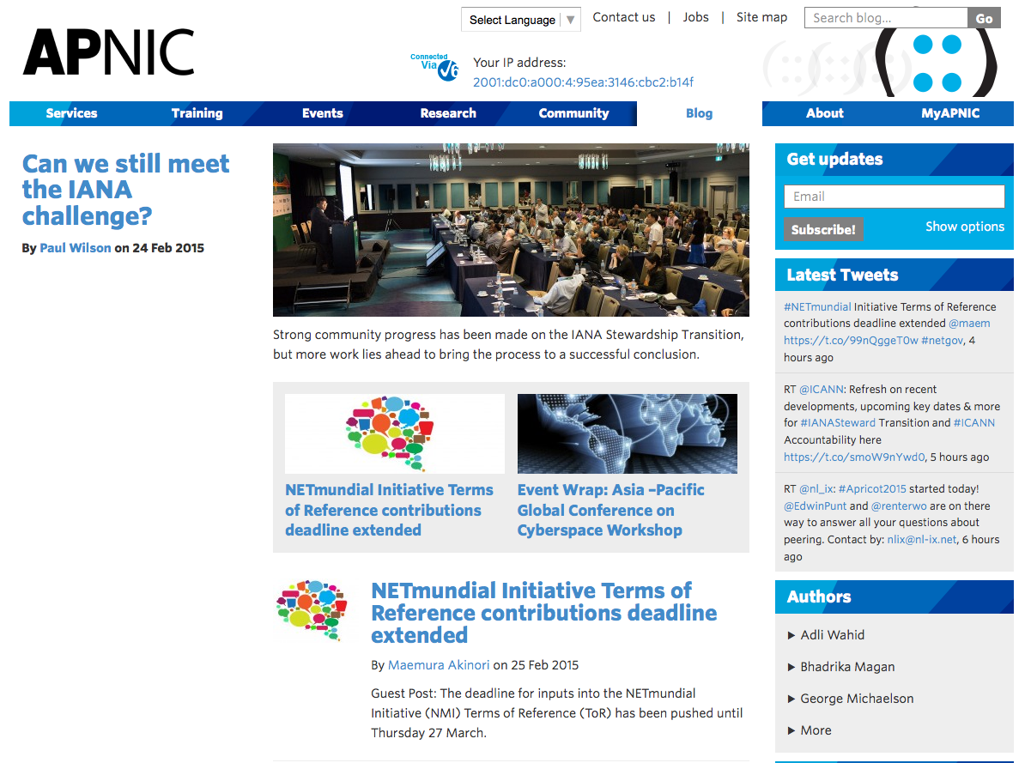
blog.apnic.net
APNIC Blog launched in August 2014 to simplify APNIC communication
Simple and more engaging format
Total of 232 Posts
33 bloggers – including 12 guest community bloggers
39,000+ views – ave 239/day
Notes:
The creation of the APNIC Blog simplified APNIC’s external news promotion – it merged the old announcements page, press releases page, and Apster newsletters into a single source of APNIC news and views.
The Blog was also designed to be easy to use, accessible (less formal and simple language), and engaging with the ability to harness video, audio and social media content.
It also aimed to make APNIC seem more human, and demonstrate the personality of the organization while highlighting APNIC’s depth of talent (21 APNIC staff have blogged so far – 30% of the team!). Since it went live on August 10th, there have been 232 posts and more than 39,000 visits. 33 bloggers have contributed so far, including 12 guest bloggers from the APNIC community.

Slide 42
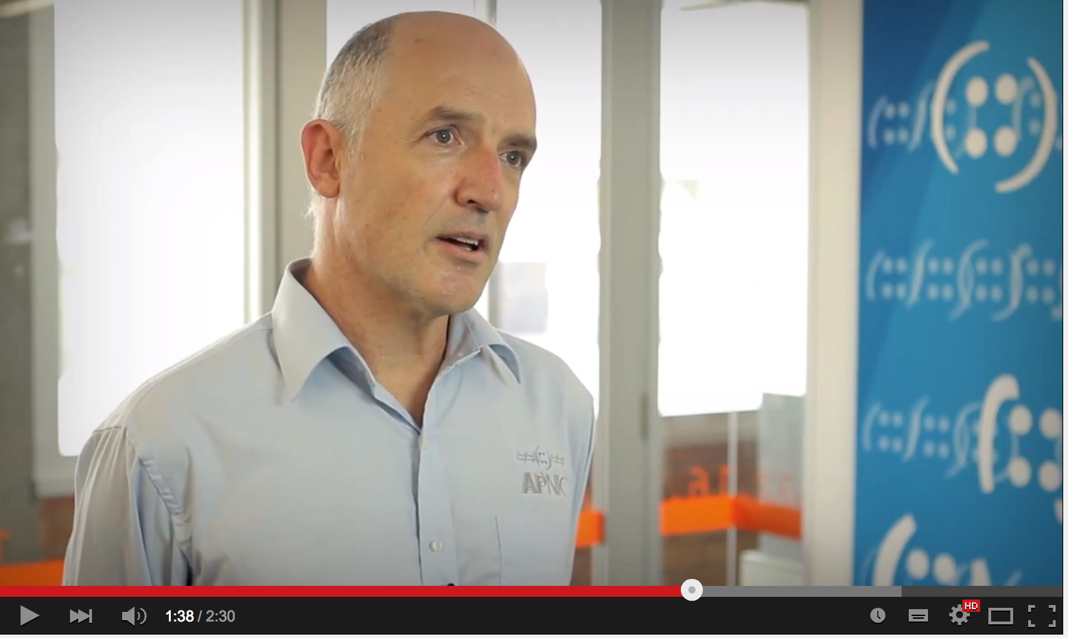
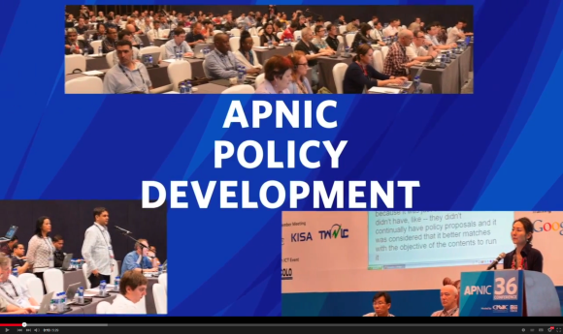
Improving Communication
‘Event wraps’ for clear reporting of APNIC event activities
More active social media
Twitter: 1,182 new followers (￪ 45%)
Facebook: 163,438 people reached organically (￪ 126%)
Weibo: established 2014
Updated APNIC video library
YouTube: 10,605 views (￪ 84%)
Website refresh – more to come!
Notes:
Website refresh accords with Corporate Identity
Event wraps help us be more transparent to our Members
APNIC has setup a Weibo account for improved outreach to Chinese speaking communities
We updated the About APNIC, APNIC Policy, History of RIR videos

Slide 43
You’re Invited!
APNIC 40, Jakarta, Indonesia 3-10 September 2015
conference.apnic.net/40
Notes:
This will be a big event, another one we run in conjunction with APAN.

Slide 44
Thank you
pwilson@apnic.net

